Slide 1
Community Circles
Circles help people to be happier, healthier and more connected with the support of their community
Cath Barton, Community Circles Connector

Slide 2
Community Circles
A person centred approach to supporting people make decisions about their life
Cath Barton, Community Circles Connector

Slide 3
Community
What comes to mind when you hear the word
“Community”
Tweet us @C_Circles • www.community-circles.co.uk

Slide 4
Introduction
Traditionally, communities organised themselves to support each other.
Today the way we live, work and interact with our communities has changed, but the principles have stayed the same.
We believe that all today’s communities need is a little help to learn how to support each other again.
Advocates make sure that people are better connected within their own communities.
Community Circles are a proven way to make that happen.
Tweet us @C_Circles • www.community-circles.co.uk

Slide 5
How do Circles Work?
A Community Circle brings two or more people together around someone who wants a little help to make a change in their life.
That change can be anything – from getting out and about more, to starting a new hobby or restarting an old one, or creating opportunities to spend more time with friends or family.
Tweet us @C_Circles • www.community-circles.co.uk

Slide 6
Stories

Slide 7
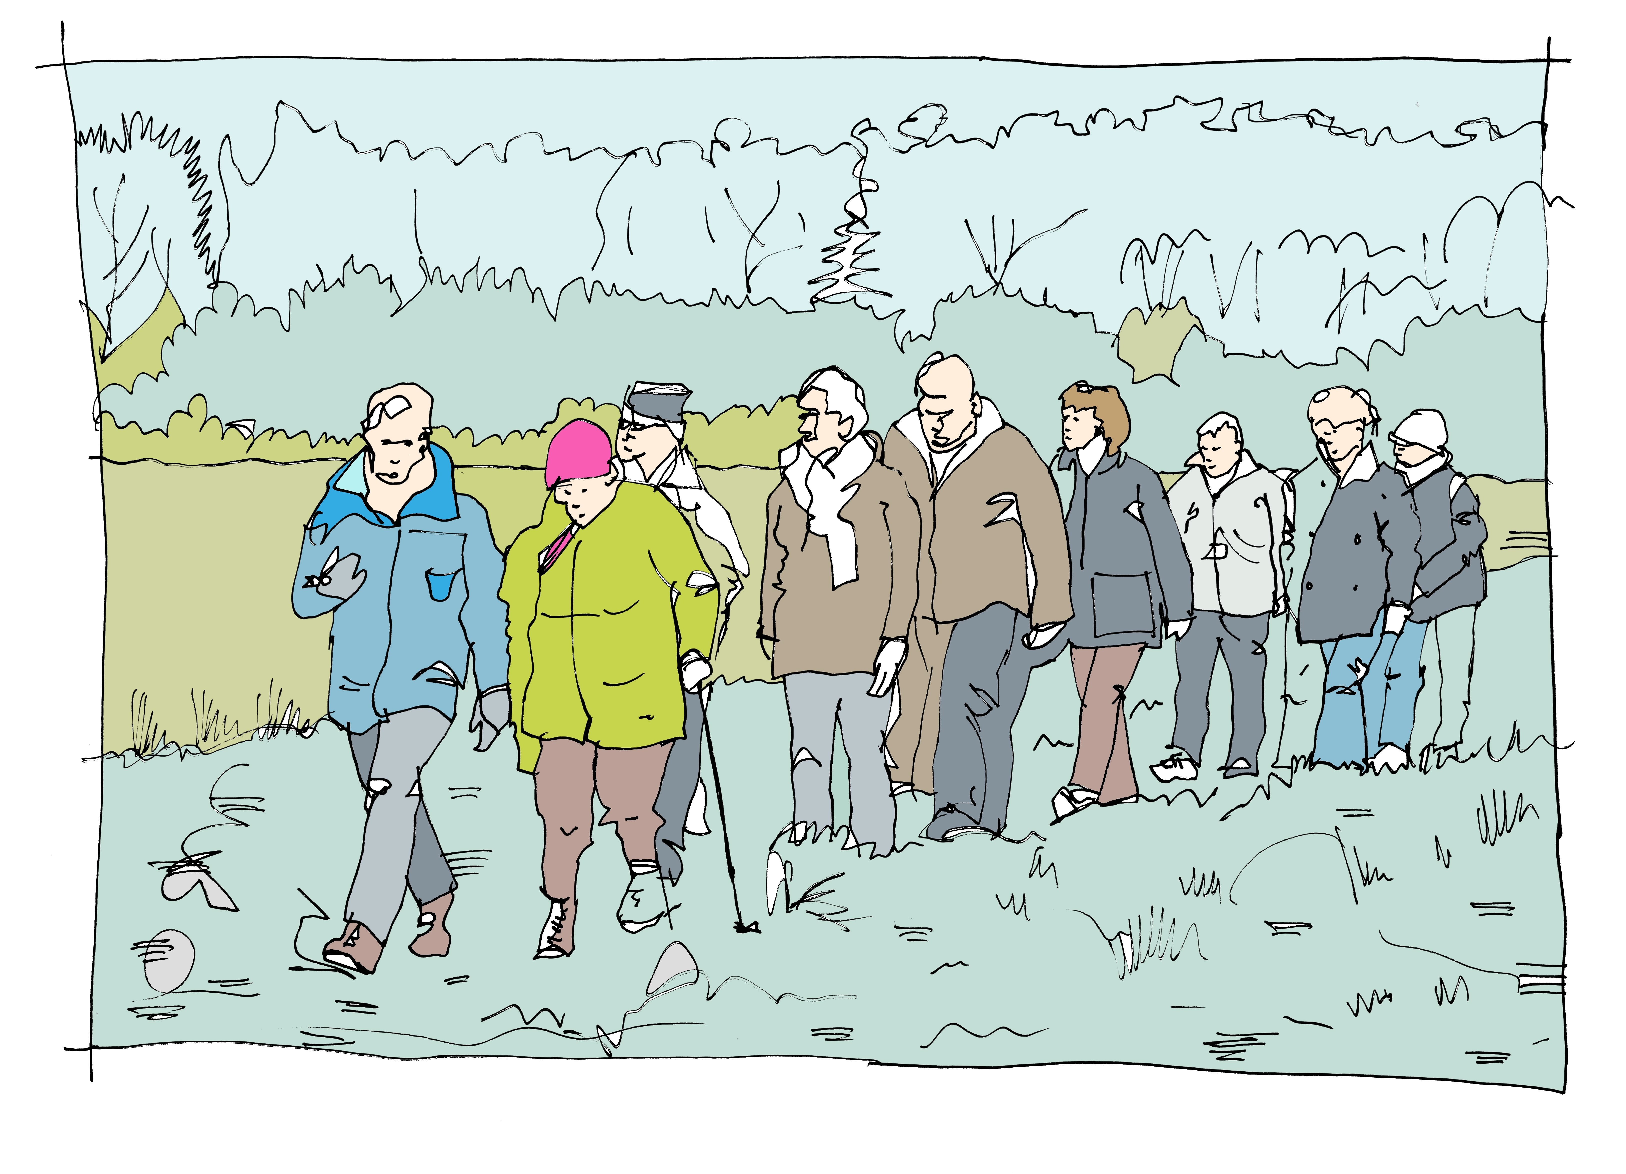
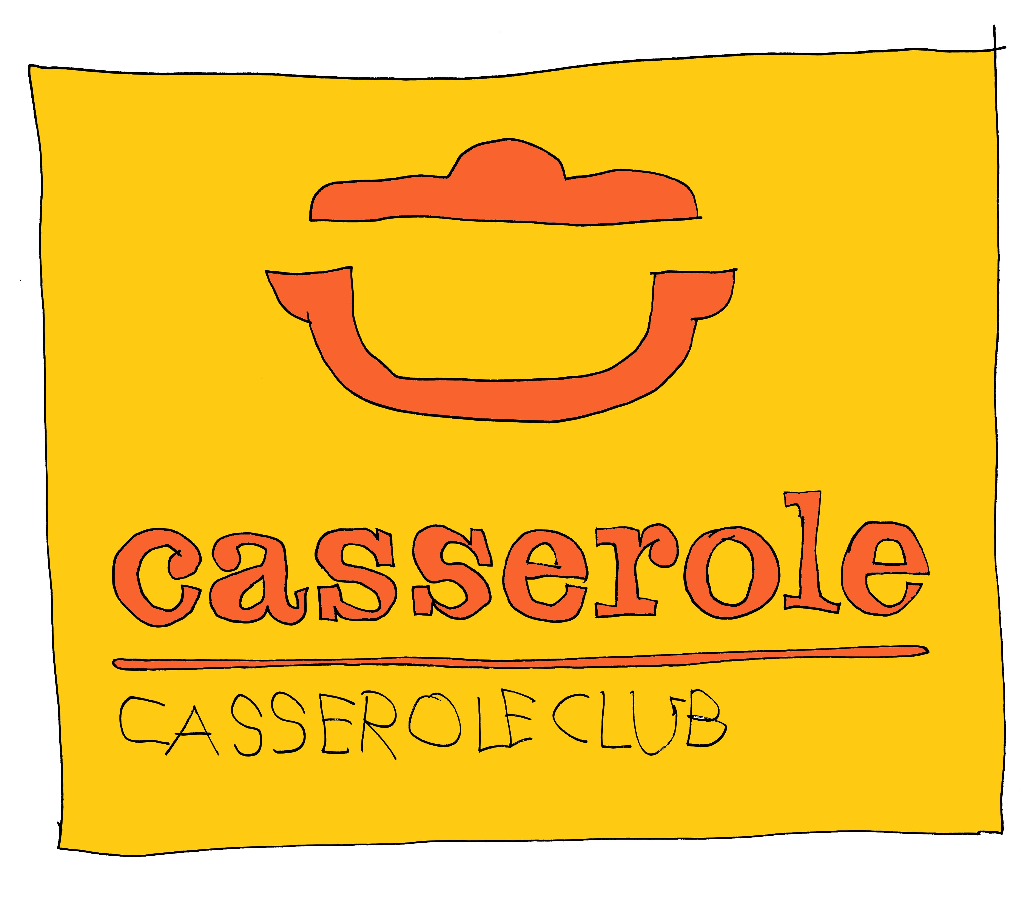
Lynda’s Circle
Lynda’s Circle helped her to live well with dementia, keeping involved with hobbies, supporting her husband Alan in his role as a carer and making decisions for their future
Tweet us @C_Circles • www.community-circles.co.uk

Slide 8
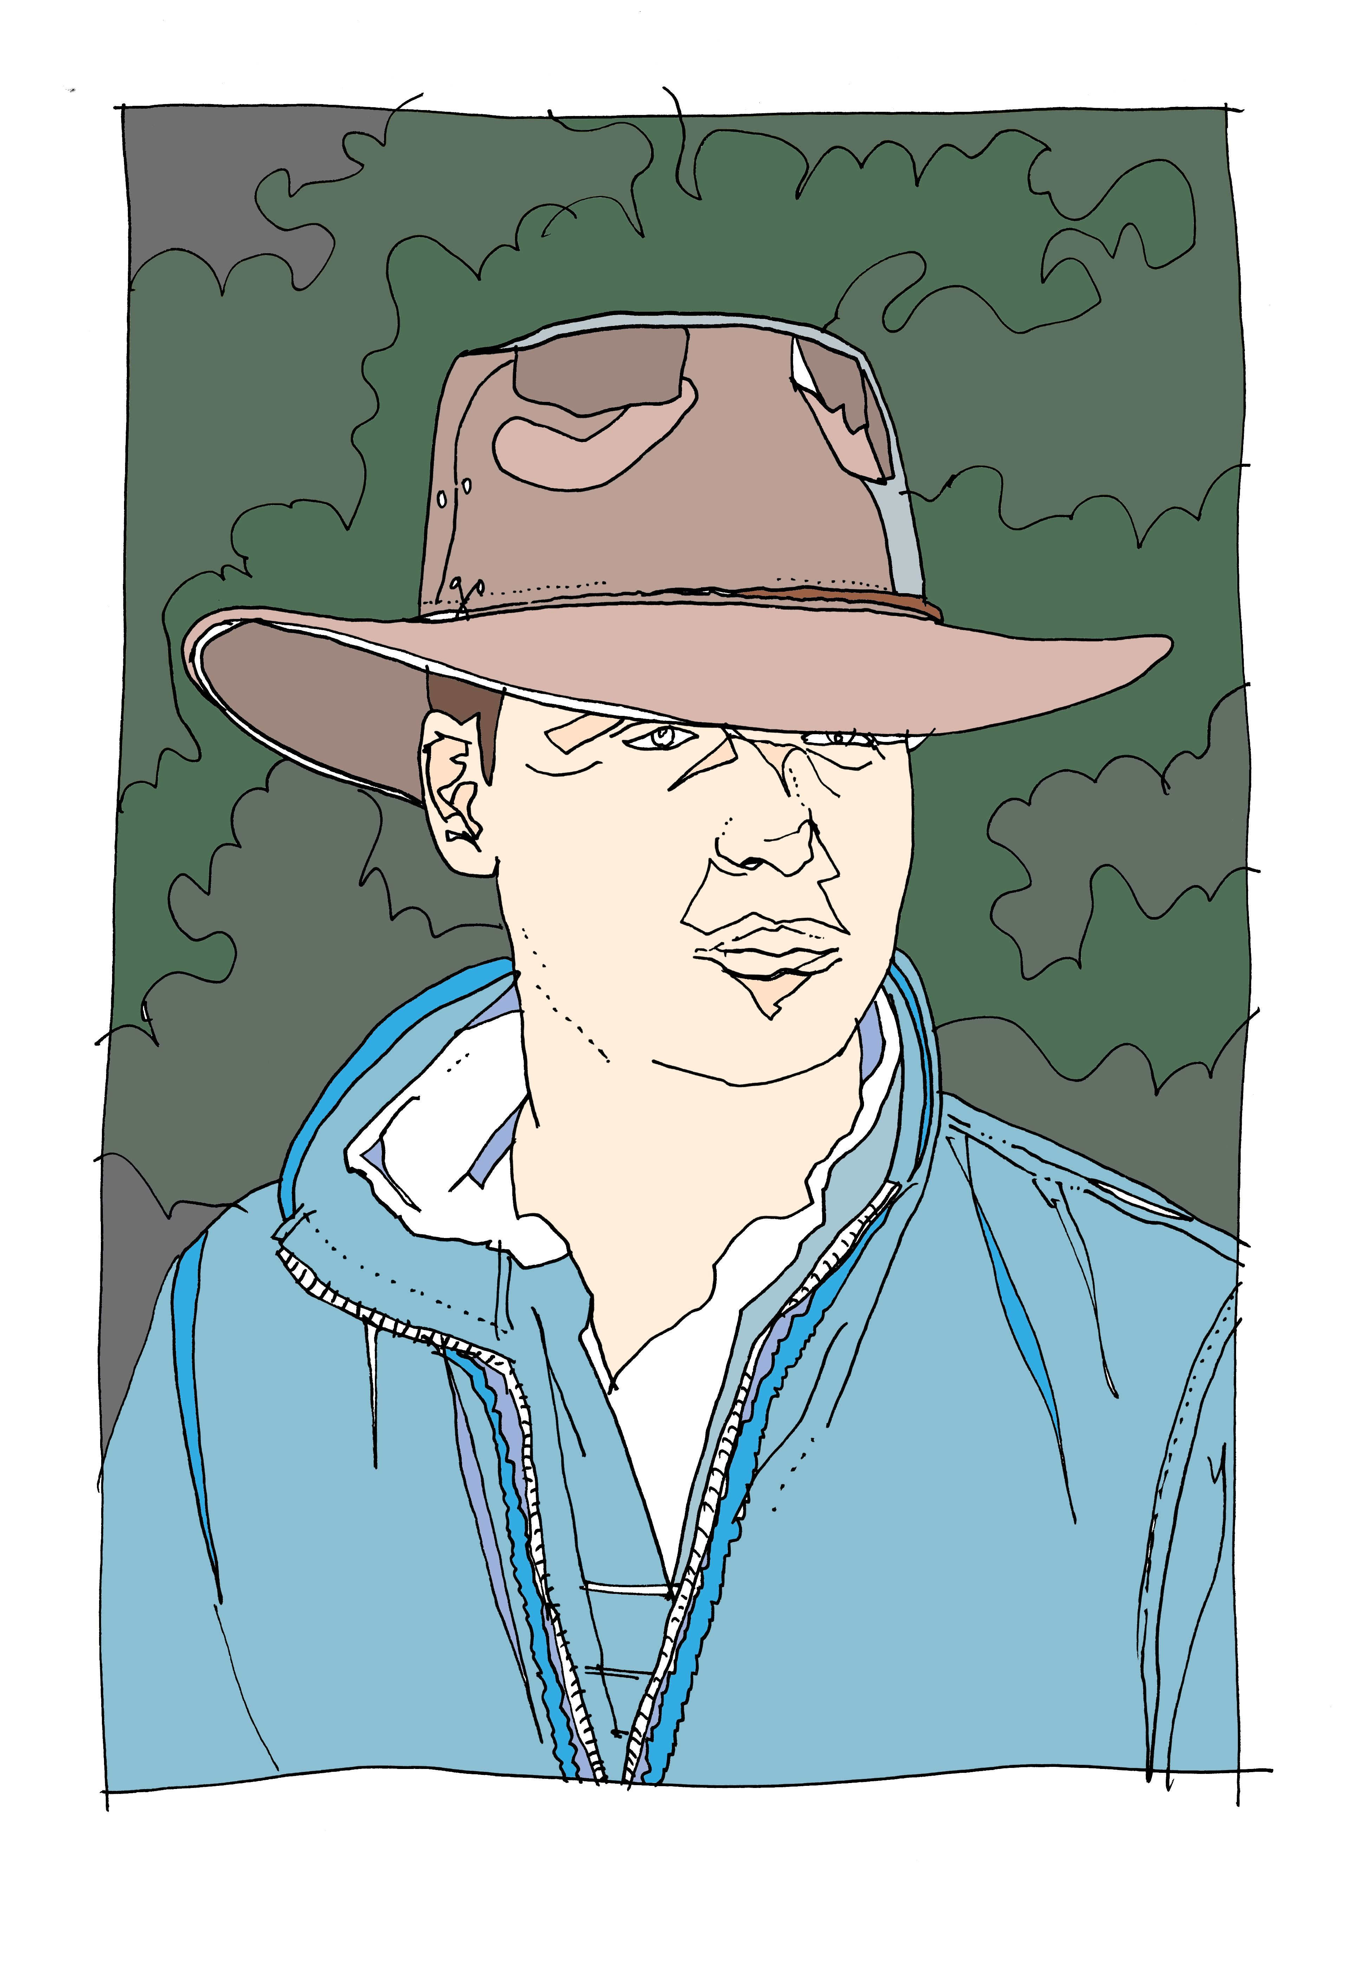
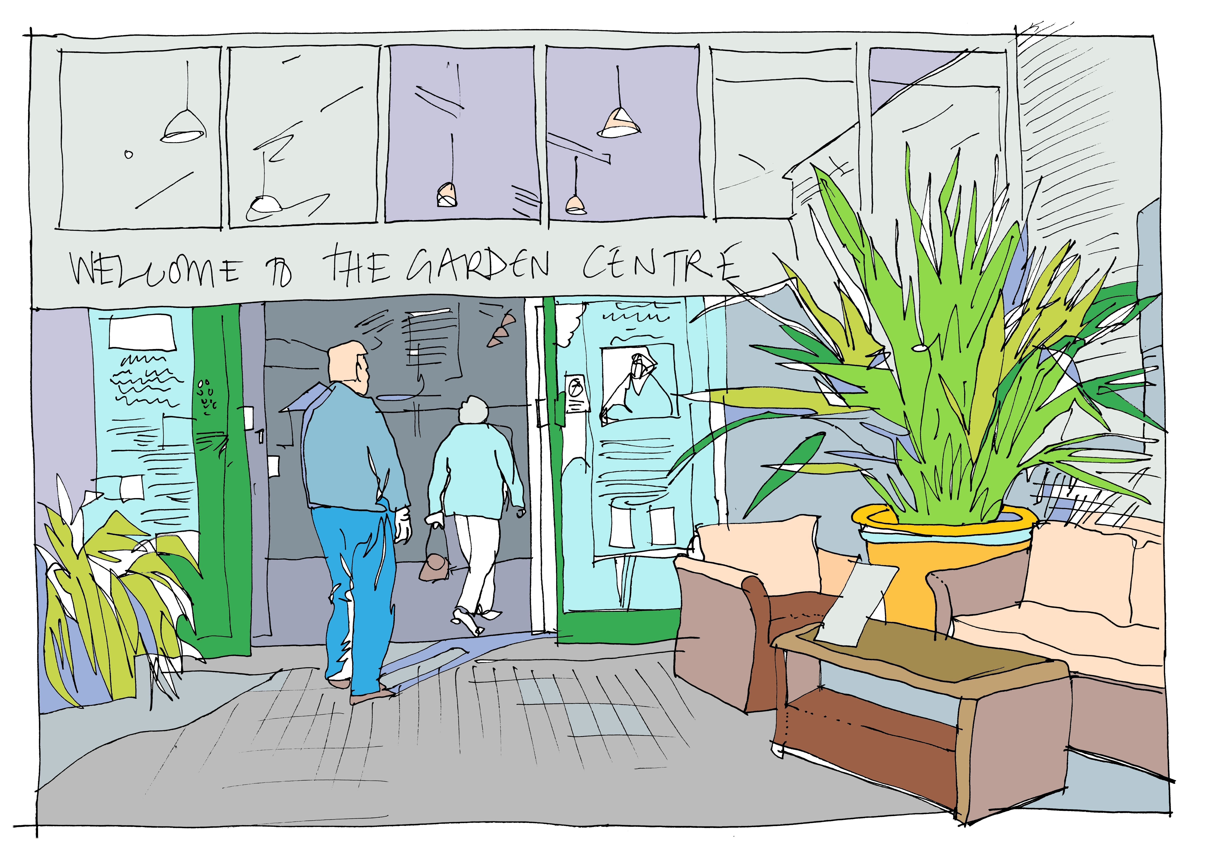
Henry’s Circle
Henry’s Circle helped him to decide how he wanted his life to look after leaving school
Tweet us @C_Circles • www.community-circles.co.uk

Slide 9
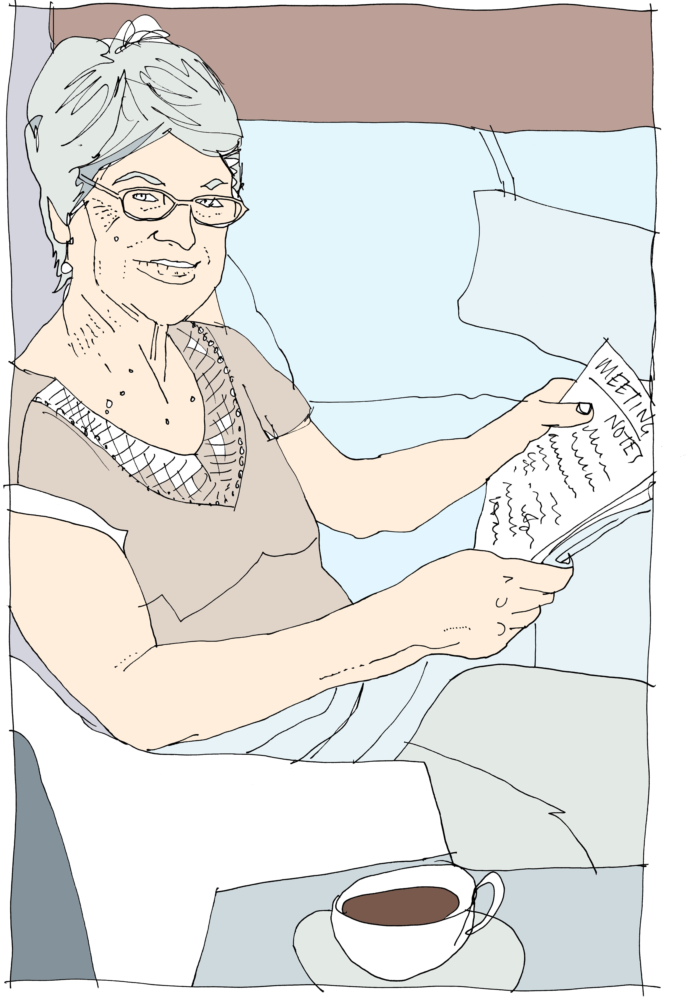
Henry’s Circle
When the Circle started, Henry’s mum was feeling ‘burnt out’ after advocating for Henry in education over the last twelve years.
She was increasingly frustrated by the lack of support for her and for Henry in transition.
Having a Circle has not only supported Henry but his Mum too
Tweet us @C_Circles • www.community-circles.co.uk

Slide 10
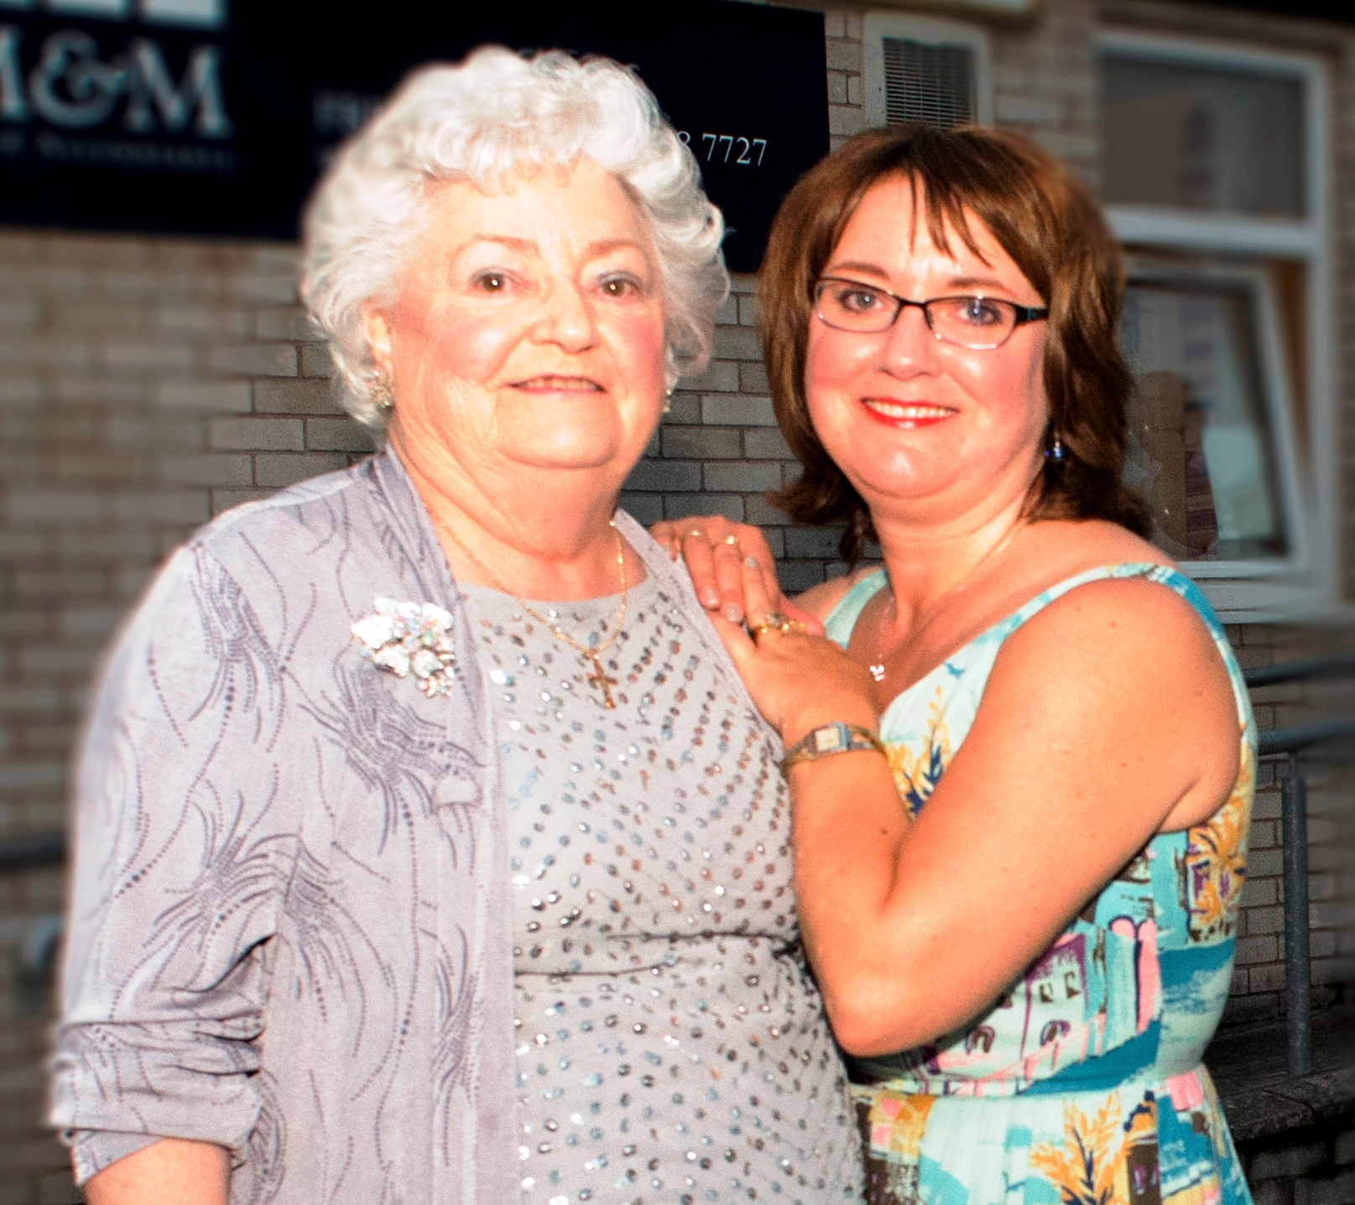
Doreen’s Circle
Doreen’s Circle provided practical and emotional support following her cancer diagnosis and helped with making decisions for the end of her life
Tweet us @C_Circles • www.community-circles.co.uk

Slide 11
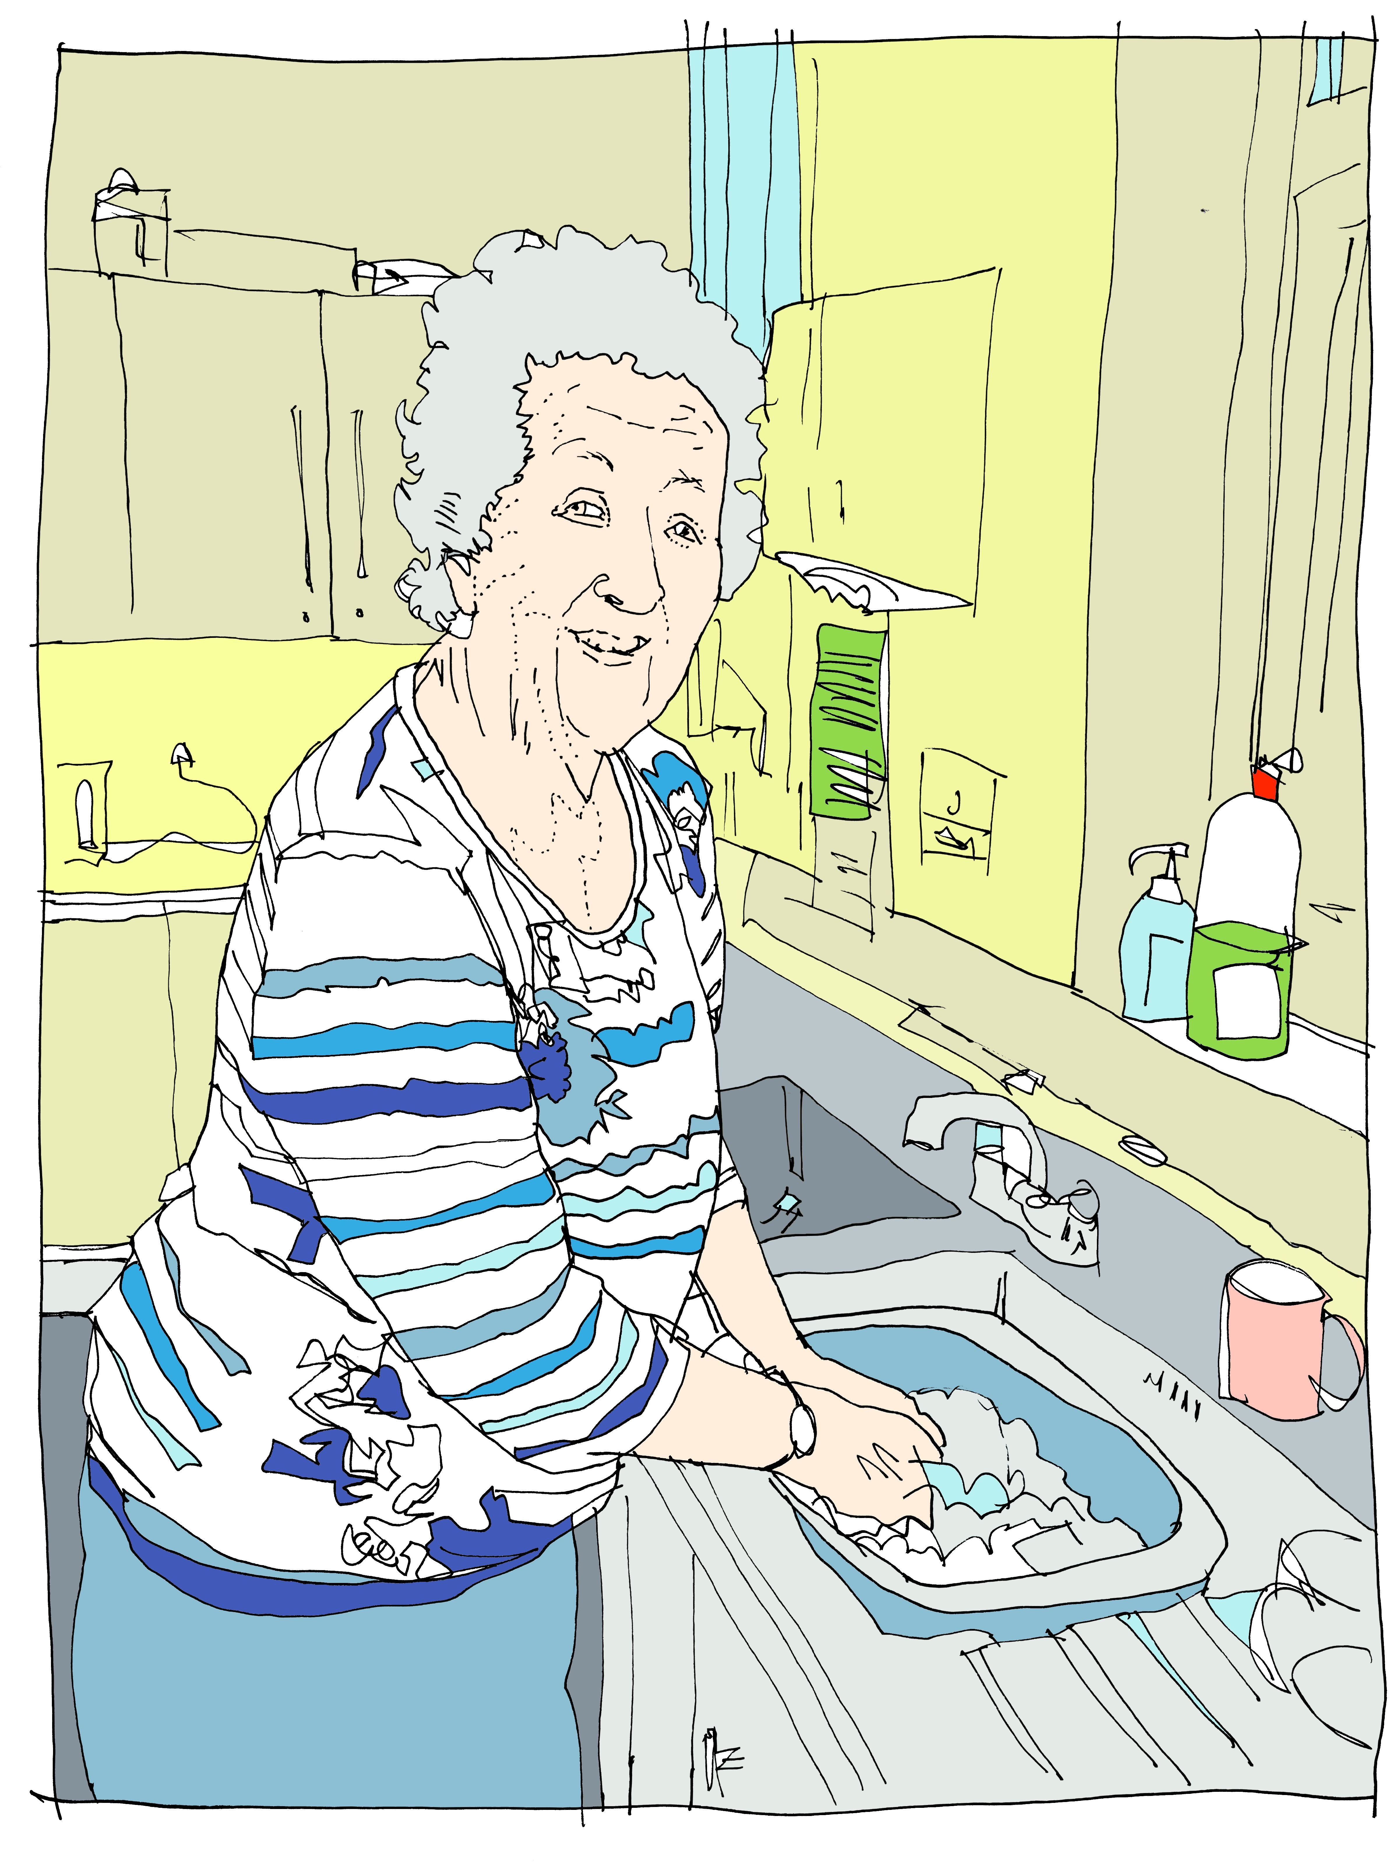
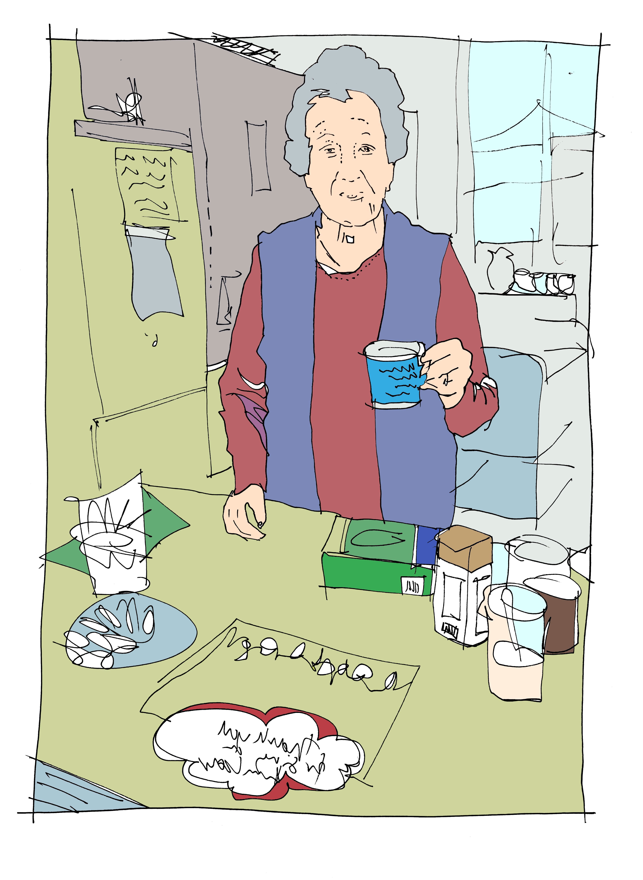
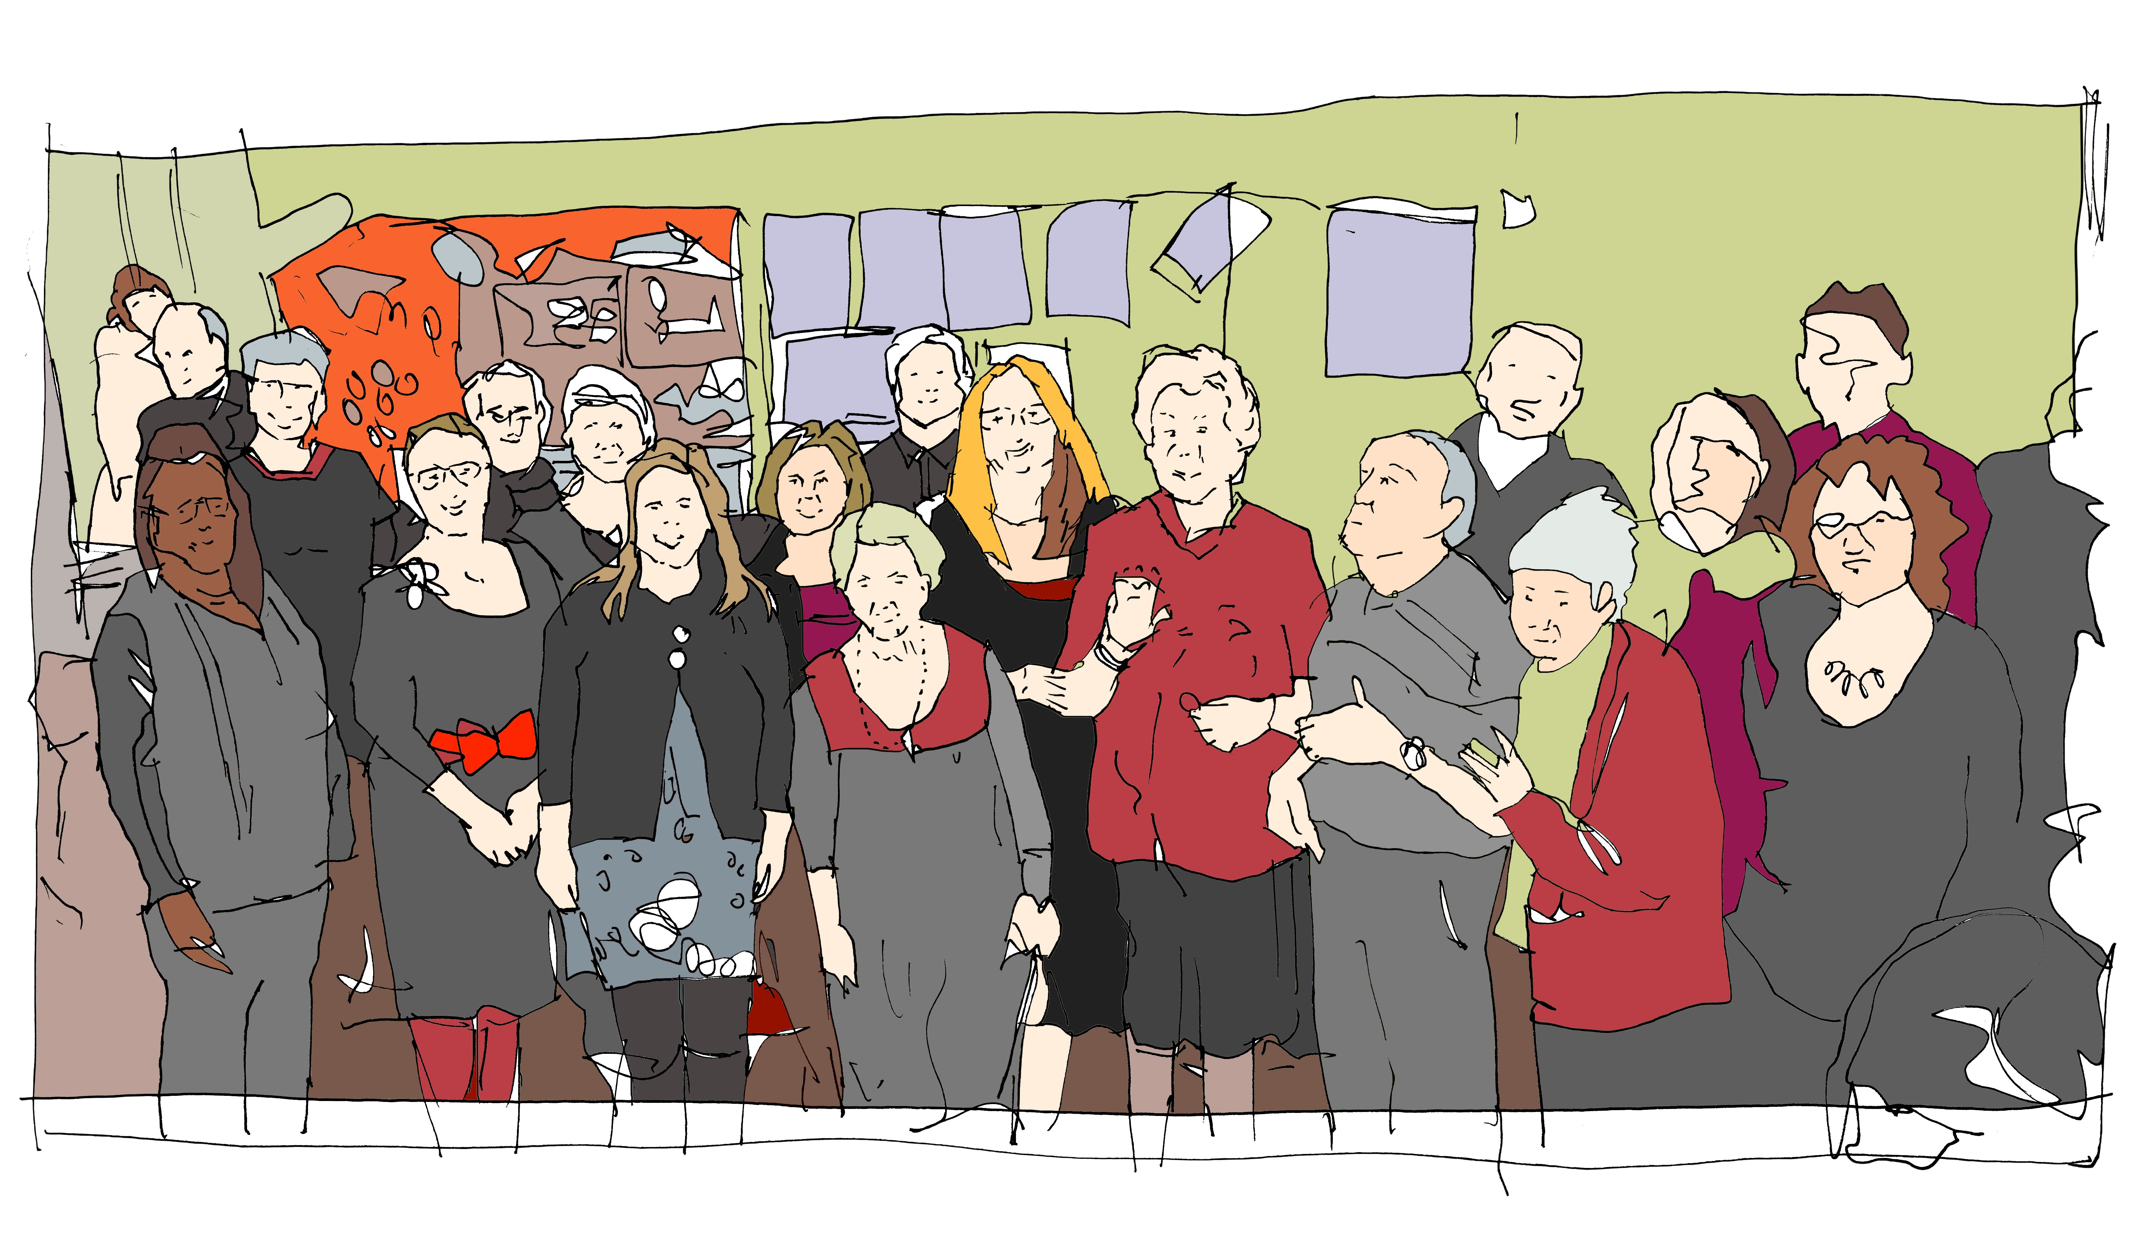
May’s Circle helped her to start singing again
Tweet us @C_Circles • www.community-circles.co.uk

Slide 12
Tools

Slide 13
What’s working and not working

Slide 14
What’s working and not working
This tool sorts what is working and what is not working from different perspectives to identify a way forward.
It identifies what’s working well for someone, the things they want to stay the same or do more of
Also the things that aren’t working so well, that need to change
Tweet us @C_Circles • www.community-circles.co.uk

Slide 15
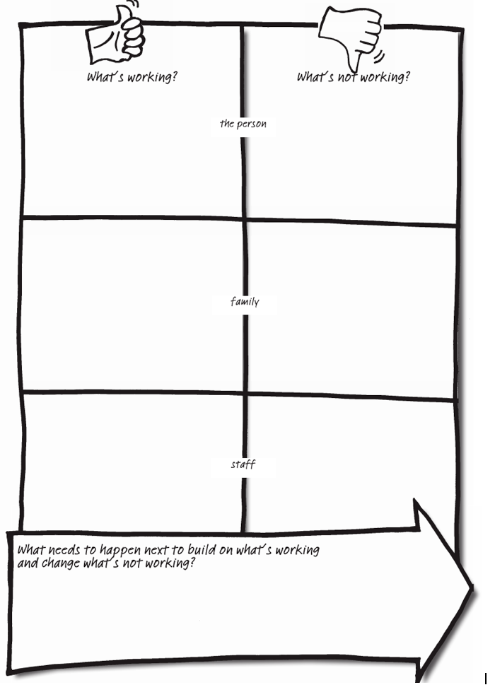
What’s working and not working
Once this information from everyone’s view is recorded, the Circle can start to think about next steps and actions, supporting the person to continue the things that are working well and change what’s not working.
Tweet us @C_Circles • www.community-circles.co.uk

Slide 16
Kathleen’s example
What’s working | What’s not working
Kathleen’s point of view Enjoying knitting Spending time with Dorothy knitting together Joyce bringing Communion on a Tuesday | Kathleen’s point of view Not having a lot of choice of wool Legs feeling stiff
Family’s point of view Kathleen still enjoying her knitting Kathleen spending time with Dorothy Staff getting to know Kathleen better and chatting with her about things she enjoys Being in the main lounge which is familiar Kathleen enjoying afternoon tea in the tea room | Family’s point of view Knowing that Kathleen’s legs feel stiff Kathleen spending time in the upstairs lounge
Staff’s point of view Staff spending quality time with Kathleen and having good conversations | Staff’s point of view Kathleen going from the lounge to the tea room for afternoon tea Kathleen is sometimes reluctant to have a short walk which can mean her legs feel stiff later in the day
Tweet us @C_Circles • www.community-circles.co.uk

Slide 17
Kathleen’s example
What needs to happen next to build on what’s working and change what’s not working?
Support Kathleen to choose more wool
Continue to support Kathleen and Dorothy to knit together, Dorothy to visit Kathleen rather than Kathleen going to upstairs lounge
Use learning logs to record information about supporting Kathleen to have a short walks
Tweet us @C_Circles • www.community-circles.co.uk

Slide 18
Perfect Week

Slide 19
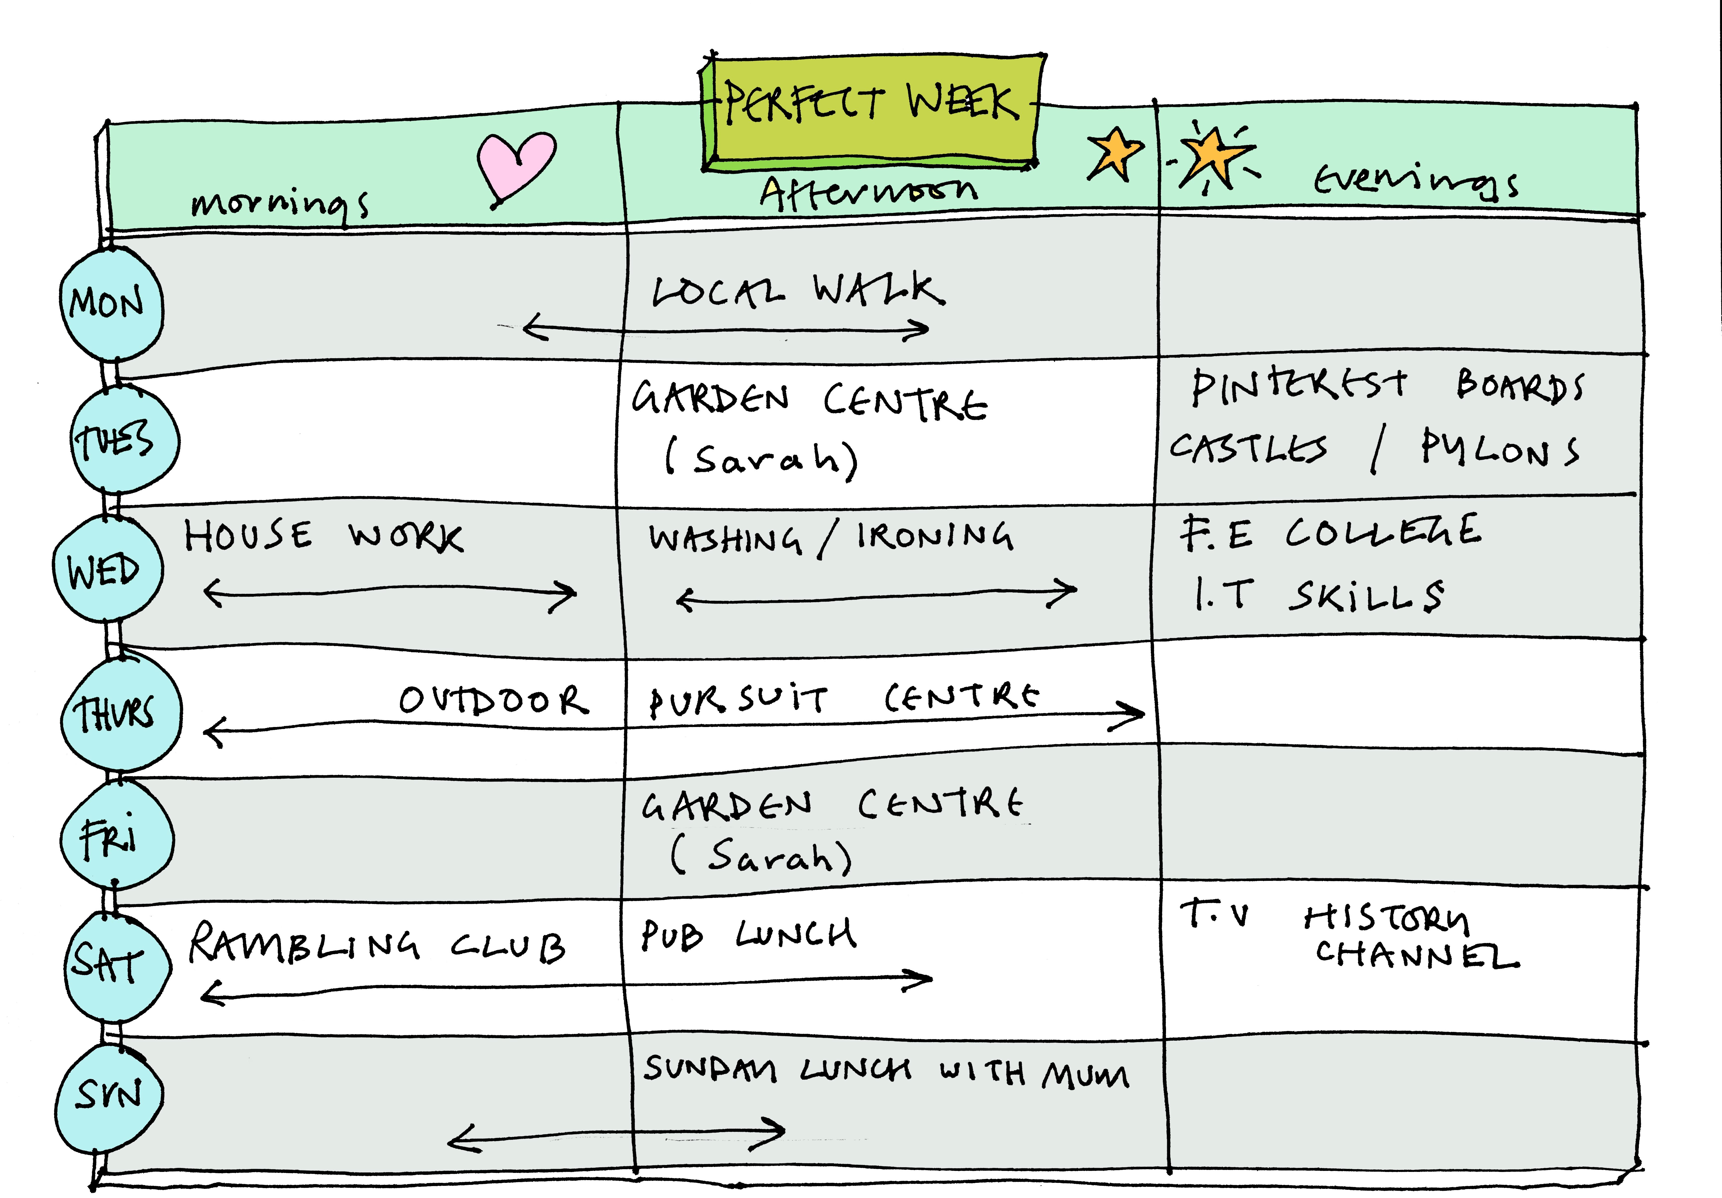
Tweet us @C_Circles • www.community-circles.co.uk

Slide 20
Decision Making

Slide 21
Decision Making
The decision making profile creates a clear picture about how a person makes a decision and how they want to be supported in decision-making. It can be used alongside the decision making agreement to help people to have choice and control in their lives.
Tweet us @C_Circles • www.community-circles.co.uk

Slide 22
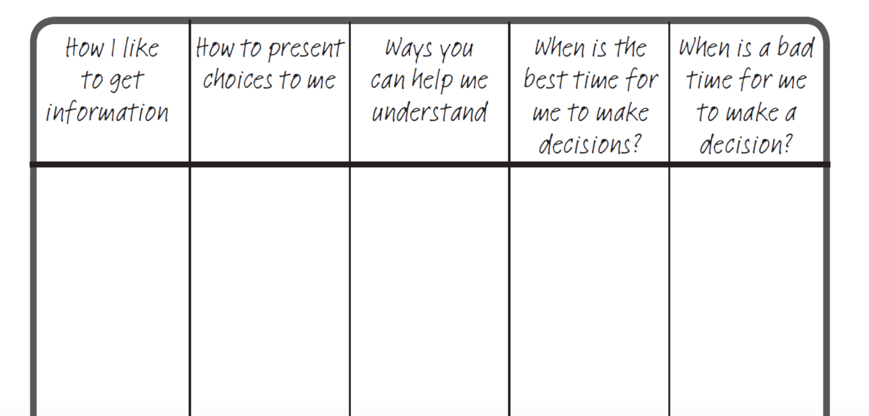
Decision Making Profile
Spoken to me, visual prompts can help
Use the calendar to help me understand
No more than two options at a time
Make sure there are no interruptions or background noise
When I’m being chatty
When feeling tired or when I am eating
Tweet us @C_Circles • www.community-circles.co.uk

Slide 23
Decision Making Agreement
Making decisions is part of being in control of your own life.
The decision-making agreement looks at specific situations that are important to a person, and sets out the decision-making process relating to each one.
Tweet us @C_Circles • www.community-circles.co.uk

Slide 24
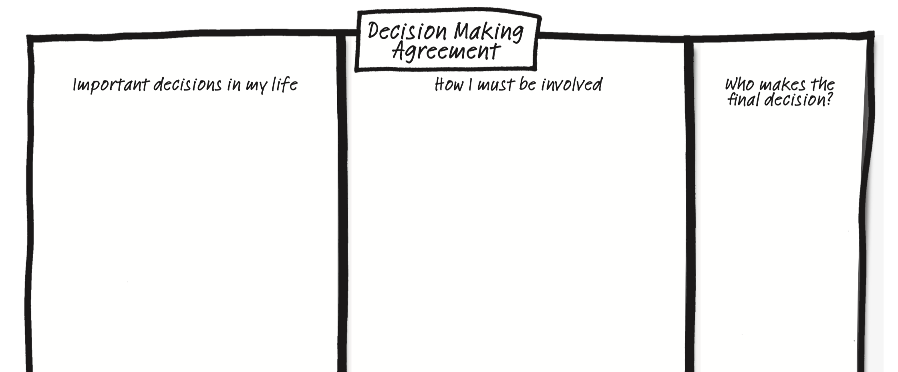
Decision Making Agreement
Whether to go to football or youth club on a Tuesday night
Mum talks it through with me
I give her leaflets about it and remind her
Ben
Tweet us @C_Circles • www.community-circles.co.uk

Slide 25
Presence to contribution

Slide 26
Presence to Contribution
Presence to Contribution is a way to think about how we can go from just ‘doing something together’ to enabling the person to be a contributing member of a community.
This tool helps you to record what the person is interested in, what it means to be present for an activity and what they could do to contribute to it more fully
Recording this information helps us to think about moving from being present to actively contributing
Tweet us @C_Circles • www.community-circles.co.uk

Slide 27
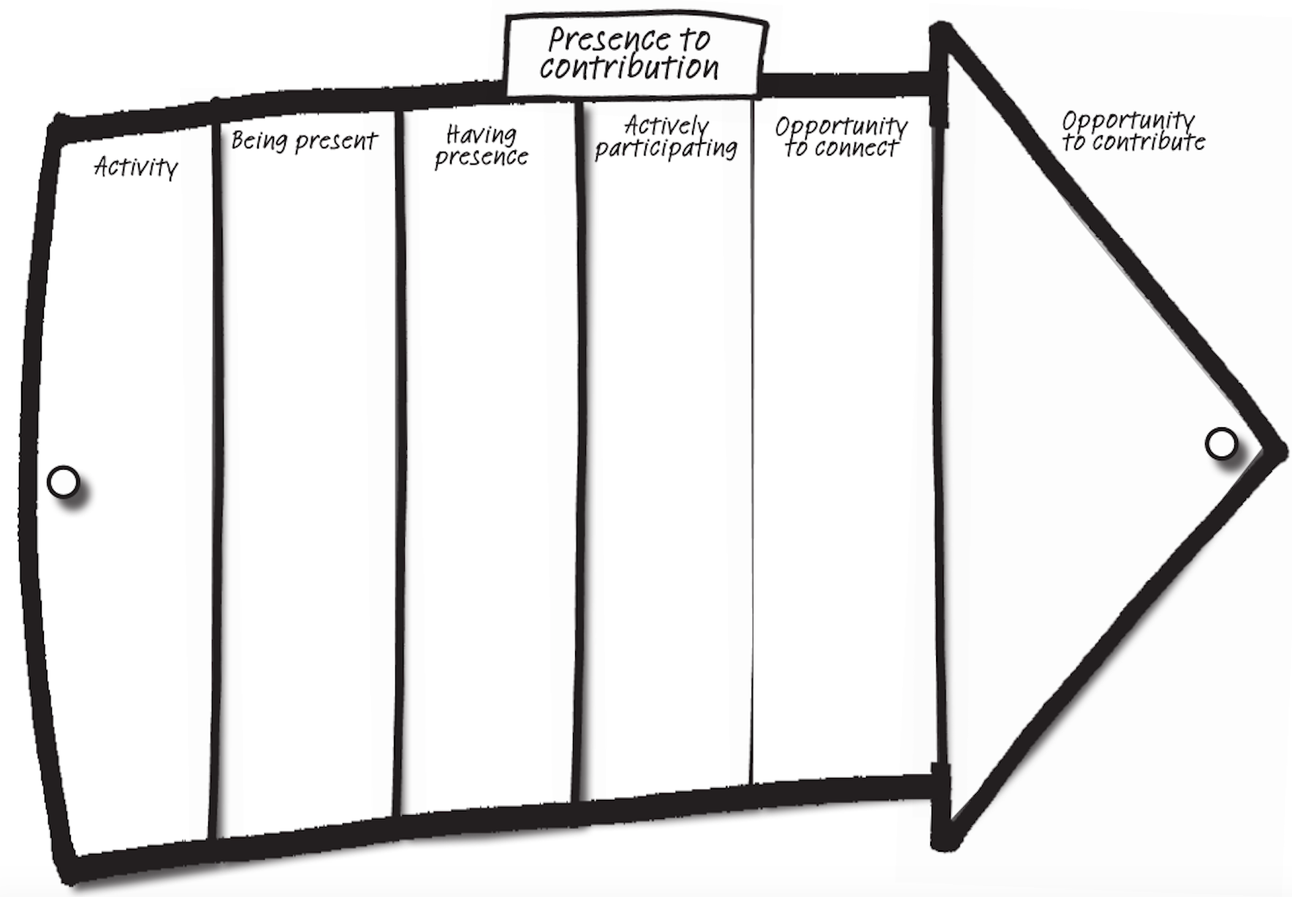
Presence to Contribution
Tweet us @C_Circles • www.community-circles.co.uk

Slide 28
Presence to Contribution
May’s Story
May’s Community Circle is helping her to get singing again and with Helen, they have joined a local community choir
Using presence to contribution helped us to think about what we could do to support May feel really connected and a contributing member of the choir
Tweet us @C_Circles • www.community-circles.co.uk

Slide 29
Presence to Contribution
Activity – singing with the local community choir
Being present – turning up on time and joining in
Having presence – turning up regularly with their songbook, being more familiar faces
Actively participating – being part of the washing up rota
Opportunity to connect – gives further opportunities to chat with others while they wash up, May’s help is appreciated
Opportunity to contribute – performing as part of the choir at the care home where May lives
Tweet us @C_Circles • www.community-circles.co.uk

Slide 30
How can you get involved?
Launched a range of offers so that everyone can benefit from Community Circles
Free DIY Circles
Membership Group
Bespoke Training
Partnership
Tweet us @C_Circles • www.community-circles.co.uk

Slide 31
Next Steps…
Could Community Circles benefit people you support?
What would you need to do to build Circles into what you offer?
What help would you need?
What key questions come up when thinking about incorporating Circles?
Tweet us @C_Circles • www.community-circles.co.uk

