Slide 1
Using the law to get people out of hospital- National advocacy conference

Slide 2
About the speaker
Kirsty Stuart – Senior associate – Public law and human rights

Slide 3
I am scared they may not come out alive
They are stuck
They are not the same person who went into hospital
They are being treated as less than human
My son/daughter is in a forensic unit but has never committed a crime
They have been misdiagnosed as having a personality disorder and not autistic
They are being over medicated
I was told they were only going in for a week or two
There are none or not enough staff trained caring for them
If we say anything as family, we are not listened to

Slide 4
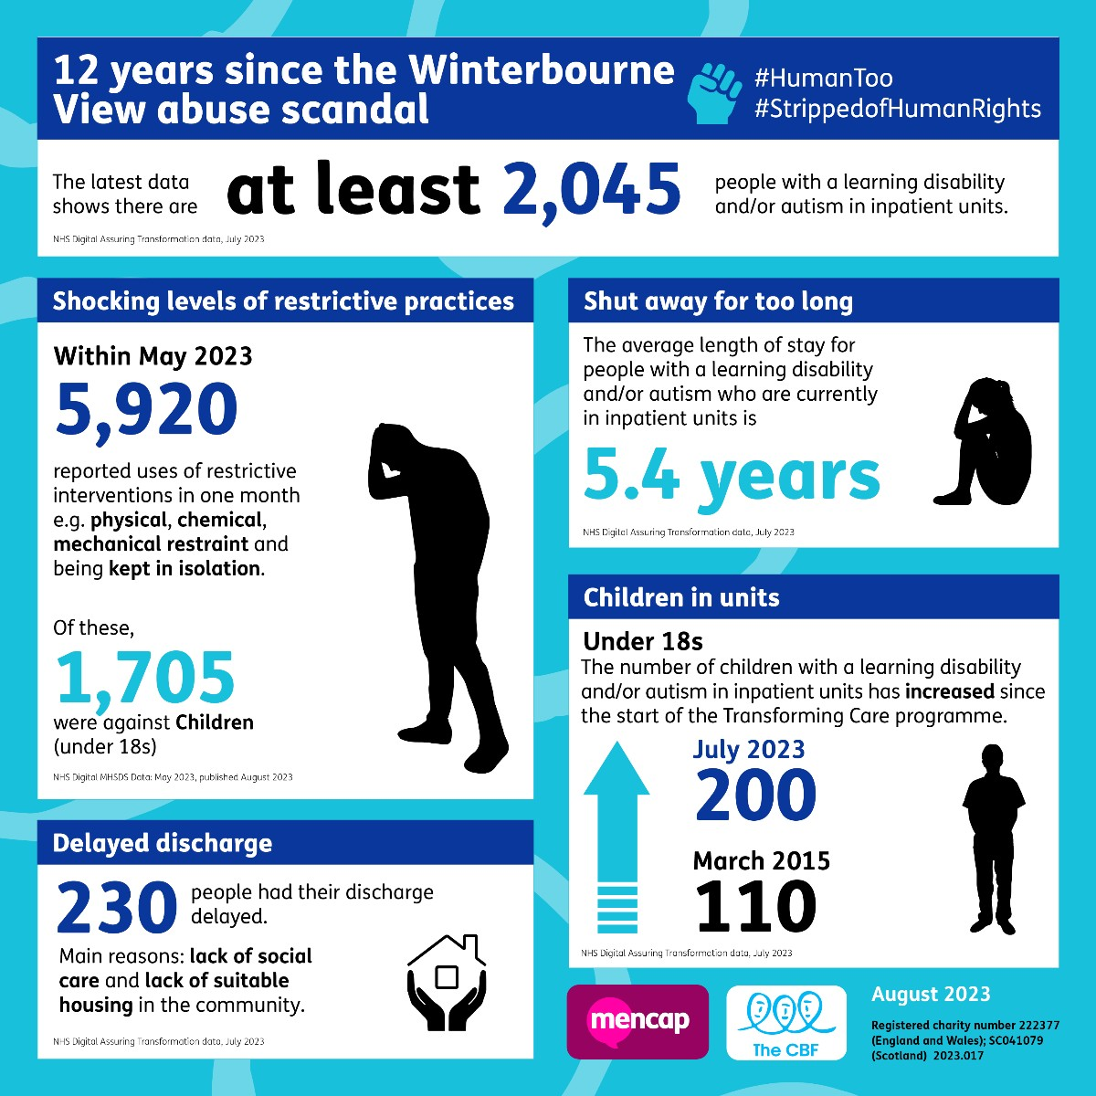
Scale of the problem

Slide 5
CQC – Out of sight – who cares? October 2020
A review of restraint, seclusion and segregation
‘Access to high-quality advocacy varied across hospitals.. And the role of an advocate was not consistent’
‘There was some confusion between the provider and commissioner about who the advocate was or which organisation provided the services.’

Slide 6
Closed culture and the role of an advocate Guidance for CQC staff
Guidance drafted during the pandemic
Inherent risk factors: people may be experiencing poor care, weak leadership and management, poor skills, experience and training of staff providing care, lack of external oversight

Slide 7
Closed culture and the role of an advocate Guidance for CQC staff
Good picture of the person, what their care and treatment/how they are supported?
Do the care plans describe people and their needs in a respectful way?
Reasonable adjustments in place for individual disabled people?
Does the service meet the Accessible Information Standard?
Are triggers for distressed behaviour clearly documented and are techniques for preventing behaviours from escalating documented?
Abused care home resident secures ‘landmark’ settlement of legal claim | Shropshire Star

Slide 8
Building the right support policy paper – August 2022
Building the Right Support Action Plan - GOV.UK (www.gov.uk)
Keeping people safe and ensuring high-quality health and social care
Making it easier to leave hospital
Living an ordinary life in the community
A good start to life
Working with changes to the system
National and local accountability to deliver

Slide 9
Building the right support policy paper – August 2022
For people with a learning disability and autistic people in hospital, commissioner oversight visits should be happening every 8 weeks for adults, and every 6 weeks for children and young people, to:
make sure that there is a reason for them to be in hospital and that they are being properly cared for
take action to tackle any barriers to discharge
Clinical contracts – any feedback?

Slide 10
Who I am matters – CQC report November 2022
From 1 July 2022, a new legal requirement introduced by the Health and Care Act 2022 requires all CQC registered providers to ensure their staff receive learning disability and autism training at a level appropriate to their role. This applies to all settings, including acute hospitals, and providers need to consider the training needs of staff who deliver care directly as well as administrative staff, for example reception and call-handlers.
To support this new legislative requirement, the government will be rolling out the Oliver McGowan training package. Co-designed by autistic people, people with a learning disability, family, carers and subject matter experts, this training is intended to ensure that health and social care staff have the skills and knowledge to provide safe, compassionate, and informed care.

Slide 11
Mental Health Act Code of Practice para 20.28
‘people with autism should be detained for as short a period as possible. Discharge planning for people with autism should begin when the person is admitted and involve health and local authorities to work together in the interests of an individual to ensure appropriate community-based support is in place before discharge. This will require assessment by a practitioner with expertise in autism, as set out by the statutory adult autism guidance.’

Slide 12
Options for legal challenge

Slide 13
The options for legal challenge
First-Tier Tribunal
Judicial Review
Court of Protection
Case law updates – MCA vs MHA

Slide 14
First-Tier Tribunal – what should I look out for?
Accessibility of reports
Accessibility of hearings
Legal representation and availability of those
Not missing automatic references for those detained under the MHA
Interaction between solicitors and the person detained
Notes:
Immediate discharge – if criteria for section not met – depends on section and whether under part 2 or 3 (s72)
Deferred discharge for e.g. forensic patient – conditional discharge until such arrangements as appear to the tribunal to be necessary for that purpose have been met (s73)
Recommendations for care including s17 leave with a view to future discharge planning, transfer to another hospital – can reconvene to review why recommendation not complied with
Consider CTO if subject to section 3
Can instruct and use independent experts e.g. psychiatrist, ISW, OT

Slide 15
Helpful tips from a psychiatrist/lawyers perspective
MDTs/ward rounds – the value of a good advocate cannot be underestimated
Checking on Rio/Paris
Raising concerns about incidents
Good practice for communication
Updating as to family contacts
Being a collaborative team overall
Practical – section dates, dates of hearings/CPAs/CTRs

Slide 16
Judicial Review
Process by which the Admin Court can review decisions of public bodies to act or failure to act on behalf of individuals
This includes the government and the NHS – bodies that deliver a public service
Remedy of last resort
Complex, costly and sometimes lengthy cases which require permission to issue with strict rules around aspects such as pre-action protocol
Limited number of remedies – quashing order, prohibiting order, mandatory order, declaration, declaration of incompatibility, damages, injunction
All remedies are discretionary – even if court finds public body acted wrongly, does not have to grant the remedy
Must be brought promptly and within 3 months of decision/action being challenged
Notes:
Quashing order – overturns or undoes the decision being challenged – most common outcome of a successful JR
Prohibiting order – stops a public body from taking an unlawful decision or action that it has not yet taken
Mandatory order – court can direct a public body to take an active step e.g. take a new decision within a specific period of time – more unusual
Declaration – order stating what the law is – Judges reluctant to do this as they believe that their written judgment is adequate
Declaration of incompatibility – relates to when an act of parliament contravenes the human rights act – invitation to MPs to change the law to comply with the HRA
Damages – only if some other form of legal remedy is sought – 3 circumstances – 1 – where right to damages under private law but need JR to establish element of damages claim e.g. to show that a period of detention is unlawful, 2 – where there has been a breach of HR, 3 – where there has been a breach of your rights under European Union Law
Injunction – temporary order requiring a public body to do/not do something until a final decision is made
Discretionary – will make decision based on circumstances and what it considers to be appropriate, fair and practical

Slide 17
Judicial Review – case study example
Mr X – diagnoses of EUPD and ASD
Detained under section 3 MHA and appealed against his section
Notified on Friday (7 days before Tribunal) that he was going to be moved on Monday at 9am to unit 120 miles from current hospital which is rated CQC ‘inadequate’
Received instructions evening of the Friday from MH solicitor
No correspondence from Mental Health Trust or ICB (was CCG)
Issued proceedings for injunctive relief to stop the move on Sunday morning OOO Judge heard case 7.30pm Sunday evening and injunction granted until after adjourned FTT at end of September
Grounds – impact on Tribunal, impact on diagnoses, art 8, irrationality

Slide 18
Segregation vs seclusion
Seclusion – definition – ‘The supervised confinement and isolation of a person, away from other users of services, in an area from which the person is prevented from leaving.’ ‘Its sole aim is the containment of severely disturbed behaviour which is likely to cause harm to others.’
MHA code of practice 26.103- 26.149

Slide 19
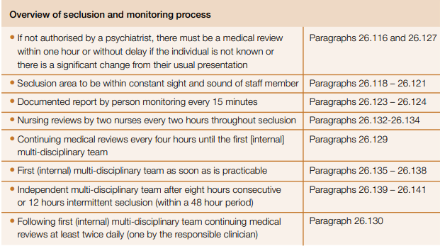
Segregation vs seclusion

Slide 20
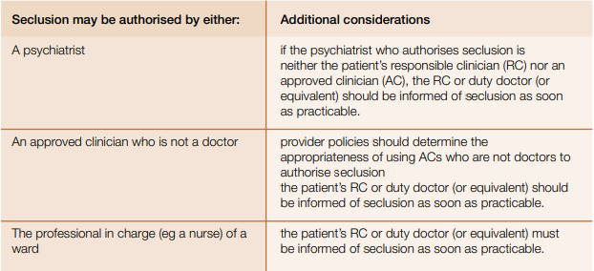
Segregation vs seclusion

Slide 21
Segregation vs seclusion
LTS - Long-term segregation refers to a situation where, in order to reduce a sustained risk of harm posed by the patient to others, which is a constant feature of their presentation, a multi-disciplinary review and a representative from the responsible commissioning authority determines that a patient should not be allowed to mix freely with other patients on the ward or unit on a long-term basis. In such cases, it should have been determined that the risk of harm to others would not be ameliorated by a short period of seclusion combined with any other form of treatment
MHA code of practice 26.150-26.160

Slide 22
Segregation vs seclusion
26.150 - The multi-disciplinary review should include an IMHA in cases where a patient has one.
26.155 - The patient’s situation should be formally reviewed by an approved clinician who may or not be a doctor at least once in any 24-hour period and at least weekly by the full MDT
26.156 - Where long-term segregation continues for three months or longer, regular three monthly reviews of the patient’s circumstances and care should be undertaken by an external hospital. This should include discussion with the patient’s IMHA (where appropriate) and commissioner

Slide 23
Judicial Review – what should I look out for?
Date of decision or consideration of an on-going breach
Breaches in policies – if unsure, request the policy
Has a decision been made? And on what basis was it made?
Documents referring to delayed discharge
Information from CTRs

Slide 24
Judicial Review –Helpful tips from a lawyers perspective
Legal aid funded – public law contract – means tested
Prompt action – bring it to the attention of a lawyer
Bring any evidence – providing copies of policies of concern
Talk to a MH lawyer if one is involved and refer on

Slide 25
Court of Protection
Only applies if the person lacks capacity to make the relevant decisions
Can be either health and welfare decisions or property and financial affairs decisions
Court applies the rules that are laid out in the Mental Capacity Act 2005
Can relate to any decision
Declarations can be sought or challenged in respect of capacity and best interests
The person who lacks capacity should be at the centre of all decision making
Legal aid can be available – dependent on the application being made
Notes:
Court cannot make decisions on behalf of a person who has capacity
Will only cover health and welfare decisions
Examples of decisions include where the person lives, who they have contact with, their use of social media, if they can marry
if they lack capacity re care, are very likely to also be considered to be DoL’d if they are in the community, and that this fact can be used as a “gateway” to getting their case into the COP

Slide 26
Problems and pitfalls faced by individuals
Disagreement over funding for community packages – s117
R (on the application of Worcestershire County Council) (Appellant) v Secretary of State for Health and Social Care (Respondent) - The Supreme Court
‘Too many cooks spoil the broth’
Institutionalised individuals
Nature of condition
Lack of suitable housing
Lack of care provider

Slide 27
Lack of suitable housing
Often bespoke packages
Adaptations – sensory needs/space for staff – Disabled facilities grant – administered locally
NHS England Capital grant
Complex process for application
Application made by ICB
Relies on the ICB having knowledge of the process
Department of Health capital, such as Care and Support Specialised Housing Fund
Homes and Communities Agency Affordable Housing Programme
Private landlords/housing association
Home ownership for people with Long-term Disabilities (HOLD)

Slide 28
Lack of care provider
Often bespoke packages
May need to consider staff burnout – core and cluster models work well
Depends on geography
Pen picture and up to date assessment of need
ICBs have framework of providers

Slide 29
Hints and tips
Ask for list of providers approached
Get to know providers and propose them to the ICB/LA
Family input is so important
Pen picture
Is the care package reflective of need or needs unmet?
The use of press and social media

Slide 30
Examples of Court of Protection cases
P is subject to a standard authorisation in hospital/in a unit and is unhappy and wishes to challenge this
s21A
Lancashire County Council ordered to pay £355,000 in damages for unlawful deprivation for 7 years for man with learning disability
P is in hospital (could be under MHA) but is going to be discharged into a non-CQC registered placement such as an ISL and so the court is required to authorise the legal deprivation of liberty
S16
P is in a non-CQC registered placement and is subject to an authorisation of the court which is reviewed annually but wishes to challenge the authorisation or an element of the restriction
S16

Slide 31
Stuck between the MHA rock and an MCA hard place
European Court of Human Rights in Rooman v Belgium [2019] ECHR 105, [2020] MHLR 1
The Court has stressed that, irrespective of the facility in which those persons are placed, they are entitled to be provided with a suitable medical environment accompanied by real therapeutic measures, with a view to preparing them for their eventual release […]
As to the scope of the treatment provided, the Court considers that the level of care required for this category of detainees must go beyond basic care
MHA vs MCA vs Inherent Jurisdiction
IJ is only for when there is a lacuna in the statutory law

Slide 32
Stuck between the MHA rock and an MCA hard place
Schedule 1A MCA para 2
Status of P | Determination of ineligibility
Case A | P is— (a) subject to the hospital treatment regime, and (b) detained in a hospital under that regime. | P is ineligible.
Case B | P is— (a) subject to the hospital treatment regime, but (b) not detained in a hospital under that regime.
Case C | P is subject to the community treatment regime.
Case D | P is subject to the guardianship regime.
Case E | P is— (a) within the scope of the Mental Health Act, but (b) not subject to any of the mental health regimes.

Slide 33
Stuck between the MHA rock and an MCA hard place
GJ v The Foundation Trust & Anor [2009] EWHC 2972 (Fam), [2010] Fam 70
Charles J had three approaches in relation to the construction of the phrase “an application could” be made:
1. A “possibility test”, namely that the decision-maker under the MCA should ask themselves whether it was possible that the person could be detained under the MHA 1983;
2. A “high probability” or “effective certainty test,” namely that no reasonable psychiatrist or s.12 approved doctor could come to the view that the patient did not meet the criteria for admission under the MHA 1983;
3. A “could” test, namely that the decision-maker should ask themselves whether the criteria for admission under the MHA are made out
Last approach was deemed to be correct

Slide 34
Stuck between the MHA rock and an MCA hard place
Applications to COP to authorise future deprivations of liberty
Need to be within 12 months of discharge
Concerns around contact, CCTV authorisation, high levels of restriction
Need more case law - PH v A Clinical Commissioning Group & Anor (Dismissal of proceedings) [2022] EWCOP 12 (14 March 2022) (bailii.org)

Slide 35
What’s next?
Mental health act – will it be pulled?
Increase in cases overall due to the impact from social media and press
Continued work to hold the government to account for not adhering to previous set out timescales for moving those with ASD and/or LD out of Assessment and Treatment Units - Issues around Transforming Care and funding
Annual mental health act stats from NHS Digital are delayed until after King’s Speech
Joint guidance from WHO and UN about a transformation of mental health services with a rights based process – October 2023
CQC consultation on the draft code of practice for the Oliver McGowan training closed 16 October 2023
ATU Pro bono legal surgery

Slide 36
Questions?
Email
kirsty.stuart@irwinmitchell.com
Twitter @mrsarcticride

