Slide 1
Using judicial review as a tool of systemic change National Advocacy Conference, October 2020

Slide 2
What we will look at
What is judicial review?
Grounds of challenge
Remedies (what can the court do?)
The process of bringing a judicial review
Case studies: individual, local and national
Q&A

Slide 3
Judicial review and advocacy

Slide 4
What is public law?
Public law is the part of the law which:
Governs relationships between people and the state
Governs the conduct of public bodies
Public law requires public bodies to act lawfully, rationally, fairly and compatibly with the human rights of people affected by their actions

Slide 5
What is public law?
“Ministers and public officers at all levels must exercise the powers conferred on them in good faith, fairly, for the purpose for which the powers were conferred, without exceeding the limits of such powers and not unreasonably.”
Tom Bingham, The Rule of Law

Slide 6
What is judicial review?
Judicial review is the process by which the courts review the lawfulness of decisions and acts by public bodies
It is a practical means of enforcing the rule of law: the principle that everyone – including the government, local authorities, police and the NHS – is subject to the law:
Parliament legislates to make the law
The government governs in accordance with the law
The courts interpret and apply the law

Slide 7
What is judicial review?
An application to the Administrative Court (a specialist court within the High Court)
Brought by a Claimant – this can be an individual, a group of people, a charity, NGO, campaign group, company etc
Against a Defendant – a public body such as a government department, local authority, NHS Trust or CCG, police force etc (or a company exercising public functions, e.g. where a public service is ‘outsourced’)
There may also be Interested Parties or Interveners

Slide 8
What is judicial review?
Judicial review is generally a remedy of last resort – if there is another effective means of challenging a decision, you will be expected to use it, unless it will not provide a sufficient remedy
Examples of alternative means of challenge include:
Right of appeal to a tribunal, e.g. for individual welfare benefits decisions
Complaints procedure
Ombudsman scheme, e.g. the Parliamentary and Health Service Ombudsman or the Local Government Ombudsman

Slide 9
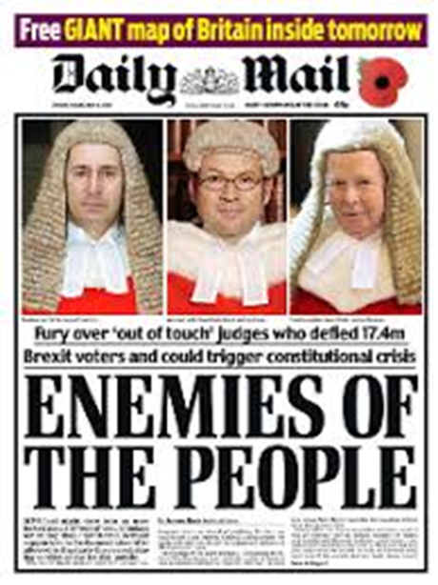
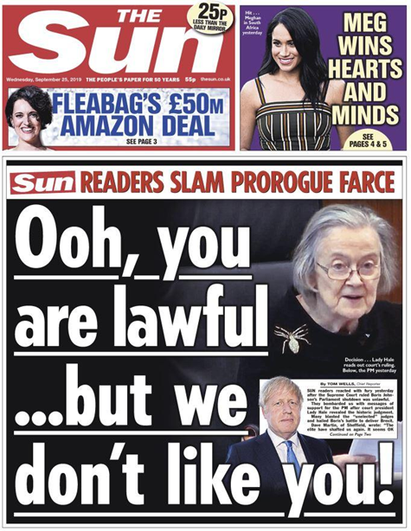
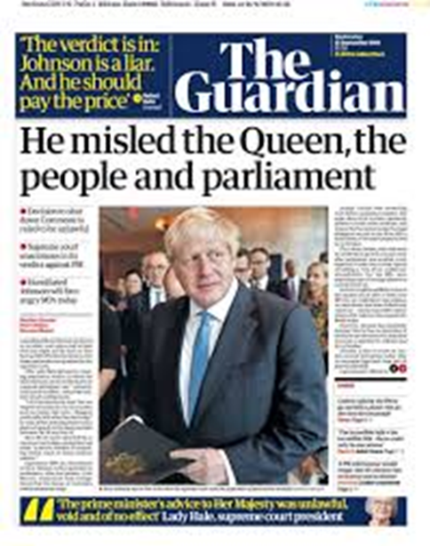
Judicial review on the front pages…

Slide 10
Who can bring a judicial review?
An individual (or individuals) who is affected by the decision – with support from a litigation friend such as a family member or advocate if they lack capacity to litigate
An organisation such as a charity, NGO or campaign group – as long as it has ‘sufficient interest’ in the issue

Slide 11
How can you fund a judicial review?
Legal aid is available for judicial review cases if a person is financially eligible (see civil legal aid eligibility keycard for summary). Legal aid also provides protection against adverse costs if the case is lost.
Crowdfunding – e.g. CrowdJustice
Private funding

Slide 12
Key questions
Who made the decision which your client wants to challenge?
When was the decision made?
What is the impact of the decision on your client and others?
How was the decision made?
Why is the public body’s decision or act unlawful?

Slide 13
Grounds of challenge
Why is the public body’s decision or act unlawful?
Three main ‘grounds’ of judicial review (which may overlap):
Procedural unfairness: the process leading to the decision was unfair
Illegality: the public body acted outside its legal powers
Irrationality: the decision was so unreasonable that no reasonable decision-maker could have made it (a high bar)

Slide 14
Grounds of challenge
Why is the public body’s decision or act unlawful?
A decision can also be challenged on the basis that the public body has acted in a way which is incompatible with human rights, as given effect by the Human Rights Act 1998
Note: the courts cannot overturn primary legislation passed by Parliament – the most they can do is declare it incompatible with the Human Rights Act (this is very rare)
The courts can overturn secondary legislation, e.g. Regulations made by government ministers

Slide 15
Grounds of challenge – examples
Procedural unfairness:
Failing to consult or carrying out an inadequate consultation
Breach of duties under the Equality Act, e.g. the public sector equality duty
Failures in the Care Act assessment process
Failure to follow guidance (e.g. statutory guidance)
Illegality:
Misinterpreting legal powers or duties
Applying an overly rigid policy (‘fettering’ of discretion)
Using a legal power for an improper purpose
Failing to take into account relevant considerations / taking into account irrelevant considerations

Slide 16
Grounds of challenge – consultation
In order for a consultation by a public body to be lawful:
It must be carried out when proposals are at a formative stage
It must give sufficient information about proposals to permit intelligent consideration and response by consultees
It must provide adequate time for consultees to respond
The product of the consultation must be conscientiously taken into account before a final decision is made

Slide 17
Remedies (what can the court do?)
Quashing order: to overturn or undo the decision being challenged, so that it has no legal effect
Prohibiting order: to stop a public body taking an unlawful decision or action which it has not yet taken
Mandatory order: to direct a public body to do something, e.g. to make a new decision

Slide 18
Remedies (what can the court do?)
Declaration: an order stating what the law is, or that a public body’s decision was unlawful
Declaration of incompatibility: a declaration that an Act of Parliament contravenes the Human Rights Act
Damages: financial compensation for the unlawful conduct (only available in limited circumstances)

Slide 19
The process of bringing a judicial review
You must act quickly:
Any application for judicial review must be filed at court promptly and in any event within three months of the decision under challenge

Slide 20
The process of bringing a judicial review
Step 1: Identify the decision – what is the decision, who took it, when and how was it taken
Step 2: Funding – how will the case be funded? e.g. legal aid, crowdfunding, private funding
Step 3: Pre-action stage – send a pre-action letter to the Defendant setting out the facts and legal arguments. A response must usually be provided within 14 days

Slide 21
The process of bringing a judicial review
Step 4: Apply for permission – apply to the court for ‘permission’ to bring a judicial review (and for interim relief if urgent action is needed, e.g. an injunction)
Claimant files statement of facts and grounds
Within 21 days, the Defendant files summary grounds of defence
The papers are then passed to a judge to consider

Slide 22
The process of bringing a judicial review
Step 5: Permission – a judge will consider whether the case has ‘arguable’ grounds. If it does, the judge will grant permission to proceed to a final hearing. Within 35 days, the Defendant files detailed grounds of defence
(Step 5a: Permission refused – if permission is refused ‘on the papers’, you can apply for an oral renewal hearing for this to be reconsidered)

Slide 23
The process of bringing a judicial review
Step 6: Final hearing – the parties make legal arguments in court (oral witness evidence is rare), usually for one day The judge(s) will usually reserve judgment, i.e. hand down or deliver their judgment at a later date
Step 7: Costs – the usual rule is that the losing party pays the winning party’s legal costs

Slide 24
The process of bringing a judicial review
Step 8: Appeal – if your case is unsuccessful, you can apply for permission to appeal to the Court of Appeal. Permission will only be granted if there is a real prospect of success or there is another compelling reason for the appeal to be heard.
Step 9: Second appeal – if unsuccessful again, you can apply for permission to appeal to the Supreme Court

Slide 25
If the case is successful…
Winning in court will usually mean the decision is overturned – but note that this does not stop the public body trying to ‘re-make’ the decision lawfully at a later date
Many judicial review cases settle before reaching court – the vast majority of cases do not reach a final hearing, and often Defendants back down after a pre-action letter, or when the court grants permission

Slide 26
Case studies
An individual social care challenge: Laura v the council
A local consultation challenge: Fairway Day Centre
A local Equality Act challenge: Saving a soup kitchen
A national policy challenge: Article 39 v the government

Slide 27
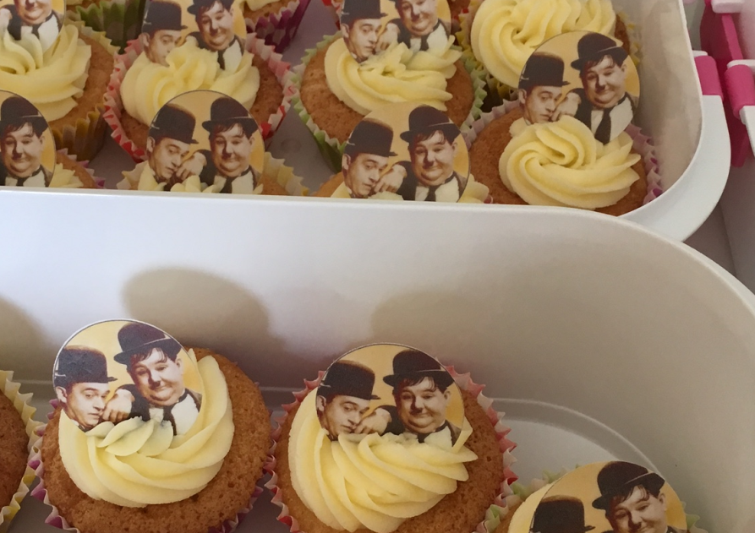
Case study 1: Laura v the council
Laura is a 22 year old woman with autistic spectrum disorder and learning difficulties
She lives with her parents and needs support with personal care and day-to-day tasks

Slide 28
Case study 1: Laura v the council
After a re-assessment, the council reduced her support from 20 hours to 8 hours p/w
We sent a pre-action letter to challenge the council’s failure to lawfully assess Laura’s needs and produce a lawful care plan in accordance with the Care Act

Slide 29
Case study 1: Laura v the council
With help from Laura and her mum – who was her litigation friend – we set out in detail the support Laura needed
The council agreed to re-assess Laura’s needs, and after doing so produced an amended support plan which included 15 hours of direct payments for care and community activities, plus 6 hours of enablement support
This support enabled Laura to start a work experience scheme and a cooking life skills course

Slide 30
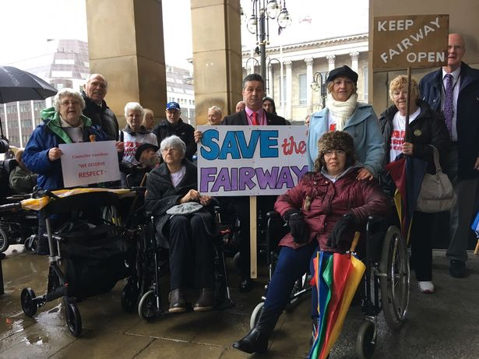
Case study 2: Fairway Day Centre
We acted for Jane, one of 70 disabled adults who used Fairway Day Centre in Birmingham
Jane has cerebral palsy and attends Fairway four days a week
Birmingham City Council decided to close Fairway – but without properly consulting users or their families (despite saying it would do so)

Slide 31
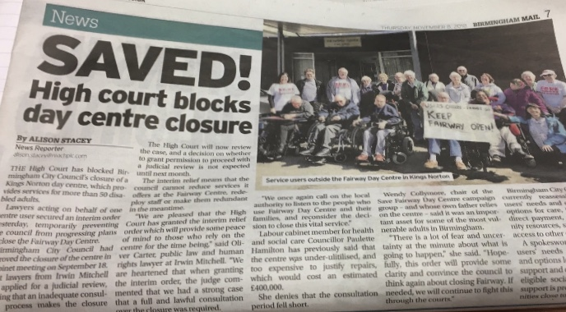
Case study 2: Fairway Day Centre
We sent a pre-action letter and, after the council refused to back down, filed an application for judicial review
We asked the court for interim relief: an urgent order to prevent the council from closing Fairway until the court heard the case
The court granted the interim relief… and the council backed down!

Slide 32
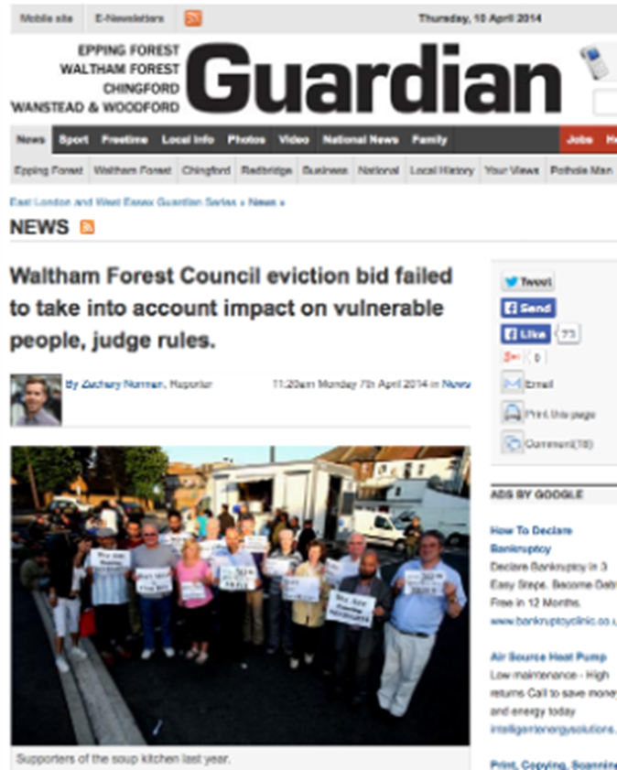
Case study 3: Saving a soup kitchen
We acted for two homeless users of a soup kitchen, and the charity which ran it
The council decided to stop the soup kitchen using the publicly-owned car park which it had operated from for years
The court found that the council’s decision was in breach of the Public Sector Equality Duty (s149 of the Equality Act), and it was quashed

Slide 33
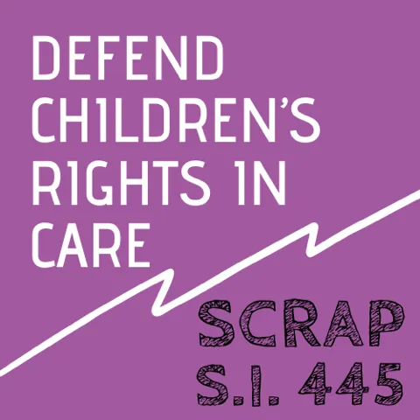
Case study 4: Article 39 v the government
We are acting for Article 39, a children’s rights charity, in a challenge to Regulations which remove or dilute safeguards for children in care
Statutory Instrument 445: the Adoption and Children (Coronavirus) (Amendment) Regulations 2020

Slide 34
Case study 4: Article 39 v the government
Article 39 say the changes are a disproportionate response to the Covid-19 crisis and significantly increase risk to vulnerable children
In the judicial review, we argue the Department for Education failed to carry out a lawful consultation before bringing in the Regulations

Slide 35
Case study 4: Article 39 v the government
High Court judgment:
“In anything less than a national crisis of quite such urgency I would have been minded to find that the consultation was not lawful if the (Children’s) Commissioner was not consulted. However, given the very particular focus of what the Defendant had to decide in amending the 2020 Regulations, the extreme urgency and the scale of the issues facing the Defendant in March-April 2020, I do not think there was an error of law in not consulting either the Commissioner or the Claimant.”
…but we were granted permission to appeal to the Court of Appeal, and the case was heard in September – watch this space

Slide 36
Q&A

Slide 37
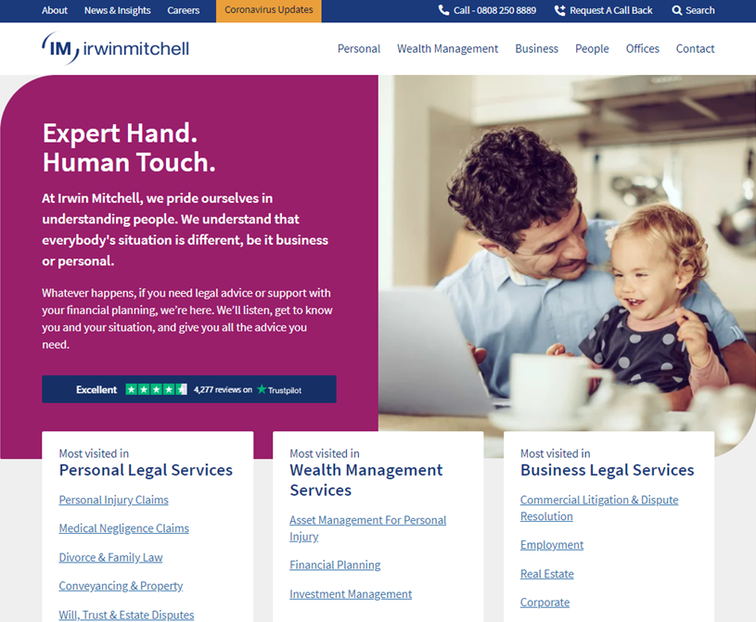
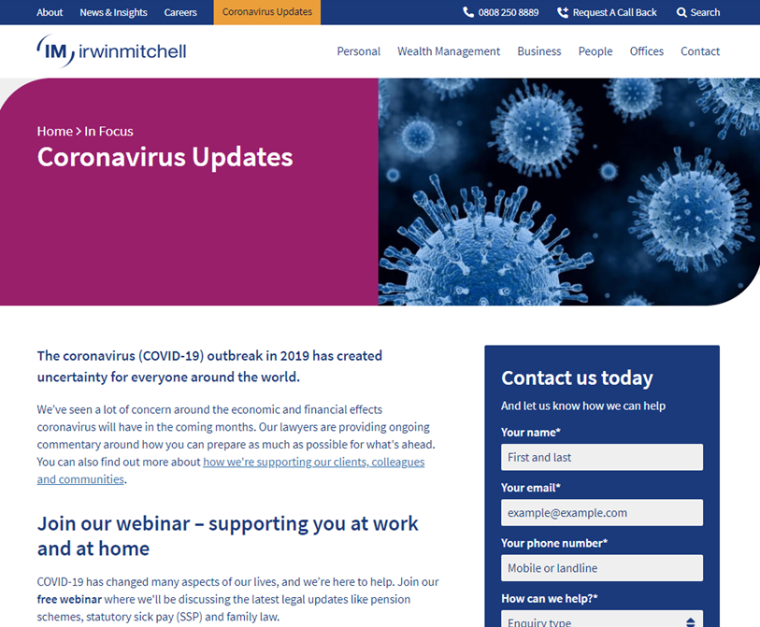
irwinmitchell.com

Slide 38
Contact
Oliver Carter
Solicitor
Oliver.Carter@IrwinMitchell.com

