Slide 1
How CQC is improving the way it regulates closed culture services
Mary Cridge
Deputy Chief Inspector of Adult Social Care
Be More, Doing More, Becoming More, 30 October 2020
Notes:
1

Slide 2
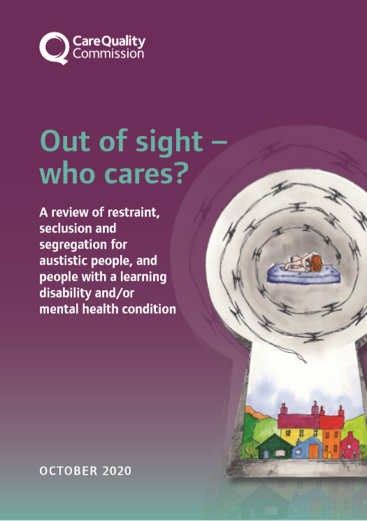
Our purpose and role
We make sure health and social care services provide people with safe, effective, compassionate, high-quality care and we encourage care services to improve
Register
Monitor and inspect
Use legal powers
Speak independently
Encourage improvement
People have a right to expect safe, good care from their health and social care services
#OutOfSight
Notes:
Our purpose remains the same – our focus and drive behind all that we do.

Slide 3
Introduction
This report:
Tells the story from the people who have experienced restraint first hand
Describes what we found about the current state of the care for children, young people and adults who have diverse needs
..and that are subject to restrictive interventions and who are cared for in a range of settings
However, our findings have implications and learning for settings that support people who have a mental health condition and/or who are living with dementia
#OutOfSight
Notes:
Concerns about the use of restrictive practices and people being segregated are not new. Since the Mansell report in 2007, there have been many reports that have highlighted similar issues, especially around the care for people with a learning disability or autistic people.

Slide 4
Our findings: Review of restrictive practices and advocacy
Access to high-quality advocacy varied and the role of an advocate was not consistent.
In some cases, there was no evidence that advocacy had been offered to people.
There was some confusion between the provider and commissioner about who the advocate was, or which organisation provided the services.
An advocate was not always informed of certain people on the ward.
Advocates were also under pressure themselves and felt they did not have enough time to support everyone that they were responsible for.
#OutOfSight
Notes:
Page 18 of the report
During our thematic review of restrictive practices, we found that:
Access to high-quality advocacy varied and the role of an advocate was not consistent.
In some cases, there was no evidence that advocacy had been offered to people.
There was some confusion between the provider and commissioner about who the advocate was, or which organisation provided the services.
An advocate was not always informed of certain people on the ward.
Advocates were also under pressure themselves and felt they did not have enough time to support everyone that they were responsible for.
Even when people did have access to advocates there were examples :
where advocacy was of a poor quality,
where advocates were not upholding people’s rights.
where advocates were not always engaged in decisions about the person’s care.
Off the back of our report on restrictive practices we made some relevant recommendations around advocacy, including ensuring that:
An investment and an action plan should be developed to ensure that all autistic people, and people with a learning disability and/or mental health condition have access to an independent advocate. This will need adequate resourcing and specialist training for advocates. This must expand on the recommendation of the Independent Review of the Mental Health Act and also apply to those who are informal patients and those receiving social care who have their liberty restricted under legislation.
CQC must check on how services give access to advocacy and involve people and their families in care.
People, their families and advocates must be involved in the development of services and care plans.

Slide 5
Jen’s story – an opportunity for the future
Jen had been moved around different hospitals, before being transferred to a hospital over 200 miles away from her home because of the step-down pathway it offered.
However, her clinical commissioning group (CCG) had serious concerns about having to place her so far from home and so commissioned their own advocate to act as their “eyes and ears”….
#OutOfSight
Notes:
Page 19 of the report:
During our review, we saw what a best practice model of advocacy would look like. It had been specifically commissioned for Jen, who had been in hospital for many years. Many of the advocacy examples we found were not like this, and advocates were often spread across multiple people, and may have lost touch with people when they moved services. We describe Jen’s story below;
Jen had been moved around different hospitals, before being transferred to a hospital over 200 miles away from her home because of the step-down pathway it offered. However, her clinical commissioning group (CCG) had serious concerns about having to place her so far from home and so commissioned their own advocate to act as their “eyes and ears”.
The advocate saw Jen once a week, initially focusing on building a relationship with her, and then spending time in her company, talking to her or directly observing her care. The advocate made a point of reading Jen’s notes and speaking to the ward staff before attending her ward round to ask questions of Jen’s care team and advocate her wishes.
In doing this, the advocate became increasingly knowledgeable about Jen and built up a relationship whereby Jen felt safe to tell her things or she was able to act in Jen’s best interests.
The advocate challenged some of the daily restrictions in Jen’s environment and in her routine, and also raised safeguarding alerts where she believed the standard of her care fell short of what was required.
Because of the amount of time Jen has spent in hospital, the advocate played an active role in escalating her case to external agencies.

Slide 6
Advocacy in closed cultures
Our ‘identifying closed cultures guidance’ for inspectors includes:
When to speak to advocates on inspection and during monitoring activity
How to request contact details so the inspector can email, phone or video call advocates to interview them
We are looking at how:
inspectors work with advocates
to ensure people are enabled by providers to speak confidentially to an advocate
to set up more formal arrangements with local advocacy groups
#OutOfSight

Slide 7
Questions and closing remarks
Thank you and any questions?
Mary Cridge
Deputy Chief Inspector of
Adult Social Care
www.cqc.org.uk
enquiries@cqc.org.uk
@CareQualityComm
#StateOfCare
#OutOfSight www.cqc.org.uk/rssreview

