Slide 1
Two Men & a Dog?
A story of Shared Lives and Connected Lives.
From Institution to Community.

Slide 2
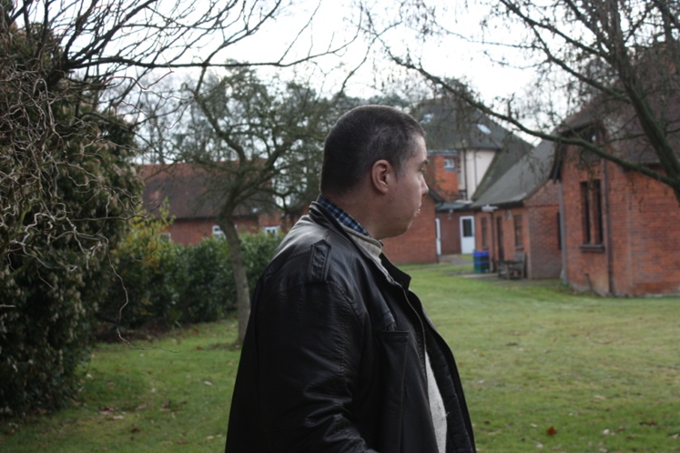
Chalfont
Two Men & a Dog
‘I didn’t get the support when I needed it’
‘Boring, I was always doing the same thing, walking around the centre’

Slide 3
Chalfont
Two Men & a Dog
‘My bedroom and the place where I spent a lot of my time’.

Slide 4
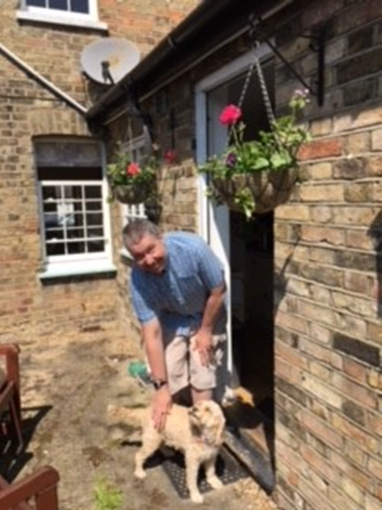
Two Men & a Dog
New House
I didn’t think I would ever get my own house’.
‘I went with Andy and the family to choose Bronte and she runs up stairs and jumps on my bed nearly every morning’

Slide 5
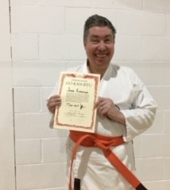
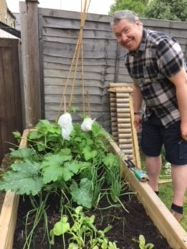
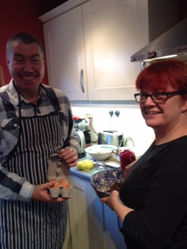
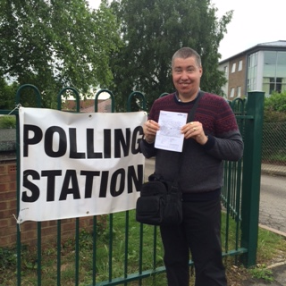
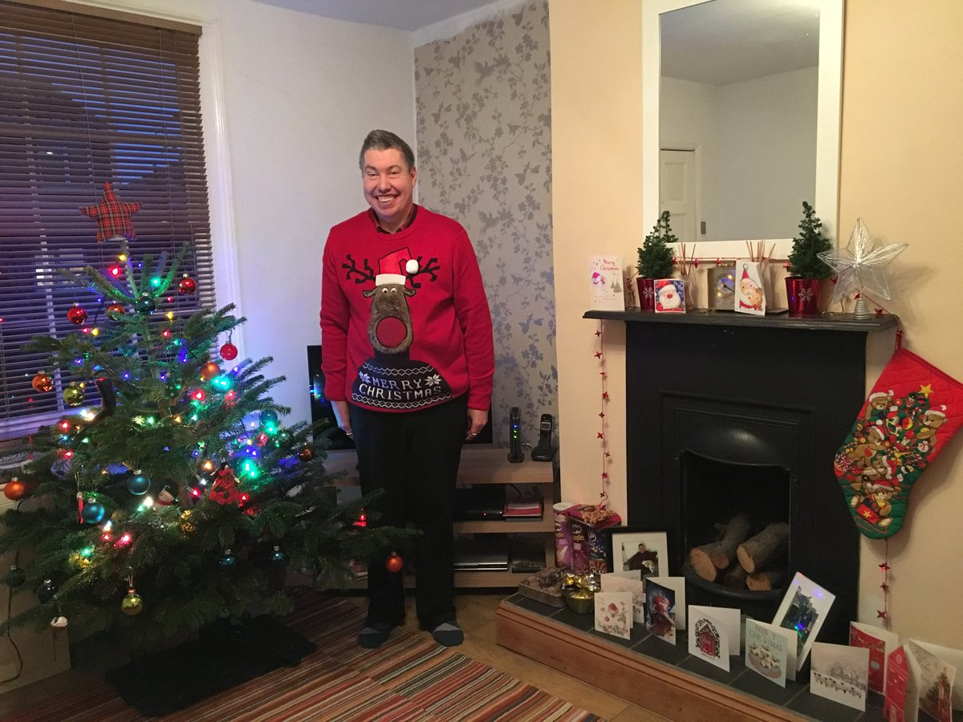
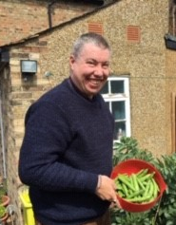
Home
Two Men & a Dog

Slide 6
Our lives get better when they’re shared
Share your story

Slide 7
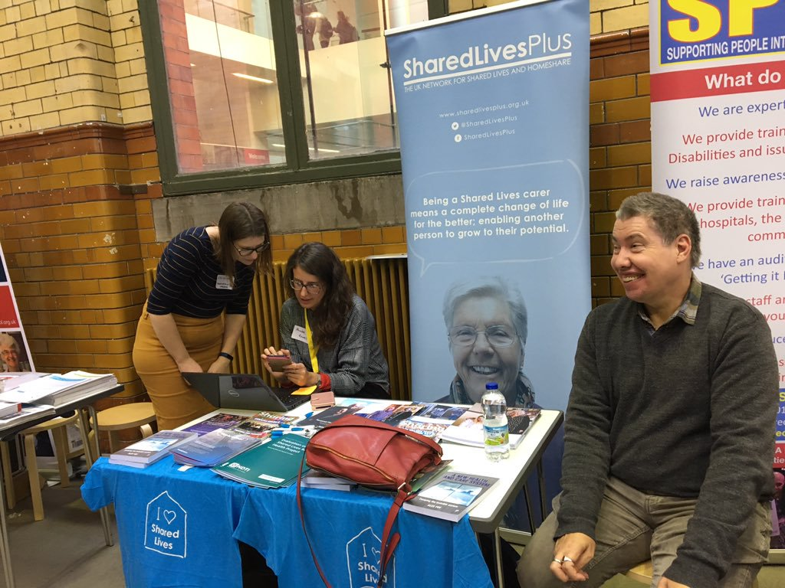
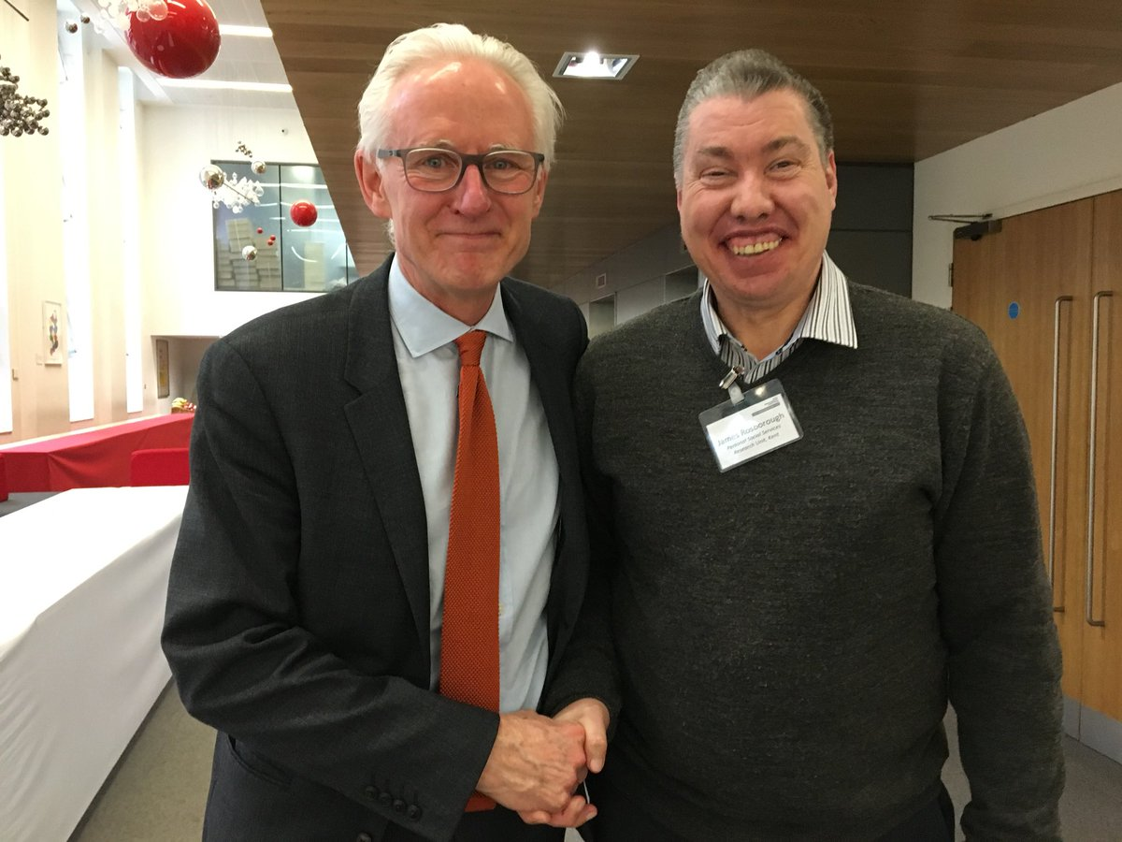
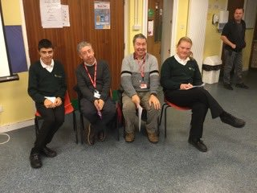
Ambassador
Two Men & a Dog

Slide 8
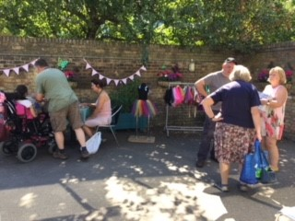
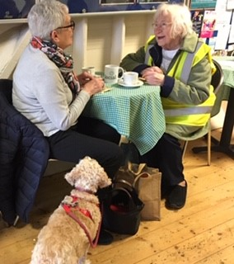
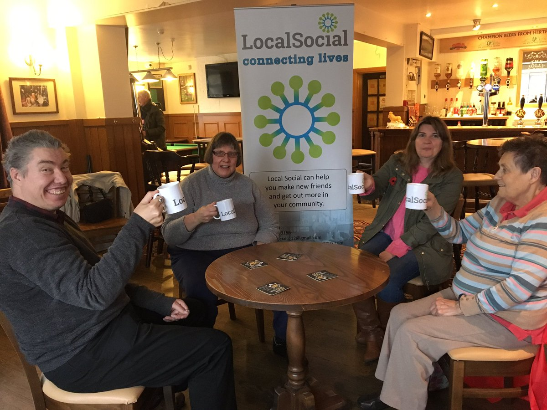
Community ‘I like to be part of things’
Two Men & a Dog

Slide 9
‘My health has got a lot better’.
Two Men & a Dog?
‘…..the improvement in James’ seizure disorder and dissociative episodes has arisen through building his confidence and independence’.
Consultant Neurologist Sept 2108

Slide 10
Any Questions
Two Men and a Dog?

Slide 11
Andy Cooke & James Rosborough
andy@sharedlivesplus.org.uk

