Slide 1
Making Positive Moves: Finding out how to support community living after moving under Transforming Care
Louisa Rhodes
Sam Prowse
Kirsty Warrack
Silvana Mengoni
Helen Ellis-Caird
Annabel Head
David Wellsted
Pashtana Zormati
Peter Langdon
Lauren Taber

Slide 2
What is Transforming Care?
Media coverage of abuse of people with learning disabilities in a privately-run hospital – Winterbourne View, 2011
Review found that there was a lack of assessment or treatment in inpatient services and people often remained in these settings for longer than necessary
‘Transforming Care’ was set up by NHS England in 2012
Aim to support people with learning disabilities (LD) and/or autism to move from living in inpatient settings to the community
Lack of evaluations focusing on the perspectives of people who have moved
Notes:
The yearly cost of inpatient care for people with learning disabilities is estimated to be approximately £115,000 per person more expensive than community living (NAO, 2017).
3250 people in in-patient settings in 2012
2500 people in in-patient settings in 2017

Slide 3
Update on Transforming Care
Review of Transforming Care has identified targets not met. Still 2000+ people with learning disabilities in inpatient settings.
Further abuse scandals in the news
Eldertree Lodge,
Whorlton Hall
Next phase of transforming care
Building the Right Support

Slide 4
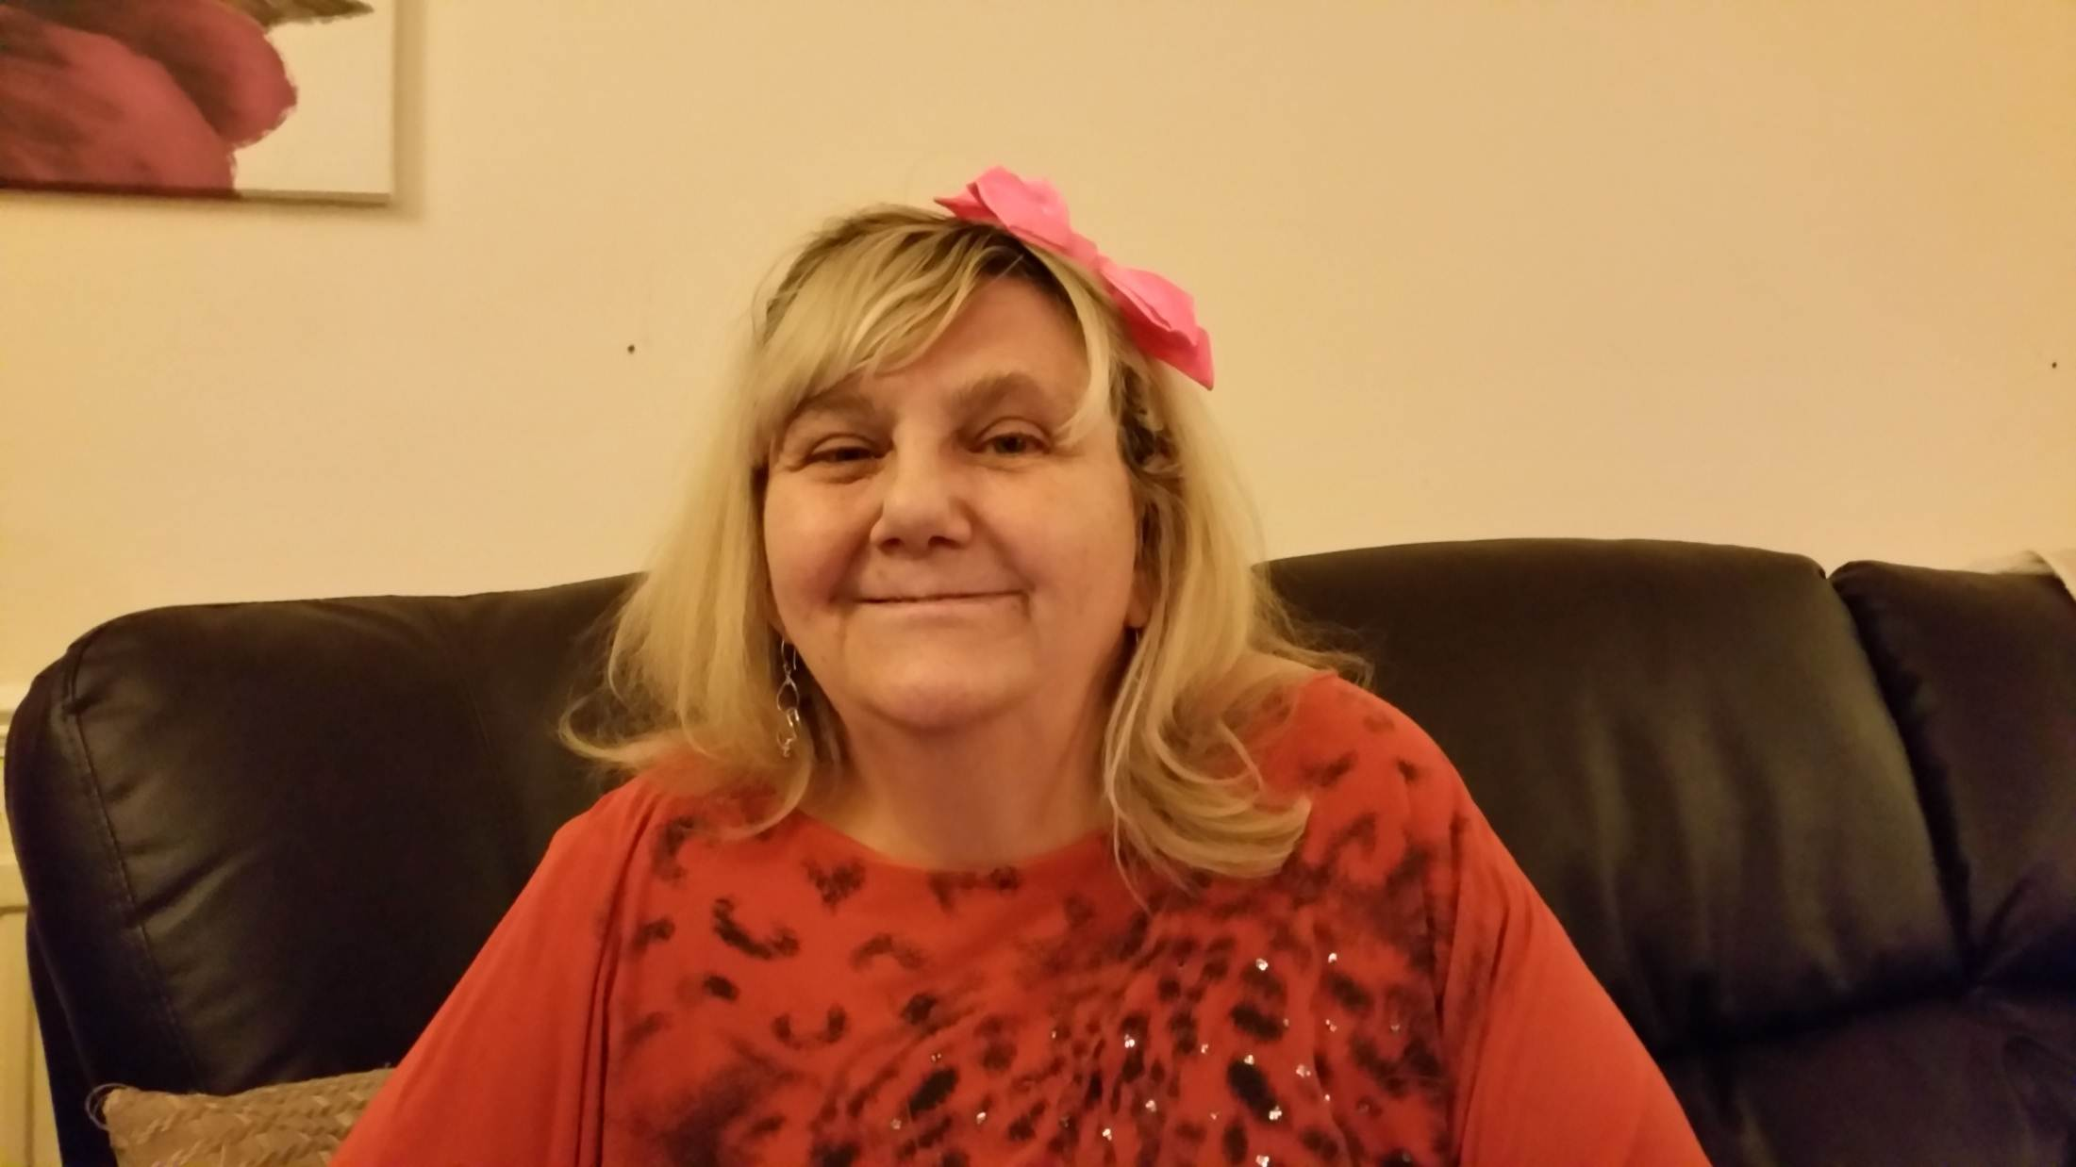
How the project began
Our Inspiration: Joan’s Story
https://www.youtube.com/watch?v=eIC6mfEMD7E

Slide 5
The ‘moving process’
UH DClinPsy project
Aim to explore how people with learning disabilities experienced moving under Transforming Care

Slide 6
How we found things out
11 people with learning disabilities were interviewed twice
‘Internalised other’ interviewing with Key Support Person
KSP was interviewed “as if” they were the person who had moved
Grounded Theory
Aim to generate a theory from data
Simultaneous data collection and analysis
Theoretical sampling
Tell me about where you lived before you lived here
Did you make any choices about your move?
What is a typical day like now?

Slide 7
What did people tell us?
Notes:
People talked about being ‘naughty’ and being defined by some aspects of their behaviour, and how behaviour was seen by carers. This led to a sense of a restricted identity in inpatient settings.
Going through transitions could mean a loss of important relationships, for example with staff at the inpatient setting or other service users. However, this was countered by gaining new relationships through the move, or re-establishing existing ones. Often people had lived far away from friends and family during their time in hospital
In community settings, people spoke about how they were treated differently, for example no longer like patients. This was important to changing the way people saw themselves and adapting to their new life.

Slide 8
“Behave yourself. And do the treatment. And you’ll get out. If you’re good. If you’re bad – forget it.”
Interviewer: And how did [new staff when you transitioned] get to know you, did they ask you questions about you and your life? Did they hang out with you?
Fred: They have to check all the paperwork, and make sure any risks and things.
“if you do anything wrong . Like try and get out. … they’d used to press the alarm, and then you’d get the staff from all over the ward coming in. And then they used to pin you down, and then they used to give you an injection to keep you quiet.”
Interviewer: What sort of person were you when you lived in the unit?
Larry: Terrible
Interviewer: Why was that?
Larry: Naughty man.

Slide 9
“I’ve been given a chance. To prove myself. And I’ve proved it. So… That means I stay here. And get on with my life” (laughs)
“I get very irritable. Cos I know that I shouldn’t be in hospital. I’m not unwell, you know. I know when I’m unwell. But, I told the doctor that, I’m not unwell. I’m fine.”
“My friend Jerry… he lives in Ireland, I don’t know what part. I haven’t heard from him since I left. And, you know. I’d like to hear from him one of these days but I don’t think I ever will. “
“it’s hard, but… it’s very hard but…you’ve just got to do it. Coming out of hospital into a flat is a very big, scary thing. “

Slide 10
“Obviously I have my bad days. And they’re always gonna stay with me. But when people understand my bad days. And they compensate. And they know how to treat me well when I’m having a bad day. I find it much easier to come out of that bad place. Than if I’m just ignored, or shut in a room, or-, there’s nobody there to guide me or talk to me.”
“Every time we was in a meeting [Mum] goes ‘oh I’m so proud of you TJ’… it was really nice to hear, and made me want to carry on doing what I’m doing so. Really, you know, really commit to it.”
Pamela: We were treated like patients.
Interviewer: What does that mean to you, to be a patient?
Pamela: Horrible… it made me feel that I couldn’t do anything for myself.
Interviewer: What do you feel like now?
Pamela: Really good, I can do things myself now. They don’t treat me like a little kid.
Interviewer: And what sort of person are you now?
Larry: A normal man
Interviewer: What does that mean?
Larry: I’m a good man.

Slide 11
Conclusions
Moving out of hospital is a process of adjustment.
Everyone needs a personalised approach to their move
Communication needs to be good.
Important to consider emotional and relational aspects of moving alongside the practical.
If the right package of support is in place, people can thrive in community settings.

Slide 12
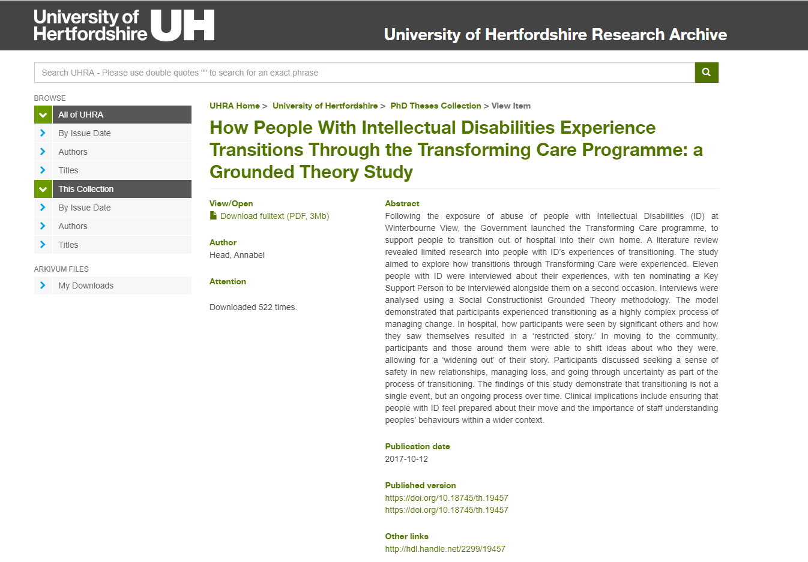
https://uhra.herts.ac.uk/handle/2299/19457
Head, A., Ellis‐Caird, H., Rhodes, L., & Parkinson, K. (2018). Transforming identities through Transforming Care: How people with learning disabilities experience moving out of hospital. British Journal of Learning Disabilities, 46(1), 64-70.

Slide 13
Small group discussion
In groups have a discussion about how the findings we have shared relate to your work as advocates.
Please take some notes on the paper provided and identify a spokesperson to share your ideas with the wider group.

Slide 14
Making Positive Moves – the ‘living process’
What do we want to find out?
What is it like to live in the community after moving under Transforming Care
What helps people to stay living in the community long term
What makes it harder to stay living in the community long term

Slide 15
How have we done the research?
We have talked to 24 people with learning disabilities who have moved from mental health hospitals to the community
We have talked to people who live in different places in England
We talked to people twice
By themselves
By themselves or with a Key Support Person, depending on their choice
We talked to people again after one year to learn about any changes
17 people talked to us at both times

Slide 16
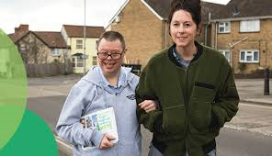
What do we hope the research will do?
Reduce admissions and re-admissions to hospital
Improve quality of life for people with learning disabilities living in the community.

Slide 17
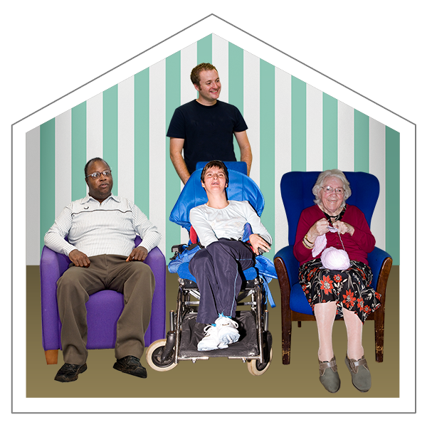
What have people told us?
Our participants have told us so much about their lives in their communities after moving as part of Transforming Care. The main themes have been around:
Wanting an ordinary life
Fitting into the expectations of society
Learning to ‘play the game’
Feeling safe
Getting used to life outside of hospital
Safety in my home
Feeling ‘safe’ and secure in the relationships I have now
Feeling supported to enjoy life outside of hospital
Processes about my changing sense of self
who am I, now in the community, having been through what I have been through?
How do I make sense of myself in relation to other people, my past, the future?

Slide 18
"I do what I have to do, then I'm like, well, this just feels so much better than bloody being in there, you know what I mean?"
What are some of the things that have helped people to stay in their communities?
Our final analysis will be complete over the next two months. There are lots of findings but for today we will share some quotes which might answer the main question of our research.

Slide 19
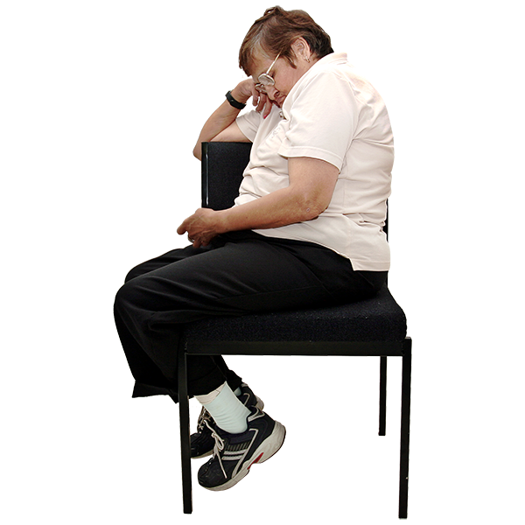
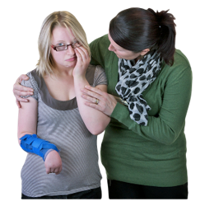
1. Staff giving me the right support; a person-centred plan
Interviewer: Do the staff do anything that's helpful now on a bad day?
Chris: Erm, if I - if I'm having a bad day, er, they just, leave me to it, erm, and when I'm ready to, to, er, to chat about.
Interviewer: Yeah. …. And is that helpful, do you find?
Chris: Very helpful, yeah.
Sabrina: They're helpful because they - they know when I need to talk, they know when I need to be on my own. …. They're getting - some people get to know me a bit more, so they know my sense of humour and everything.

Slide 20
2. Feeling accepted; people understanding me in the context of my past; better understanding of behaviours:
Interviewer: what are the most positive things that you think have happened, since you've moved out?
Max: Well, being with nice support. Being with nice support people. And for them to understand that I have been through difficult times, and they know that, and when they read my care plan, they do not judge people, that they take people as they see them. I'm always scared when staff read my care plan, because what things I've done. But I can't - I can't really change and staff say, well, you're in a better place now, Max, and that's it!

Slide 21
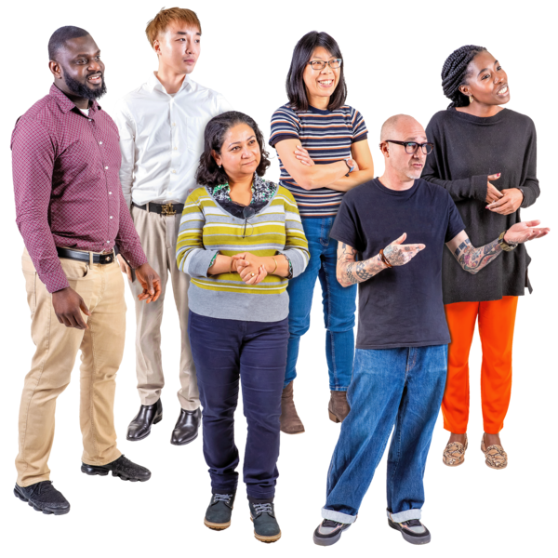
3. Talking more (to staff) about what is bothering me:
KSP: But what happens when that gets difficult? What - what is the management plan you can have for that?
Mary: Talk to the staff…. And that's what I'll do, talk to the staff.
Interviewer: what does it feel like now, talking more to people?
Larry: I feel much better. Happier.

Slide 22
4. Learning to live within (tolerate) the restrictions I still have:
Sabrina: Well, they say I've got a choice… But I've told myself, listen to what they're saying.
TJ: there's no point me sitting here moping and smashing my place up, just because I can't do these things. I might as well just accept it, and just have to move on with it

Slide 23
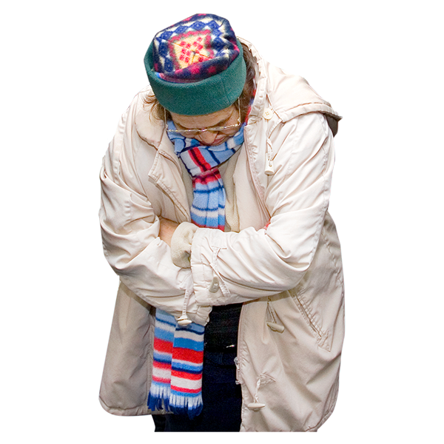
5. Managing “being on edge” [without acting in ways that will find me back in hospital]
Max: It's a totally new game, is when you go into supported living, you're frightened of what the staff are actually thinking about you… it's like you are really scared, but until the staff get used to… Until the staff get used to you, then you're on edge… Then you're on edge all the time.

Slide 24
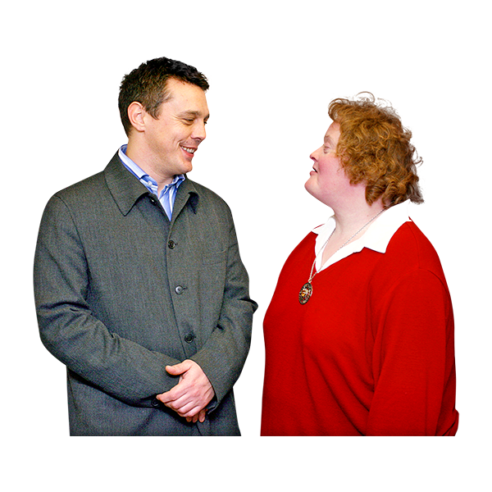
6. Being listened to and having my needs met [without the need for “behaviours that challenge”]
Interviewer: do you ever feel you need to run away from where you live now?
Pamela: No.
Interviewer: How come?
Pamela: Because I feel relaxed, and I feel the staff believe me, and they talk to me and they help me. You know what I mean? And it - it felt… …. I don't know, it felt really company. It really felt lovely that I'd got my freedom. I don't feel - …. I don't feel like hurting myself.

Slide 25
6. Being listened to and having my needs met [without the need for “behaviours that challenge”]
Interviewer: I'm trying to understand, for other people who have moved out of hospital and living in the community. You know, your experience right now is really important…to understand why has it not worked this time?
Lisa: I just - I just feel like they don't listen, and I'm still part of there, and… I just basically want people to listen to me, and I'm like, I'm like, oh, if I go for different scenarios, I… Oh, if I cut my wrist open at dad's house, they won't let me stay there, and they'll make me go back to the [previous] house. And I said if they make you go to the house, I'll cut my wrist wide open and they'll, maybe they'll listen, basically, and get me a [new] house, if I don't die first.

Slide 26
Small group discussion
In groups have a discussion about how the findings we have shared relate to your work as advocates.
Please take some notes on the paper provided and identify a spokesperson to share your ideas with the wider group.

Slide 27
What next?
We are still reading the interviews and making sense of these
We will write a model about what we found
We are working hard to understand how to share the findings so they can have an impact on the way care is delivered.

Slide 28
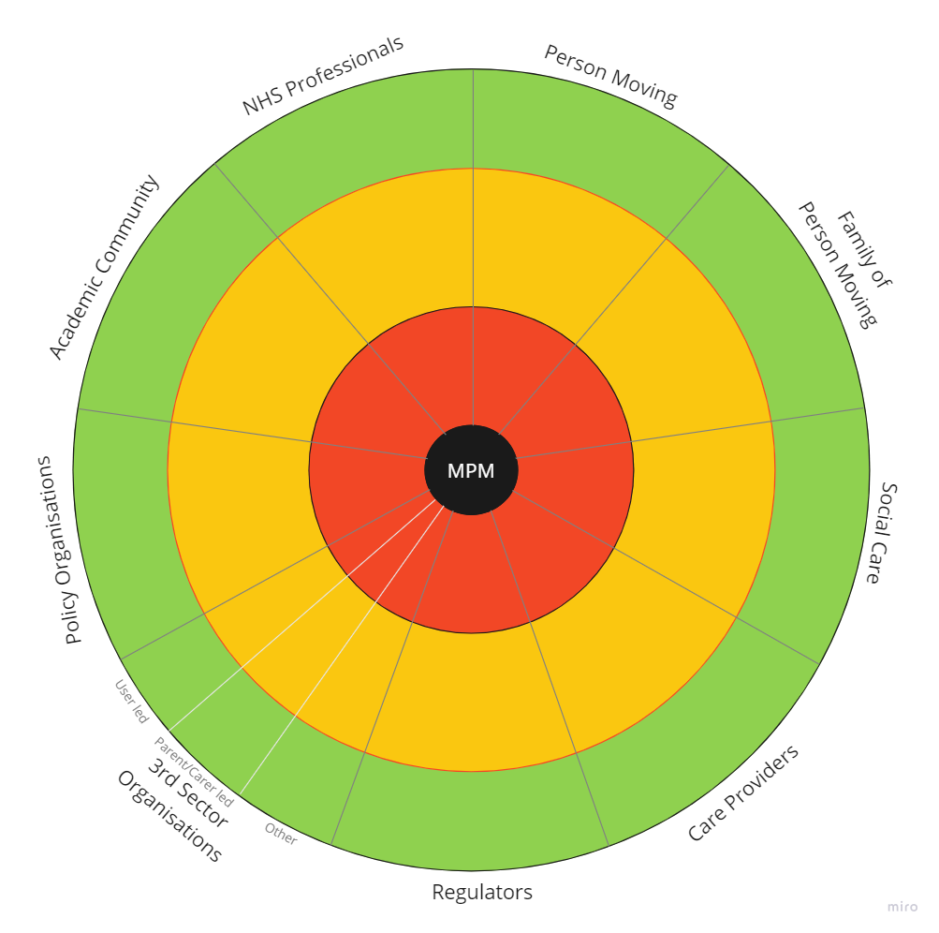
takS
Stakeholder Mapping

Slide 29
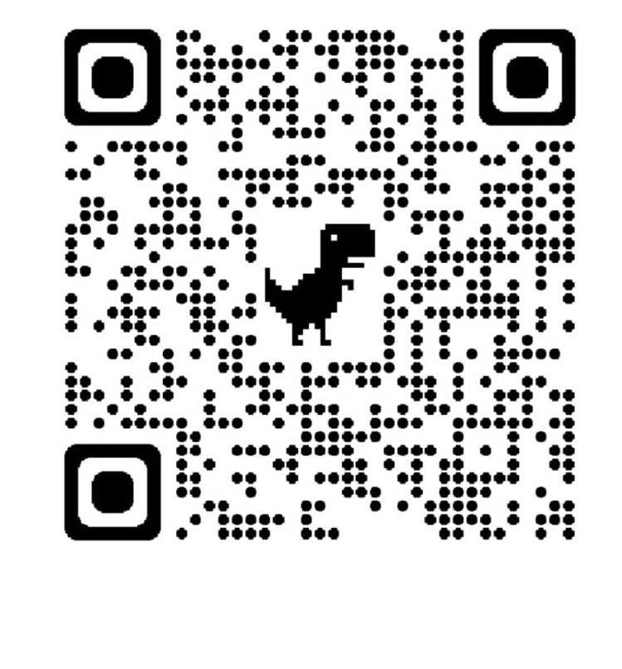
www.makingpositivemoves.org

Slide 30
hello@makingpositivemoves.org
@moves_positive @makingpositivemoves Making Positive Moves
This study is funded by the National Institute for Health Research (NIHR) Research for Patient Benefit (PB-PG-1217-20032). The views expressed are those of the author(s) and not necessarily those of the NIHR or the Department of Health and Social Care.

