Slide 1

Depriving Children and Young People of liberty lawfully
A broken system
Ventura House
Market Street
Hoylake CH47 2AE
0151 632 6699
peter@peteredwardslaw.com
November 2023

Slide 2



PETER EDWARDS
Director of Peter Edwards Law
Law Society Accredited ALR (Health and Welfare)
Fellow of the Royal Society of Medicine
Visiting Senior lecturer
Editorial board of International Journal of Human Rights in Healthcare
Nominated Mental Health Lawyer of the Year
Director: Peter Edwards Law Training
Teacher and Broadcaster
Working with Jersey government
Sponsor of outstanding advocate of the year
Past Appointments:
  President Mental Health Lawyers Association
  Director IMHL
  Consultant to Solicitors Regulation Authority
  Legal Consultant WHO
  Trainer in Gibraltar, the Isle of Man
  Member of World Federation Mental Health Human Rights Committee
  Law Society Chief Assessor MHRT Panel
  President of mental health charity: Imagine
  Member of Central Policy Committee of MHA Commission
  Member Mental Health and Disability Committee
  Member NACRO Advisory Committee
  Member of MIND Council of Management

Slide 3

As well as team in North West / North Wales
Two MCA ALR (Welfare) accredited solicitors
Solicitors based in Lancashire and London areas
MHT’s
MCA
Court of Protection
  S.21A appeals
  Welfare and capacity challenges
Financial deputyship

Slide 4


Slide 5
MacDonald J in Lambeth v L
LAs are under a duty to consider whether children who are ‘looked after’ are subject to restrictions amounting to a DoL
A LA will plainly leave itself open to liability in damages, in some cases considerable damages, under the HRA 1998
if it unlawfully deprives a child of his or her liberty
by placing a child in a placement without, where necessary, first applying for an order authorising the DoL.

Slide 6
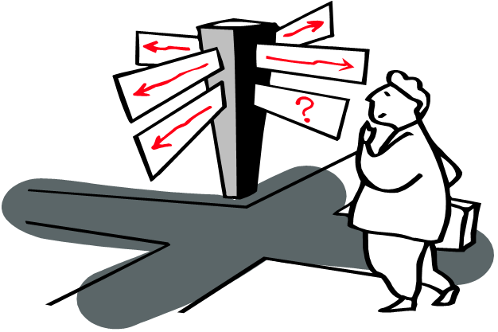
Age
Child - up to 15
Young person – 16/17
MHA detention – No lower limit
MCA DoLA – 18
MCA Court of Protection – 16
Inherent jurisdiction – no lower limit
Children Act s.25 – No lower limit
Parental consent – No lower limit (qualified)
  Does age affect whether it is a DoL?

Slide 7

P (by the Official Solicitor) v Cheshire West and Chester Council, and
P & Q (or MIG & MEG)(by the official Solicitor) v Surrey County Council
[2014] UKSC 19.
Supreme Court
“The most far-reaching human rights case heard in the UK for a decade.”
Simon Burrows

Slide 8
MIG and MEG sisters first became subject of care proceedings under the Children Act 1989 in 2007, when they were aged respectively 16 and 15.
MIG LD lower end of moderate range or upper end of the severe range.
Problems with her sight and her hearing.
Communicates with difficulty and has limited understanding, spending much of her time listening to music on her iPod.
She needs help crossing the road because she is unaware of danger.
MEG LD at the upper end of the moderate range, bordering on the mild
Communication skills are better than her sister's and her emotional understanding is quite sophisticated.
Nevertheless, she may have autistic traits and she exhibits challenging behaviour.
At time of hearing
MIG 18 MEG 17

Slide 9
At para 57, Lady Hale states that:
  “because of the extreme vulnerability of people like P, MIG and MEG,
  I believe we should err on the side of caution in deciding what constitutes a DoL in their case.
  They need a periodic independent check on whether the arrangements made for them are in their best interests …..
  [but we should not]regard the need for such checks as in any way stigmatising of them or of their carers.
  Rather, they are a recognition of their equal dignity and status as human beings like the rest of us.”

Slide 10
The acid test
Proposed by Lady Hale (49) is that of
  a combination of continuous supervision and control
  and a lack of freedom to leave
Lord Neuberger (63) expresses his agreement with Lady Hale,
  “the twin features of continuous supervision and control and lack of freedom to leave are the essential ingredients of deprivation of liberty (in addition to the area and period of confinement).”

Slide 11

HUMAN RIGHTS

Slide 12
UN Convention on the Rights of the Child
UK signed 19 April 1990, ratified it on 16 Dec 1991 and it came into force on 15 Jan 1992.
Article 9
1. States Parties shall ensure that a child shall not be separated from his or her parents against their will,
  except when competent authorities subject to judicial review determine,
  in accordance with applicable law and procedures,
  that such separation is necessary for the best interests of the child.
Such determination may be necessary in a particular case
  such as one involving abuse or neglect of the child by the parents,
  or one where the parents are living separately and a decision must be made as to the child's place of residence.

Slide 13
Article 20
1. A child temporarily or permanently deprived of his or her family environment, or in whose own best interests cannot be allowed to remain in that environment,
  shall be entitled to special protection and assistance provided by the State.
Article 25
States Parties recognize the right of a child who has been placed by the competent authorities for the purposes of care, protection or treatment of his or her physical or mental health,
  to a periodic review of the treatment provided to the child and all other circumstances relevant to his or her placement.

Slide 14
Article 37 - States Parties shall ensure that:
  (b) No child shall be DoL unlawfully or arbitrarily
    The arrest, detention or imprisonment of a child shall be
      in conformity with the law and shall be used
      only as a measure of last resort and for the
      shortest appropriate period of time;
  (d) Every child DoL shall have the right to prompt access to legal and other appropriate assistance
    as well as the right to challenge the legality of the DoL before a court or other competent, independent and impartial authority,
    and to a prompt decision on any such action.

Slide 15
ARTICLE 5 - Right to liberty and security
Article 5(1) – “Everyone has the right to liberty and security of person.
No one shall be DoL save in following cases and in accordance with a procedure prescribed by law.”
Article 5(1)(e) – “The lawful detention of persons for the prevention of the spreading of infectious diseases, of persons of unsound mind, alcoholics or drug addicts or vagrants.”
Notes:
Seclusion
A v UK friendly settlement
Dhoest v Belgium Commission noted that it would not normally consider the segregation for security, protective or disciplinary reasons as part of criminal proceedings as breach.
However, McFeely v UK all the circumstances need to be constantly reviewed.
Matters such as conditions,justification, and duration need to be monitored.
Treatment
Herczegfalvy v Austria forcibly given food and medication whilst handcuffed to bed not breach.
‘The Court must nevertheless satisfy itself that the medical necessity has been convincingly shown to exist.’
Very difficult to establish art 3 breach re treatment.

Slide 16
Article 5(2) – “Everyone who is arrested shall be informed promptly, in a language which he understands, of the reasons for his arrest and of any charge against him.”
Article 5(4) – “Everyone who is DoL by arrest or detention shall be entitled to take proceedings by which the lawfulness of his detention shall be decided speedily by a court and his release ordered if the detention is not lawful.”
Notes:
Seclusion
A v UK friendly settlement
Dhoest v Belgium Commission noted that it would not normally consider the segregation for security, protective or disciplinary reasons as part of criminal proceedings as breach.
However, McFeely v UK all the circumstances need to be constantly reviewed.
Matters such as conditions,justification, and duration need to be monitored.
Treatment
Herczegfalvy v Austria forcibly given food and medication whilst handcuffed to bed not breach.
‘The Court must nevertheless satisfy itself that the medical necessity has been convincingly shown to exist.’
Very difficult to establish art 3 breach re treatment.

Slide 17

ARTICLE 6 - Right to a fair trial
6(1) - to a fair and public hearing within a reasonable time by an independent and impartial tribunal established by law.
6(3) - following minimum requirements to fair trial
  (a) be informed promptly in a language he understands the detail of
  the nature of the case against him
  (b) adequate time and facilities to prepare case
  (c) free legal representative when justice requires
  (d) to examine or have examined witnesses against him and to obtain the attendance and examination of witnesses on his behalf …
  (e) … free assistance of an interpreter …
Notes:
Seclusion
A v UK friendly settlement
Dhoest v Belgium Commission noted that it would not normally consider the segregation for security, protective or disciplinary reasons as part of criminal proceedings as breach.
However, McFeely v UK all the circumstances need to be constantly reviewed.
Matters such as conditions,justification, and duration need to be monitored.
Treatment
Herczegfalvy v Austria forcibly given food and medication whilst handcuffed to bed not breach.
‘The Court must nevertheless satisfy itself that the medical necessity has been convincingly shown to exist.’
Very difficult to establish art 3 breach re treatment.

Slide 18

Article 8: Right to respect for family life and privacy
1.Everyone has the right to respect for his private and family life, his home and his correspondence.
2.There shall be no interference by a public authority with the exercise of this right
  except such as is in accordance with the law and is necessary in a democratic society
  in the interests of national security, public safety or the economic well-being of the country, for the prevention of disorder or crime, for the protection of health or morals, or for the protection of the rights and freedoms of others.

Slide 19

CAN THE C or YP CONSENT TO DOL?

Slide 20
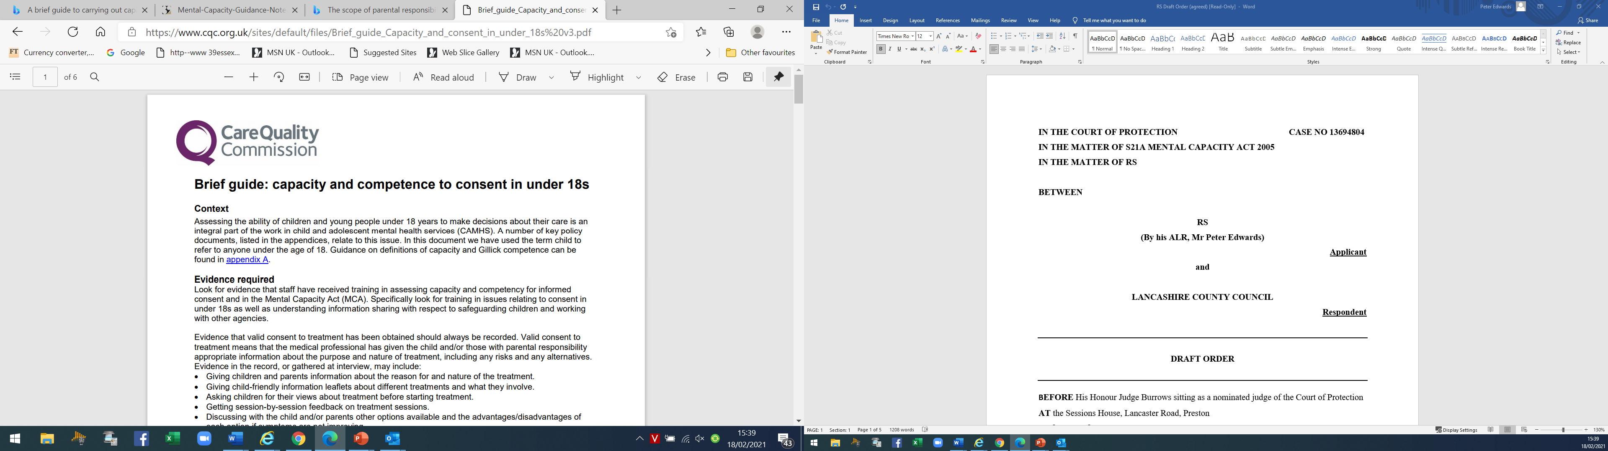
Brief_guide_Capacity_and_consent_in_under_18s v3.pdf (cqc.org.uk)

Slide 21
Evidence valid consent to treatment has been obtained must be recorded.
Means medical professional has given the child and/or those with PR appropriate information about purpose and nature of treatment, including any risks and any alternatives.
Evidence in the record, or gathered at interview, may include:
  Giving children and parents information about reasons for and nature of the treatment.
  Giving child-friendly information leaflets about different treatments and what they involve.
  Asking children for their views about treatment before starting treatment.
  Getting session-by-session feedback on treatment sessions.
  Discussing with the child and/or parents other options available and the advantages/disadvantages of each option if symptoms are not improving.

Slide 22

A BROKEN SYSTEM?

Slide 23
Re X (A Child) (No 3) 3.08.17 Sir James Munby
“One of the measures of a civilised society is how well it looks after the most vulnerable members of its society.”
If this is the best we can do for X, and others in similar crisis, what right do we, what right do the system, our society and indeed the State itself, have to call ourselves civilised?
The honest answer to this question should make us all feel ashamed
For my own part, acutely conscious of my powerlessness – of my inability to do more for X – I feel shame and embarrassment; shame, as a human being, as a citizen and as an agent of the State, embarrassment as President of the Family Division, and, as such, Head of Family Justice, that I can do no more for X.

Slide 24

“The entire staff group’s opinion that:
‘X’s goal is not to go to [her home town] it is to kill herself’
X’s intention to kill herself has ‘intensified’ in the past 2 weeks
The care plan to send her back to any community setting, especially [her home town] ‘is a suicide mission to a catastrophic level’.
Staff do not think it will take more than 24 to 48 hours before they receive a phone call stating that X has made a successful attempt on her life

Slide 25
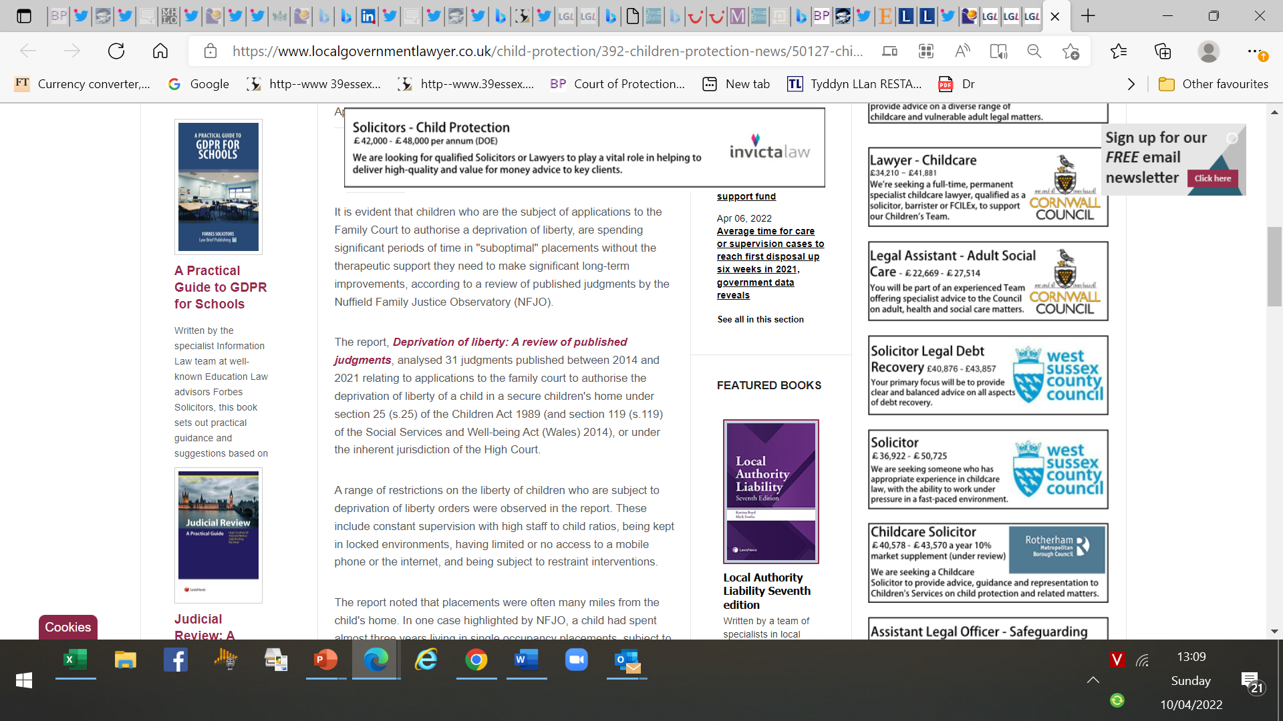
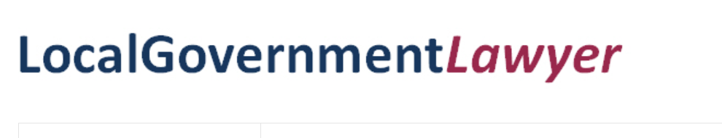
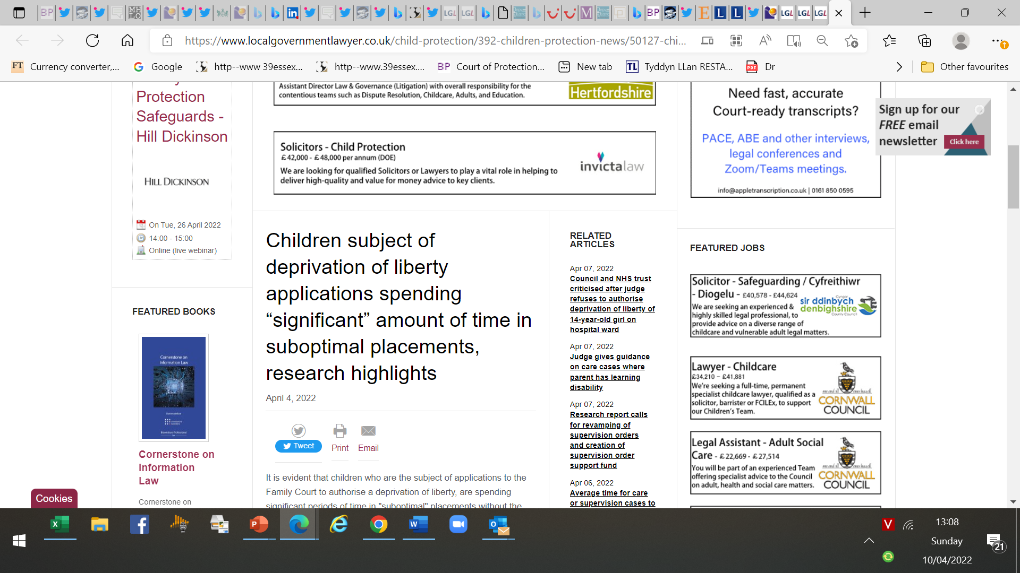

Slide 26
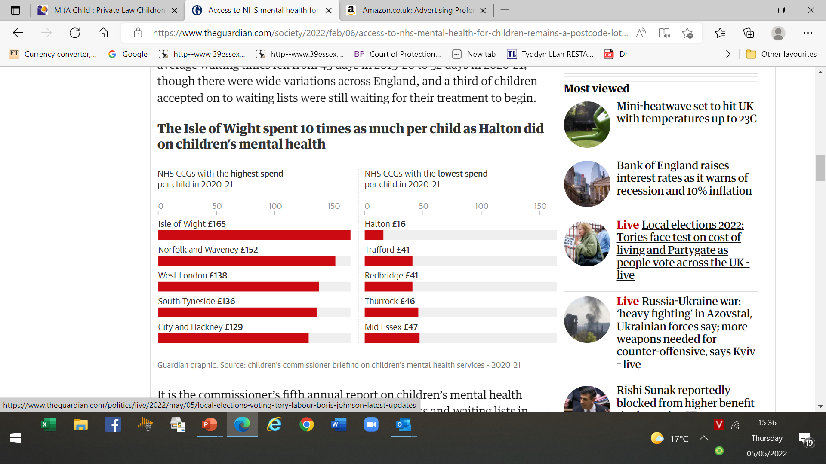
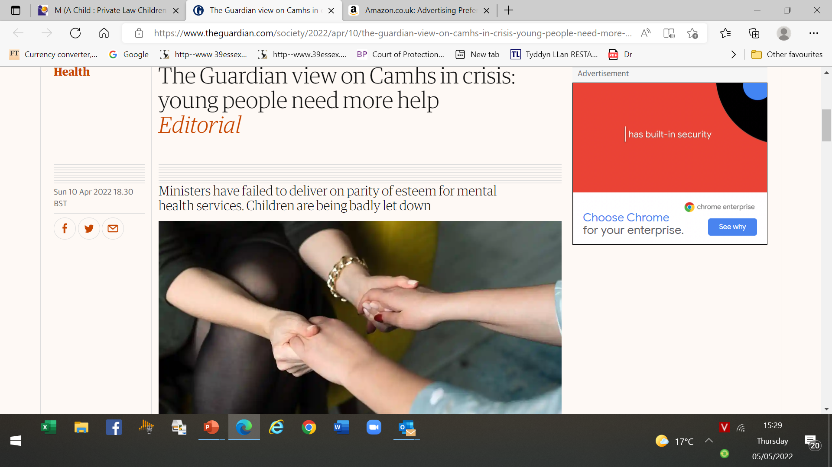


Slide 27
CAMHS in England (also in Wales) are overstretched to the point where YP in some areas are waiting up to 2 years for treatment.
A recent survey of GPs - half - most of their referrals of YP for conditions including anxiety and depression are rejected.
One CAMHS refused to take on a boy found with a ligature in his room because the fact that he had no marks on his neck meant that he did not meet the threshold for treatment.
Figures obtained via FOI request show average waiting times for autism referrals of 1½ at Coventry and Warwickshire NHS trust, with one child kept waiting for 5 years.

Slide 28

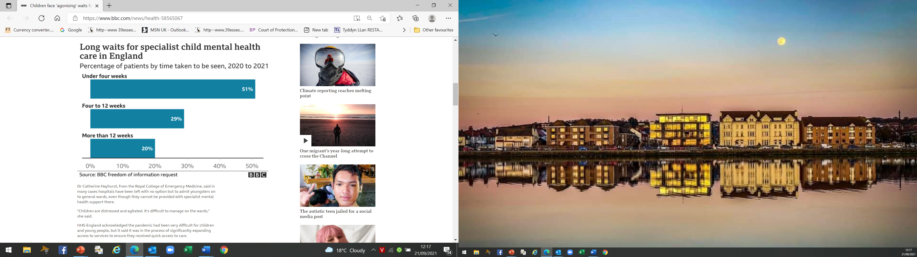

Slide 29

The ONLY “procedures prescribed by law” to provide lawful authority
1. MHA 1983 where applicable.
  May lead to an increase in MHA because degree or intensity of arrangements in most psychiatric units likely to give rise to confinement.
  Unlikely that there will be any place for informal admission for incapacitated 16/17 year olds on the basis of PC
2. S. 25 CA 1989 bearing in mind limitations
3. Order of the court. Whether CoP or IJ
For children who do not lack capacity
  In Re K (A Child) (Secure Accommodation Order: Right to Liberty) [2001] Fam 377

Slide 30

CAN PARENTS AUTHORISE A DOL?

Slide 31

In D (A Child), [2019] UKSC 42, Supreme Court (Lady Hale) 26.09.19
Scope of PR to consent for 16 / 17- which would otherwise amount to DoL in particular where lacks capacity
D born 1999. Diagnosed ADHD, Asperger’s and Tourette’s plus mild LD.
Age 14 admitted to mental hospital attended a school which was integral
Door locked and accompanied whenever he left the site.
Trust applied to Court for declaration - lawful for trust to deprive D of his liberty
Keehan J held DoL - but proper exercise of PR to consent while under 16.
Age 16 CoP for declaration consent of parents meant not DoL
Keehan J held parents could no longer consent MCA now applied.
Authorised placements as being in D’s best interests.
When 18 his DoL could be authorised under the DoLA

Slide 32

Obligation of State to protect human rights of children under the ECHR
PR never absolute and became increasingly subject to overriding consideration of child’s own welfare.
Physical control was a dwindling right as child acquired sufficient understanding and intelligence to make his or her own decisions - the age of discretion –
  which could be before the age of majority (known as ‘Gillick competence’)
Art 5 protects children who lack capacity to make decisions for themselves from being arbitrarily DoL

Slide 33
Clearly degree of supervision D was subject at the placements was not normal for a child of 16 or 17 [39].
D’s living arrangements had to be compared with those of children of the same age without disabilities,
and the fact that they were made in his best interests
did not mean he was not DoL [41].
PC could not substitute for the subjective requirement under article 5 for valid consent to DoL[42].

Slide 34
The procedural requirements of art 5 applied [44].
Human rights are about relationship between private persons and the state, and D’s DoL in the placements was attributable to the state [46].
No scope for PR to authorise what would be a violation of a fundamental human right of a child [49].
Do the provisions of s 25 CA 1989, regarding the placing of children in accommodation provided for the purpose of restricting liberty,
apply to D’s living arrangements.

Slide 35

Lincolnshire CC v TGA & Ors [2022] EWHC 2323 (Fam) (17.08.22) (Lieven J)
14 epilepsy, autism, Attention Deficit Disorder and global developmental delay
Accommodated by LA under s.20 CA
  with the consent of his testamentary guardians.
The issue was “whether K is DoL” and
  “whether the testamentary guardians can consent to such a deprivation”.
Common ground - would make no difference if parents were alive and themselves exercising PR
Issue - whether Re D (parents could consent to DoL of a child under 16)
had been overtaken by Re D (which held that no such consent could be given upon turning 16).
The short answer was ‘no’ it had not.

Slide 36

Lieven J - parent could consent to confinement of their child under 16 if
  child lacks Gillick competency to make decision as to his liberty and
  no dispute that confinement is in the child's best interests (s 47, 58)
However, no consent can be given upon the child turning 16:
  50. The contrast with the statutory position of children aged 16 and over is set out by Lady Hale in Re D at [26].
  host of statutory provisions which mark
  legal importance of attaining the age of 16,
  and legal separation that gives between a child's rights and
  those of his/her parents.

Slide 37
  51. However, the position is different for a child under 16 both in common law and under ECHR.
  It follows that the very nature of "family life" and therefore the protections under Article 8 for the parents' rights,
  will be different for a younger child.
  critical to have in mind that the exercise of any parental rights in respect of a child must be for the benefit of the child.
  If the parent was exercising PR, including consenting to the DoL, in a way which was said to be contrary to the child's best interests then such a decision would no longer fall within the zone of parental responsibility.

Slide 38
Comment 39 Essex Chambers
This judgment reaffirms the current understanding that natural parents (and testamentary guardians) can consent to the confinement of their under-16-year-old
if the arrangements are in the child’s best interests.
As a result, no DoL occurs because the subjective element of the Storck trinity (objective-subjective-state responsibility) is not made out.
Perhaps owing to the parties’ arguments, within the judgment there is not an insignificant amount of analysis of the role of a child’s particular characteristics when considering the objective element of confinement.

Slide 39
Child’s particular characteristics are relevant
when determining if in best interests and,
therefore, whether it is an appropriate exercise of PR to consent.
  accords with Keehan J in Re D [2015] EWHC 922 (Fam): 57.
The decisions which might be said to come within ZPR for a 15 who did not suffer from the conditions with which D has been diagnosed
will be of a wholly different order from those decisions which have to be taken by parents whose 15 year old son suffers with D’s disabilities.

Slide 40
Decision to keep such a 15 year old under constant supervision and control
would undoubtedly be considered an inappropriate exercise of PR and would probably amount to ill treatment.
Autistic 15 - erratic, challenging and potentially harmful behaviours under constant supervision and control is a quite different matter; to do otherwise would be neglectful.
In such a case I consider the decision to keep this young person under constant supervision and control is the proper exercise of parental responsibility

Slide 41

Lancashire CC v PX & Others [2022] EWHC 2379 (Fam) (21.09.22)(HHJ Burrows)
PX 15 ADHD, LD, frequent epileptic seizures every day
Accommodated by LA under s.20 CA
1:1 in placement 2:1 .
Support all aspects of his care and meds
Restraint last resort.
An application under IJ to authorise PX’s DoL
HHJ Burrows agreed with comparator approach in determining whether a child under 16 was DoL.
Are “restrictions imposed beyond what one would expect to be imposed on an average child of 15, without mental health issues and challenging behaviour?”
Not “a 15-year-old with the same characteristics as PX”, otherwise the test risked being discriminatory on the grounds of disability.

Slide 42
Could parents consent to DoL?
but for recent decision Lincolnshire County Council v TGA & others [2022] EWHC 2323 (Fam),
HHJ Burrows would have held
that arrangements went far beyond what any parent should be called upon to approve or authorise.
After all, “there is always a danger that good and devoted parents such as PX's might simply follow the advice given to them by clinicians and social workers who are, after all, agents of the State.” [ 53]

Slide 43
  Art 5 is not engaged unless and until matter is referred to a Court.
  At that stage if, and only if the Court then concludes that it has to override the parent's decision because it is not in the child's best interests, is Art 5 engaged.
  That is because it is the Court that is authorising the State detention of the child rather than the parents, and the subjective limb in Art 5 is present.
However, Lincolnshire held that parents could consent to the confinement of their under-16 child and HHJ Burrows observed
  56. This means that the Court will only become involved if there is a dispute between the parents and LA or other State body,
  such as the NHS, or between the parents themselves, as to what is in the child's best interests.

Slide 44
PX’s parents were held to be entitled to use their PR to consent to DoL and, given the consensus that the same was in his best interests,
  “the court has no business interfering” with their exercise of it (57).
The judge went on to note:
  59. Ironically, of course, had I concluded that PX ought to be subject to a care order, I would have been required to authorise his DoL
  The law, however, is that where parents agree with statutory bodies as to what care provision is in the best interests of their under 16
  there is no place for the Court to intervene as a separate guarantor of the human rights of the child.
  However, PX will be 16 in two months’ time so the matter would need to pass to CoP for future authorisation. [62]

Slide 45
USING THE MHA

Slide 46
When can MHA be used to authorise a DoL?? s.3 MHA - TREATMENT
MENTALLY DISORDERED
NATURE OR DEGREE
APPROPRIATE
DETAINED
HOSPITAL
TREATMENT
HEALTH or
SAFETY or
PROTECTION OF OTHERS
APPROPRIATE MEDICAL TREATMENT IS AVAILABLE

Slide 47

Clinically recognised conditions which could fall within MHA definition
• Affective disorders, such as depression and bipolar disorder
• Schizophrenia and delusional disorders
• Neurotic, stress-related and somatoform disorder, such as anxiety, phobic disorders, OCD, PTSD and hypochondriacal disorders
• Organic mental disorders such as dementia and delirium
• Personality and behavioural changes caused by brain injury or damage (however acquired)
• Personality disorders
• Mental / behavioural disorders caused by psychoactive substance
• Eating disorders, non-organic sleep disorders non-organic sexual disorders
• LD
• Autistic spectrum disorders (including Asperger’s syndrome)
• Behavioural and emotional disorders of C & YP
Note: this list is not exhaustive

Slide 48

USING THE CHILDREN ACT

Slide 49
19.19 Where admission to hospital under MHA not appropriate,
but C or YP has significant needs
  which mean level and type of intervention is likely to amount to a DoL,
placement in secure accommodation under s. 25 CA 1989
  may be required
Matter for the LA children’s services to consider in the light of the provisions of s 25 CA 1989, and relevant guidance
Children who are not Gillick competent or YP who lack capacity
whose needs are severe and long-term, and where DoL is one necessary element of their education or care,
may also be accommodated in other placements.

Slide 50
Secure Accommodation
Where a C or YP needs to be detained
But primary purpose not to provide medical treatment for mental disorder
consideration should be given to s25 CA 1989.
Applies to restriction of liberty of both C or YP who are ‘looked after’ (includes C or YP who are voluntarily accommodated as well as those subject to a care order) by the LA
and those accommodated by NHS bodies and LEAs or placed in private psychiatric hospitals.
Does not authorise medical treatment.

Slide 51
Grounds for s.25
Court may order that a C or YP is placed and kept in ‘accommodation provided for the purpose of restricting liberty’ (‘secure accommodation’) if satisfied:
  history of absconding and is likely to abscond from any other type of accommodation; and
  that if absconds, likely to suffer significant harm or
  that if kept in any other type of accom they are likely to injure themselves or other persons.
The length of the order
Initially, the maximum period 3 months.
May be renewed for further periods of up to 6 months
Can only be kept in secure accommodation for max period specified in an order and while the criteria are still satisfied.

Slide 52

USING INHERENT JURISDICTION

Slide 53

T (A Child) [2021] UKSC 35 - 30.07.21
Shortage of approved secure children's homes has forced LAs to seek orders under IJ authorising alternative restrictive placements
  Secure children’s home commonly include extensive CCTV, high fencing or walls with limited views, and reinforced and locked doors and windows.
In view of her particular needs, LA intended to accommodate T in a placement - not registered children’s home or approved for use as secure accommodation, which involved her being DoL
Applied under IJ authorising it to deprive T of her liberty there, and the order was granted.
After that placement broke down, court authorised LA to DoL in a registered children’s home in England, which was not approved for use as secure accommodation.

Slide 54

Two main issues
1. Is it a permissible to exercise IJ to deprive a child of his or her liberty
  T argues such use of IJ is barred by Children Act and contrary to Art 5 ECHR
2. If, contrary to T’s argument, High Court use IJ,
  what is relevance of child’s consent to proposed living arrangements?
T argues that consent is highly relevant, and that as she consented to the placements, it was contrary to her best interests to make the orders.

Slide 55
Use of IJ to authorise DoL in cases like this is permissible
  but expressed grave concern about its use to fill a gap in the child care system caused by inadequate resources.
Issue 1: Use of IJ to authorise a DoL
LAs - duty to protect / support children
  including duty to provide child in care with accommodation
S 25 CA
  Regs provide that a children’s home must only be used as secure accommodation if approved for that purpose by the S of S for Education and registered with Ofsted
Anyone who carries on or manages a children’s home without being registered commits an offence

Slide 56
Shortage of such placements has prompted LAs to seek IJ authorising DoL in other accommodation.
IJ is a means of providing protection for children whose welfare requires it.
  It has been described as the great common law safety net which lies behind all statute law
But it is subject to limits.
S 100 CA prohibits the use of IJ to confer, in particular, power to determine any question in connection with any aspect of PR for a child on a LA.
This reflects requirement of the CA 1989 that LAs which need such a power must obtain a care order.
Does not prevent IJ where LA already had PR by virtue of a care order

Slide 57

166. First is the enduring well-known scandal of the disgraceful and utterly shaming lack of proper provision for children who require approved secure accommodation
These unfortunate children, who have been traumatised in so many ways, are frequently a major risk to themselves and to others.
Those risks are of the gravest kind, and include risks to life, risks of grievous injuries, or risks of very serious damage to property.
This scandalous lack of provision leads to applications to the court under its IJ to authorise DoL in a children’s home which has not been registered, there being no other available or suitable accommodation.
However, any person who carries on or manages a children’s home without being registered is guilty of an offence
So, the issue arises as to whether IJ can be used to authorise a DoL in circumstances in which a criminal offence may be committed by those carrying on or managing a children’s home.
Lord Stephens

Slide 58
As to the contention that IJ cuts across s 25
  there are no findings as to the precise regulatory status of T’s placements.
But unthinkable High Court should have no means to keep children safe from extreme harm.
If LA cannot apply for an order under s 25 because there is no secure accommodation available,
  IJ can be used to fill that gap.
Where absolutely no alternative and where
the child, or someone else, likely to come to grave harm if court does not act,
IJ may be used to authorise LA to DoL, notwithstanding that the placement will be in an unregistered children’s home in relation to which a criminal offence would be being committed

Slide 59
Nor does the use of IJ in these circumstances fall foul of Art 5 ECHR,
  given safeguards which the courts have devised,
  in particular by mirroring the procedural protections applicable in a s 25
Any order made under IJ to authorise DoL where placement is an unregistered children’s home
  does not authorise commission of a criminal offence or prevent an offence from being committed.

Slide 60
Matters which must be considered prior to a court authorising a placement in an unregistered children’s home and the ongoing monitoring which must take place thereafter
Such a placement may also be justified, and required, where
positive operational duties to take steps to protect life or prevent inhuman or degrading treatment under articles 2 and 3 ECHR are engaged
This is a temporary solution developed to deal with an extremely difficult situation caused by a scandalous lack of provision. The appropriate permanent solution is the provision of appropriate accommodation

Slide 61
Issue 2: the relevance of the child’s consent to the proposed arrangements
T argues that it would have been conducive to her welfare if the court had placed more weight on her consent to the restrictive placements, rather than making an order.
Lady Black – an apparently balanced and free decision made by a child may be quickly revised.
That is illustrated by the facts of this case, where T’s behaviour in the first placement confirmed the judge’s view that her consent was not genuinely expressed.
Lady Black acknowledges, however, that any consent on the part of the child will form part of the circumstances that the court must evaluate in considering an application for an order authorising a LA to restrict a child’s liberty

Slide 62
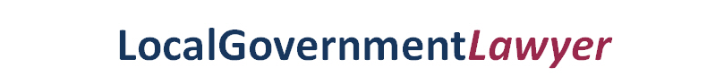
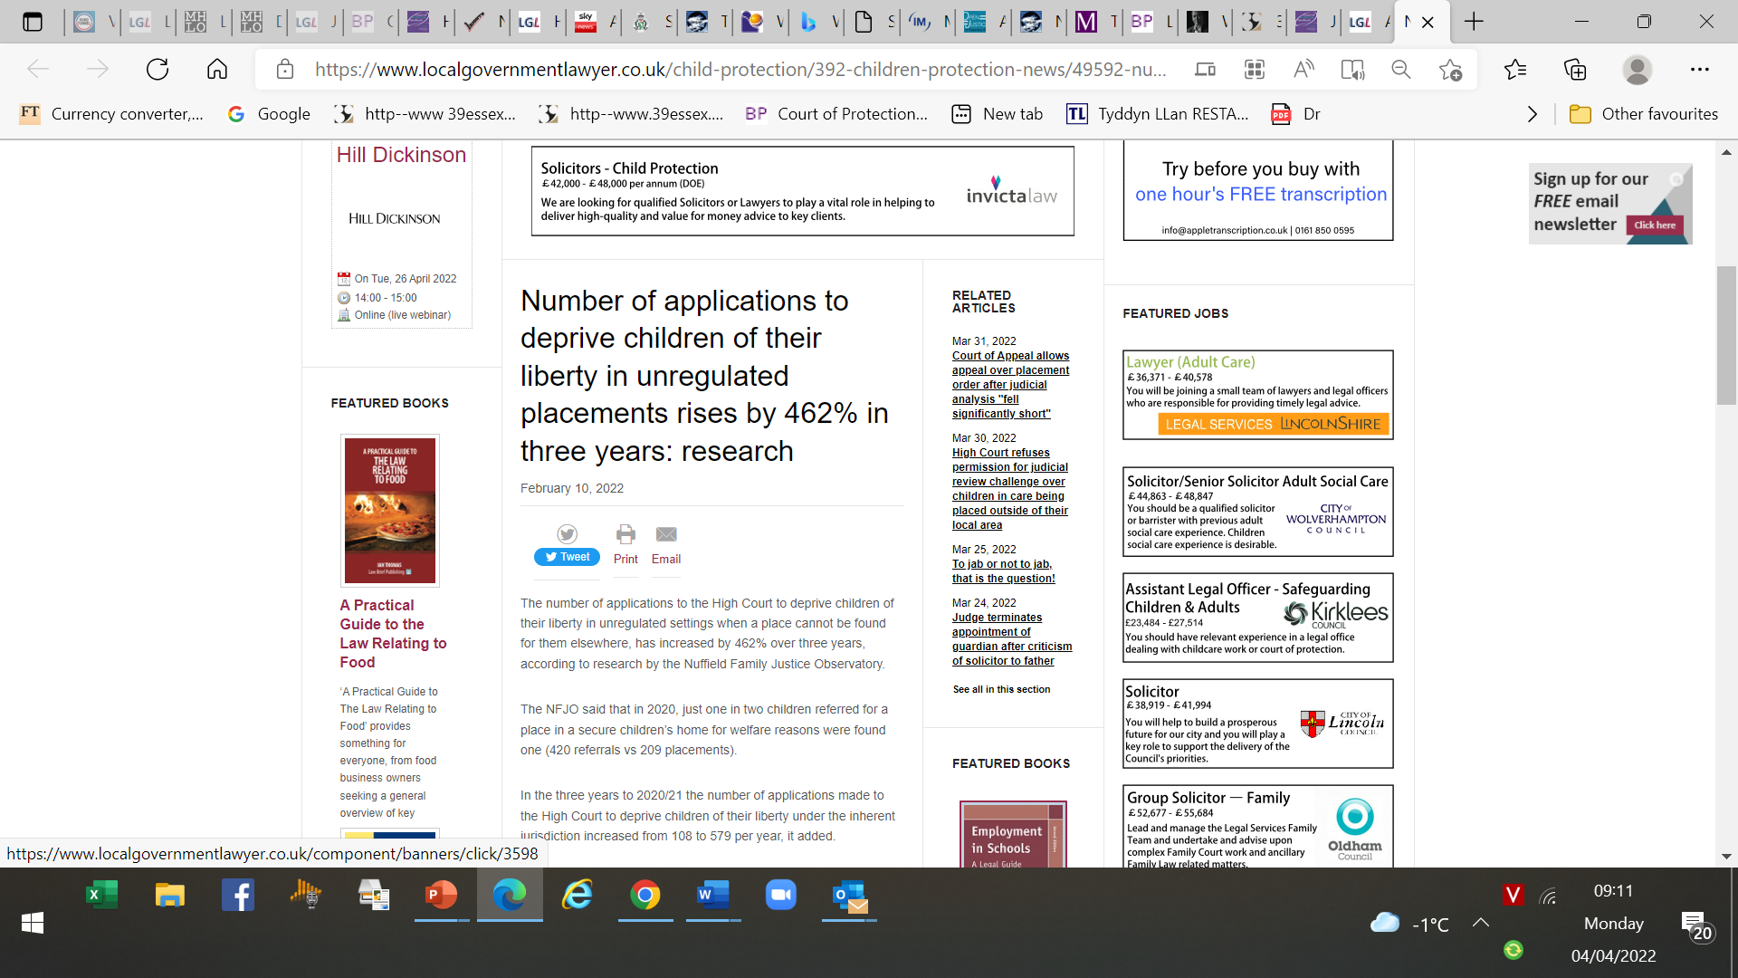

Slide 63
New National DOL Court
To improve process for considering applications
for children to be DoL under IJ
Purpose not to consider a DoL under MCA, nor a detention under MHA
DoL occurs when restrictions are placed upon a child’s liberty that are beyond what would normally be expected for a child of the same age.
This may include them being required to live somewhere they are not free to leave, being under continuous supervision and control, and subject to restraint or medical treatment without consent.
Applications are made when other statutory powers are not available in the situation, such as when there are no beds available in secure children’s homes and LAs have to look elsewhere.

Slide 64
Family President announces revised national listing protocol for applications that seek DoL orders for children
October 16, 2023
National DoL Court will no longer operate under that title.
All initial applications will be dealt with as part of the
National DoL List (“NDL”)
will continue to be overseen as part of the work of the Family Division
Court received 1,389 applications in the 12 months since its launch in July 2022.

Slide 65
A County Council v A [2022] EWHC 3572 (Fam)
Owing to the national shortage of secure accommodation,
  in England and Wales currently 62 C & YP awaiting secure accommodation
LHB reluctantly agreed to continue to keep a 16-year-old girl on a mental health ward for a further week
  pending a further court hearing and further searches for accommodation.
Although the ward was "thoroughly inappropriate",
  as most of the patients were adults, some with behaviours risky to the girl
Safer than being put out into the community.
Unlikely court could have compelled LHB
  given she was not detainable under s3
it was "not in her best interests to be there",
  other people needed the bed.

Slide 66

Manchester University Hospital NHS Foundation Trust v JS and Manchester CC[2023] EWCOP 12 (HHJ Burrows, sitting also as a s.9 judge) 18.04.2023
17 detained under s2 but DoL when lapsed.
ASD, ADHD, LD and an attachment disorder.
Admitted to a CAMHS unit as an 'informal patient' (she had been assessed as having capacity to consent to admission)
but discharged to care of mother over concerns she could become institutionalised.
A few days later, after having been detained by police once before, she was detained under s2 following an overdose.
After recovery, she remained on the ward even after authority to detain expired.
It was agreed being on the ward was inappropriate and detrimental to her health.

Slide 67
HHJ Burrows declares that once the s2 authority had expired Jane had been deprived of her liberty.
Lengthy analysis looking at the interplay of the MHA and MCA before concluding at [102-103]:
  "that Jane was ineligible to be DoL in the Hospital under MCA.
  She was within the scope of the MHA under Case E.
  I have concluded for the reasons I have given that she could have been detained and treated under the MHA. I would go further and say that she should have been so detained and treated.
  Had I reached that conclusion at the hearing, I would have been invited to invoke the IJ to authorise Jane’s detention. I did not have to do that because of the steps I took
  However, I would be reluctant to do so for the following reasons.

Slide 68
  First, because IJ should be used only where a vulnerable adult or (in this case) a child is left at risk because of a gap in the statutory framework designed to keep them safe. That is not the case here.
  The MHA should have been used.
  It was available. There is no gap for IJ to patch.
  Secondly, MHA is a long-established bespoke code dealing with the difficult regulation of the treatment of detained patients in Hospitals.
  The use of IJ or MCA would have the perverse result of a Judge having to make decisions over the management of medical treatment when that code exists and is available for use.
  For the Court to assume that role would
    (a) place Judges in an impossibly difficult position and
    (b) act as an incentive for those entrusted with using the MHA, clinicians and Hospitals, not to use it."

Slide 69
Comment 39 Essex Chambers
Whether a person is detainable under MHA turns at least in part on whether the person could receive necessary care for a mental disorder outside of hospital.
There are many people who are detained under s.3 primarily because there are not yet any adequate arrangements for their care in the community:
  they ‘need’ to remain in hospital because there is simply nowhere else for them to receive appropriate treatment.
There are many people detained under the MHA who are being treated for symptoms of their disorder by way of medication or mental health nursing, and that ‘treatment’ is necessary for their health and safety.
While hospital was more appropriately understood as the ‘least worst’ option, all other options were quite significantly worse and Jane would be at serious risk of harm if she left.

Slide 70
