Slide 1
Personalised Care and Personal Health Budgets
9th July 2021
Gemma Robinson
Senior Programme Manager Personalised Care (PHB), NHSE/I
gemma.robinson10@nhs.net
Tasnim Shah
Senior Manager, Personalised Care (PHB), NHSE/I
tasnim.shah@nhs.net
Notes:
Introductions and housekeeping - Kate.

Slide 2
Aims / Content
The aim of this session is provide advocates with the knowledge, skills and confidence to support individuals to access a personal health budget.
What is Personalised Care?
National Context
What is a Personal Health Budget
Legislation, Regulations and Guidance
Technical Aspects – end to end process
Notes:
GEMMA
The aim of this webinar is to provide advocates with the knowledge, skills and confidence to support individuals to access a personal health budget. Tas and I will be providing you with lots of useful information including:
A brief overview of universal personalised care
The national context of personalised care, including national policy and priorities
An overview of what a phb is
Legislation, regulations and guidance around the provision of a personal health budget and finally
A detailed explanation of the technical end to end process that someone would go through to get a personal health budget.

Slide 3
What is personalised Care?
Notes:
TAS
So, what is a personalised care?

Slide 4
What is personalised care?
Personalised care helps a range of people
It helps people make decisions about managing their health
Personalised Care is in response to a one-size-fits-all health and care system
Evidence shows that people will have better experiences and improved health
Notes:
TAS
Universal Personalised Care is a all age whole population model. It supports a wide range of people from people with chronic illness and complex needs to those managing long term conditions and those with mental health issues or struggling with social issues which affect their health and wellbeing.
It helps people to make decisions about managing their health so they can live the life they want to live based on what matters to them, working alongside clinical information from the professionals who support them.
Personalised care has been developed in response to a one-size-fits-all health and care system that simply cannot meet the increasing complexity of people’s needs and expectations.
Evidence shows that people will have better experiences and improved health and wellbeing if they can actively shape their care and support.

Slide 5
Benefits of Personalised care:
Improves people’s health and wellbeing;
Can reduce pressure on the system and provide efficiencies; and
Integrate joining up services across health and social care.
Benefits professionals
Notes:
TAS
Evidence shows that Personalised Care has many benefits including:
Improving people’s health and well-being by enabling people to access care and support that best meets their needs and personal outcomes.
It can reduce pressure on the system and provide efficiencies by supporting people to meet needs in a way that makes sense to them
It can help to integrate and join up services across health and social care as people can have one plan that addresses all of their needs and outcomes
And it can benefit professionals by giving them another tool in their box when working with people to meet their particular needs and outcomes.

Slide 6
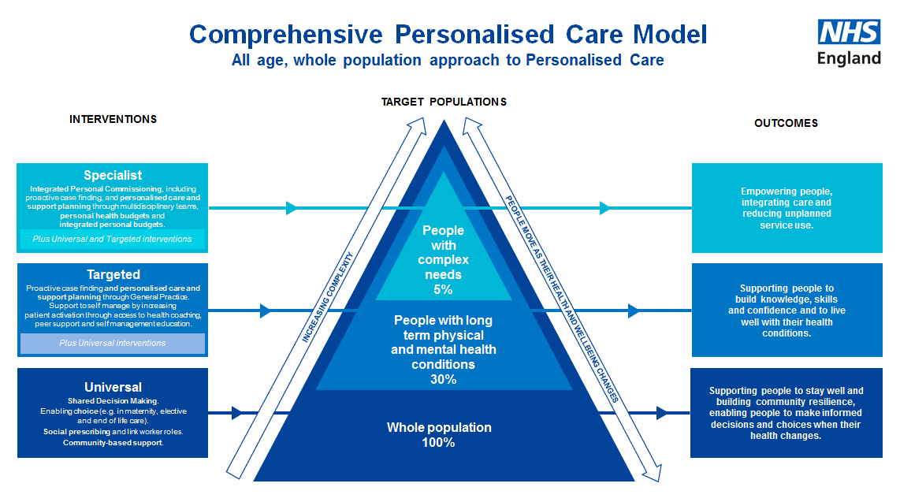
Notes:
TAS
So, as I’ve already explained, Universal Personalised Care is an all age, whole population model. It comprises 6 components:
Shared decision making
Enabling choice, including legal rights to choice
Social prescribing and community-based support
Supported self-management
Personalised Care and Support Planning
Personal health budgets and integrated personal budge
This diagram shows the personalised care triangle.
At the bottom, widest, part of the triangle the whole population should have access to shared decision making, choice and social prescribing, including community based support. People should be supported to stay well and make informed decisions when their health changes.
In the middle of the triangle, we have about 30% of the population who are experiencing long term physical and mental health conditions. These people should have access to personalised care and support planning and support to self manage by increasing patient activation though health coaching, peer support and education. These people should be supported to build the knowledge, skills and confidence to live well with their condition.
At the very top of the triangle we have about 5% of the population who have complex needs. These people require specialist support, which could include the provision of a personal health budget or integrated personal budget to ensure that they are able to access goods and services that best meet their needs and outcomes that they want to achieve. A personal health budget is the culmination of all 6 elements of the personalised care model. A personal health budget could be provided where it is evident that the person has needs that could be met in a more creative / personalised way and they can’t or won’t access commissioned services.

Slide 7
Personalised Care Operating Model
ALL AGE WHOLE POPULATION
when someone’s health status changes
30% OF POPULATION
People with long term physical and mental health conditions
Cohorts proactively identified on basis of local priorities and needs
Shared Decision Making
People are supported to a) understand the care, treatment
and support options available and the risks, benefits and
consequences of those options, and b) make a decision about a preferred course of action, based on their personal preferences and, where relevant, utilising legal rights to choice (All tiers)
Personalised Care and Support Planning
People have a proactive, personalised conversation which focuses on what matters to them, delivered through a six-stage process and paying attention to their clinical needs as well as their wider health and wellbeing.
LEADERSHIP, CO-PRODUCTION AND CHANGE ENABLER
FINANCE ENABLER
Review
A key aspect of the personalised care and support planning cycle.
Check what is working and not working and adjust the plan
(and budget where applicable)
Social Prescribing and Community-Based Support
Enables professionals to
refer people to a ‘link worker’
to connect them into
community-based support,
building on what matters to the
person and making the most of
community and informal
support (All tiers)
Supported Self
Management
Support people to develop the
knowledge, skills and confidence (patient activation) to manage their health and wellbeing through interventions such as health coaching, peer support and self-management education (Targeted and Specialist)
Personal Health
Budgets and
Integrated Personal
Budgets
An amount of money to support a person’s identified health and wellbeing needs, planned and agreed between them and their local CCG.
May lead to integrated personal budgets for those with both health and social care needs (Initially Specialist)
WORKFORCE ENABLER
Optimal
Medical
Pathway
COMMISSIONINGAND PAYMENT ENABLER
Notes:
TAS
This slide shows the Operating Model of Personalised Care. It is another way of showing how all of the 6 components of personalised care work together. Due to time, I won’t go through this slide in detail, but please have a look once the slides have been circulated and get in touch if you would like to discuss any of the elements in more detail.

Slide 8
National Context The NHS Long Term Plan, Universal Personalised Care, Operational Planning and Contracting Guidance, and the NHS Mandate,
Notes:
GEMMA
To provide a bit of background, we are now going to set out the national context for personalised care, with a focus on personal health budgets specifically.

Slide 9
The NHS Long Term Plan
The NHS Long Term Plan sets out a new NHS service model for the 21st century.
Personalised care is one of the five major, practical changes to the NHS that will take place over the next five years:-
Boost ‘out-of-hospital’ care and dissolve the divide between primary and community services
Redesign and reduce pressure on emergency hospital services
People will get more control over their own health, and more personalised care when they need it
Digitally-enabled primary and outpatient care will go mainstream across the NHS.
Local NHS organisations will increasingly focus on population health and local partnerships with local authority-funded services, through new Integrated Care Systems (ICSs) everywhere
www.longtermplan.nhs.uk
Notes:
GEMMA
As medicine advances, health needs change and society develops, the NHS has to continually move forward so that in 10 years time we have a service fit for the future. The NHS Long Term plan, published in January 2019, was drawn up by frontline staff, patient groups and national experts to be ambitious but realistic. It sets out a new NHS service model fit for the 21st century. To achieve this, it sets out 5 major practical changes to the NHS that will take place over the next five years. As you will see on this slide, one of these changes is that ‘people will get more control over their own health and more personalised care when they need it’.

Slide 10
The NHS Long Term Plan: Personalised Care Commitments:
People will get more control over their own health, and more personalised care when they need it.
Personalised care will be business as usual for 2.5 million people (adults and children) across the health and care system by 2023/24
Deliver 200,000 PHBs by 2023/24
NHS Long Term Plan
Notes:
GEMMA
In relation to people having more control over their own health and more personalised care when they need it, the Long Term Plan sets out a number of personalised care commitments:
It states that
People will get more control over their own health, and more personalised care when they need it
Personalised care will be business as usual for 2.5 million people (adults and children) across the health and care system by 2023/24
We will deliver 200,000 PHBs by 2023/24

Slide 11
Universal Personalised Care: Implementing the Comprehensive Model
Launched in January 2019.
Confirms how we will deliver personalised care so it is ‘business as usual’ for 2.5 million people (adults and children) across the health and care system by 2024, as set out in the NHS Long Term Plan.
Key commitments by 2024 include ensuring 200,000 people have a personal health budget and that all GP practices have access to a social prescribing link worker so that 900,000 people can benefit from social prescribing and community-based support.
Will be delivered with partners from across national and local government, and organisations from across health, care, voluntary and community-based sectors, as well as with people with lived experience.
https://www.england.nhs.uk/personalisedcare/upc/comprehensive-model/
Notes:
GEMMA
The Personalised Care Group launched ‘Universal Personalised Care’ in January 2019 in response to the NHS Long Term Plan. It sets out 21 actions detailing how we will deliver personalised care so that it is business as usual for 2.5 million people across the health and care system by 2023/24. This includes actions to ensure that 200,000 people have a personal health budget by 2023/24.

Slide 12
2021/22 Operational Planning and Contracting Guidance
Personalised Care Commitments:
1.2 million personalised care interventions in 2021/21
Population health management and personalised care approaches in primary care
Personalised care approaches in other key areas including maternity, cancer, mental health and learning disability.
2021/22 Operational Planning and Contracting Guidance
Notes:
GEMMA
The recently published Operational Planning and Contracting Guidance states that at least 1.2 million personalised care interventions will be delivered in 2021/22, an ambition originally set out in the NHS Long Term Plan. It also requires continued implementation of population health management and personalised care approaches in primary care, “working in a proactive, multi-disciplinary, integrated way, in line with the Comprehensive Model for Personalised Care”; as well as in other key areas including maternity, cancer, mental health and people with a learning disability.

Slide 13
NHS Mandate 2021/22
200,000 people will benefit from a PHB by 2023/24
NHS Standard Contract 2021/22
People should have greater choice and control over the way their care is planned and delivered.
2021/22 Network Directed Enhanced Service (DES) Contract Specification
Reinforces the importance of personalised care roles in general practice
Notes:
GEMMA
Personalised Care is also explicitly included in the Mandate from government to NHS England and Improvement for 2021/22, including again the target that 200,000 people will benefit from a personal health budget and the NHS will continue to improve access to primary and community care through personalised care interventions and social prescribing referrals.
The NHS Standard Contract for 2021/22 encourages commissioners to consider the specific actions required that will give people greater choice and control over the way their care is planned and delivered, and includes updates to service and general conditions relating to personalised care.
Finally, the 2021/22 Network Directed Enhanced Service (DES) Contract Specification reinforces the importance of the personalised care roles in general practice. Building on last year’s specification, supervision arrangements, safeguarding protocols and collaborative working on social prescribing plans locally have been introduced as mandatory provision for Primary Care Networks (PCNs) providing a social prescribing service.

Slide 14
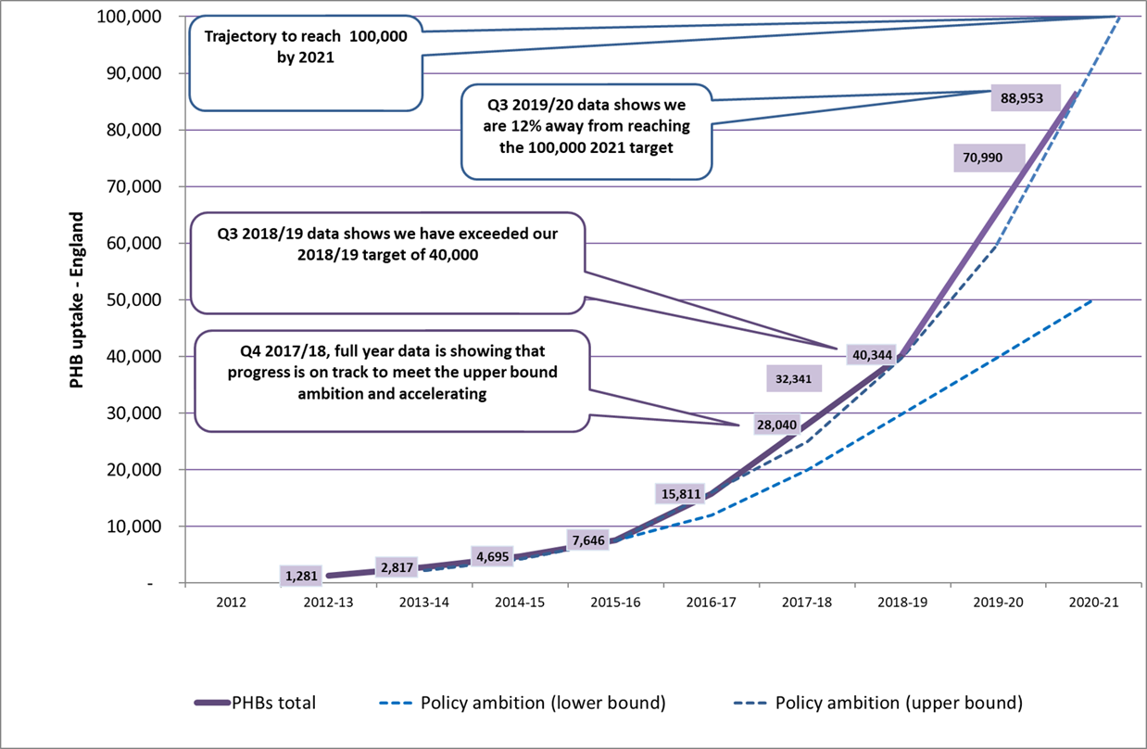
Notes:
GEMMA
So, as you can see, personalised care and personal health budgets are present throughout many policy and guidance documents published recently. The personalised care group is currently working towards meeting the identified priorities.
With a focus on PHBs in particular, this graph shows that at Q3 2019/20 CCGs reported a total of 88,953 PHBs across the country. Unfortunately, due to COVID, the PHB data collection was paused. We are expecting the collection to resume at Q2 2021/22. Preliminary discussions with CCGs indicate that they have continued to offer PHBs during the pandemic, particularly for people eligible for continuing healthcare. We therefore don’t expect this number to have reduced by much. We will continue to support CCGs and STPs to develop their phb offer in order to achieve the 200,000 phbs by 2023/24.

Slide 15
Any Questions?

Slide 16
What is a personal health budget?
Notes:
TAS
So, what is a personal health budget?

Slide 17
What is a personal health budget?
“A personal health budget is an amount of money to support a person’s identified health and wellbeing needs, planned and agreed between the person and their local NHS team”.
Notes:
TAS
A personal health budget is one way of personalising care to ensure people get the care they need. A personal health budget is an amount of money to support a person's identified health and wellbeing needs, planned and agreed between the person and their local NHS team, or with a partner organisation on behalf of the NHS.
As Gemma has already explained though, it’s more than an amount of money. It is the culmination of all 6 components of the personalised care model. It is a way of providing choice and control for people for whom commissioned services are not available or are not suitable. It is a way of people being able to access goods and services that meet their specific needs. Personal health budgets are not new money, but may mean spending money differently to ensure that people get the care they need.

Slide 18
Aim
To give people greater choice, flexibility and control over the health care and support they receive
An opportunity for people to work in equal partnership with the NHS about how their health and wellbeing needs can best be met
To target people for whom local commissioned services are not working
Notes:
TAS
The aim of a personal health budget is:
To give people greater choice, flexibility and control over the health care and support that they receive
It’s an opportunity for people to work in equal partnership with the NHS about how their health and wellbeing needs can best be met
And, as I’ve already said, they should target people for whom local commissioned services are not working.

Slide 19
Principles
NHS values still hold
No entitlement to ‘more’
Services should be safe and effective
Personal health budgets should be a positive experience
Access to services that best suit the individual
Control over decision making
Not mandatory (PHB default for CHC homecare packages)
Support planning is key
Notes:
TAS
The principles of a personal health budget are as follows:
NHS values still hold – The NHS is free at the point of use and no one should need to ‘top up’ their personal health budget to enable them to meet agreed outcomes.
No entitlement to ‘more’ – as I’ve already said, Personal health budgets are not new money, but may mean spending money differently to ensure that people get the care they need.
Services should be safe and effective
Personal health budgets should be a positive experience
Access to services that best suit the individual
Control over decision making
Not mandatory although CCGs should offer a personal health budget to anyone eligible for CHC who is living at home as default
Support planning is key

Slide 20
For people to have a personalised and integrated approach to care a person should...
be able to access information and advice that is clear and timely and meets their individual information needs and preferences
experience a co-ordinated approach that is transparent and empowering
have access to a range of peer support options and community based resources, to help build knowledge, skills and confidence to manage their health and wellbeing
be valued as an active participant in conversations and decisions about their health and wellbeing
be central in developing their personalised care and support plan and agree who is involved
be able to agree the health and wellbeing outcomes (and learning outcomes, in the case of children and young people) they want to achieve, in dialogue with the relevant health, education and social care professionals.
Notes:
TAS
For people to have a personalised and integrated approach to care a person should:
be able to access information and advice that is clear and timely and meets their individual information needs and preferences
experience a co-ordinated approach that is transparent and empowering
have access to a range of peer support options and community based resources, to help build knowledge, skills and confidence to manage their health and wellbeing
be valued as an active participant in conversations and decisions about their health and wellbeing
be central in developing their personalised care and support plan and agree who is involved
be able to agree the health and wellbeing outcomes (and learning outcomes, in the case of children and young people) they want to achieve, in dialogue

Slide 21
If this leads to a personal health budget, a person should...
know upfront an indication of how much money they have available for healthcare and support (this may be flexible in the case of one-off budgets)
have enough money in their budget to meet the health and wellbeing needs and outcomes (and learning outcomes, in the case of children and young people) agreed in the personalised care and support plan
have the option to manage the money as a direct payment, a notional budget, a third party budget or a mix of these approaches
be able to use the money to meet their outcomes in ways and at times that make sense to them, as agreed in their personalised care and support plan.
Notes:
TAS
If this leads to a personal health budget the person should:
know upfront an indication of how much money they have available for healthcare and support (this may be flexible in the case of one-off budgets)
have enough money in their budget to meet the health and wellbeing needs and outcomes (and learning outcomes, in the case of children and young people) agreed in the personalised care and support plan
have the option to manage the money as a direct payment, a notional budget, a third party budget or a mix of these approaches
be able to use the money to meet their outcomes in ways and at times that make sense to them, as agreed in their personalised care and support plan.

Slide 22
Personal Wheelchair Budgets
Personal wheelchair budgets offer the opportunity for person level integration
The personal wheelchair budget model offers a clear framework for CCGs to commission wheelchair services
Personal wheelchair budgets enable postural and mobility needs to be included PWB FAQs
Personal wheelchair budgets offer the opportunity for holistic assessments which encourage the wider system to work together
Notes:
TAS
Personal wheelchair budgets offer the opportunity for person level integration with housing, education and social care resulting in better outcomes and making sense to the wider system.
The personal wheelchair budget model offers a clear framework for CCGs to commission wheelchair services that are based on the health and wellbeing outcomes that people want to achieve, as well as care that is integrated around the person and their family.
Personal wheelchair budgets enable postural and mobility needs to be included in wider care planning and can support people to access a wider choice of wheelchair. PWB FAQs
Personal wheelchair budgets offer the opportunity for holistic assessments which encourage the wider system to work together to meet peoples whole needs, promoting the use of higher specification equipment to meet health, educational/work, social and potentially housing needs.

Slide 23
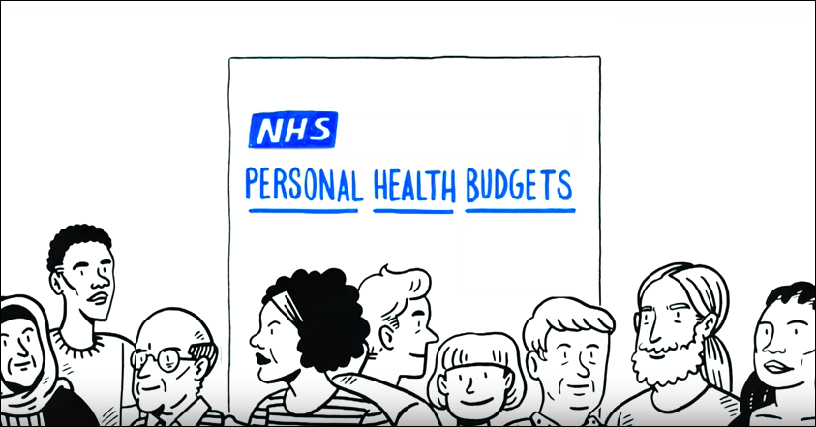
Introduction to PHBs
https://www.youtube.com/watch?v=LtlYhaTURBQ
Notes:
TAS
This video clip explains what a personal health budget is, how they work and who might be able to get one. We haven’t really got time to watch it now, but it might be useful for you to have a look at after this session.

Slide 24
Legislation, regulations and guidance
Notes:
GEMMA

Slide 25
Legal Rights to Have a PHB:
NHS continuing healthcare & children and young people’s continuing care
From 1st October 2014 (amendment)
People eligible for a NHS Wheelchair
From 2nd December 2019
People eligible for s117 Aftercare Funding
From 2nd December 2019
A relevant body is required to grant a personal health budget to a person who meets the above criteria and requests one, unless it is not appropriate in the circumstances. This means these people have the ‘right to have’ a personal health budget.
Everyone has the right to ask for a PHB
Notes:
GEMMA
At present there are 4 groups of people who have the Right to Have a Personal Health Budget:
Anyone eligible for NHS Continuing Healthcare (CHC) funding
Children eligible for continuing care
Anyone eligible for a NHS wheelchair and
Anyone eligible for s117 aftercare funding.
The Right to Have means that the CCG is required to grant a personal health budget to any person who meets this criteria and requests one, unless it is deemed not appropriate in the circumstances. Examples of when it might not be deemed appropriate include:
Where it is inappropriate for that person given their condition or the impact on that person of their particular condition;
That providing services in this way will not provide the same or improved outcomes;
Where the outcomes can be met by current services &/or
Where the PHB services are not value for money &/or
Where the item/ service being requested isn’t necessarily going to meet the need identified eg request for a type of therapy / treatment (might consider negotiating a trial in this case?)
Everyone has the right to ask for a phb.

Slide 26
Diversification of PHBs
Continuing Health Care & Children’s Continuing Care | Mental Health including S117 | Choice in End of Life Care | High Intensity Users | Wheelchairs and other specialist equipment
Renal Transport | Neurological disability | People with a learning disability | Integrated Budgets | Veterans
Notes:
GEMMA
In addition to the groups of people that have a ‘Right to Have’ a PHB, all areas of England are being encouraged to offer personal health budgets more widely to other patient groups who could benefit. This might include carers, veterans, people with a learning disability and/or autism, people with a mental health condition, joint funded budgets across health and social care, renal transport and high intensity users. As I have said previously, everyone has the right to ask for a personal health budget.

Slide 27
Default PHBs for NHS CHC home care packages
A letter from NHS England to CCGs (1st May 2018) set the expectation that PHBs will become the default/standard operating model for NHS CHC home care packages by April 2019.
Notes:
GEMMA
On 1st May 2018, a letter from NHS England was sent to all CCGs setting out the expectation that PHBs should become the default or standard operating procedure for all NHS continuing healthcare home care packages by April 2019.
This builds on the current legal right for this group to have a personal health budget.
People will know what their budget is, will be involved in personalised care and support planning and have greater control over how the budget is used, including the option of a direct payment.
PHBs for fast track are excluded – however CCGs are encouraged to offer PHBs to this group where feasible.
The expectation does not currently include children and young people’s continuing care.

Slide 28
Guidance on the Delivery of Personal Health Budgets.
Direct Payments in Healthcare Regulations
Direct Payments and Healthcare Guidance
Right to Have Guidance
Notes:
GEMMA
Lots of information and guidance has been published to support CCGs to deliver personal health budgets. I won’t go into all the details now, but here are the links to a number of documents you may find useful.

Slide 29
Any Questions?

Slide 30
Technical aspects – end to end process
Notes:
TAS

Slide 31
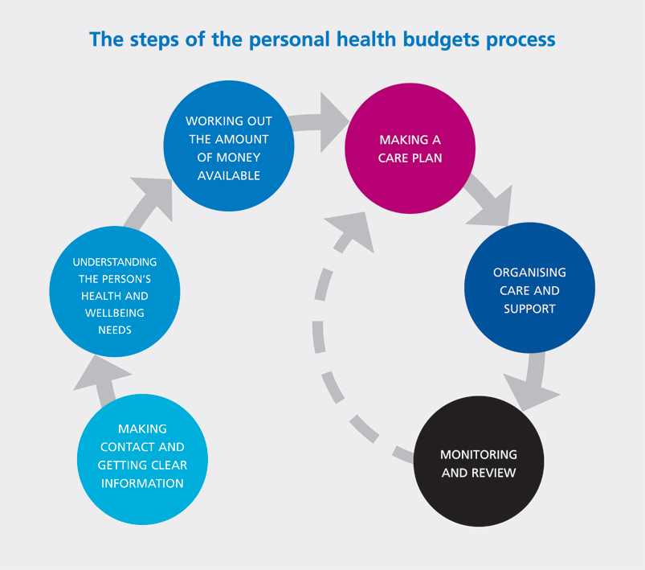
Notes:
TAS
This diagram shows the 6-step process for providing a personal health budget. It shows that we should:
Make contact and give clear information
We should understand the persons health and well-being needs
We need to work out the amount of money available
Make a personalized care and support plan
Organise the agreed care and support and
Review
It should be a dynamic process though and may not always happen in a regular, sequential way. You may for example, need to work through a personalized care and support planning conversation to identify what the patient might need at the same time as considering the amount of money that might be available. You also may need to organize some care and support before the care plan has been fully developed.
We’re now going to go through each of these steps in more detail.

Slide 32
Step 1 - Making Contact and Getting Clear Information
Notes:
GEMMA

Slide 33
Things to consider
Staff should be confident to explain what a PHB is
The CCGs Local Offer should be clear and transparent?
Information about PHBs should be available in a variety of formats
Is information easy to find?
Do you know who to get in touch with about the PHB?
Notes:
GEMMA
Making Contact and getting clear information includes information and advice for both both staff and people asking for or offered a phb.
CCGs should make sure that people are aware of their personal health budget offer. Staff should be confident to explain what a phb is to anyone eligible. Information and guidance should be available in a variety of formats, including details of where to go for further information.

Slide 34
Step 2 - Understanding the Person’s Health and Well-Being Needs
Notes:
TAS

Slide 35
What to do?!
Processes should be:
Personalised
Timely
Equitable and consistent
Whole person – health and well being needs
Notes:
TAS
The next step is to understand the person’s health and well-being needs. This might include an assessment, which ideally would not be in addition to existing assessments, for example the CHC assessment. Whatever assessment is used it should be
Personalised
Timely
Equitable and consistent for everyone
Include the whole person and look at both health and well-being needs

Slide 36
Step 3 - Working Out The Amount of Money Available
Notes:
TAS

Slide 37
Indicative budget
Clear information about the offer
Upfront allocation
Transparent calculation
Enough to meet assessed needs
Expectations managed
Consistent approach
Sign off
Important Principle
PHBs are about using existing funding differently – enabling people to have more choice, control & responsibility about how their health and care needs are met
Notes:
TAS
The assessment should then be used to calculate an indicative budget. The aim of the indicative budget is to give people an idea of what they have to spend when they are thinking about what goods and services they would like to include within their personalised care and support plan (which Gemma will be talking about next!).
The way CCGs calculate the budget is a local decision. However they calculate it though:
There should be clear information about the personal health budget offer available
The person should be told what their budget is at a relevant and appropriate time - upfront budgets make sense where people are receiving ongoing services and these can be costed e.g. in CHC, BUT sites can apply a rationale that works for them, especially in the case of small, one off budgets where upfront costs are not clear.
The way the budget is calculated should be transparent and
The budget should be enough to meet assessed needs – as I’ve already said, no one should need to ‘top up’ their personal health budget to enable them to meet agreed outcomes.
Throughout this process expectations should be managed by people knowing what the process is, there should be a consistent approach and there should be agreed sign off of budgets.
A PHB is about using existing funding in a different way, enabling people to have more choice, control & responsibility about how their health and care needs are met

Slide 38
Any Questions?

Slide 39
Step 4 - Making a Care Plan
Notes:
GEMMA

Slide 40
Changing the conversation
From – what's the matter with you
To – what matters to you
Notes:
GEMMA
The next stage in the process is to write a personalised care and support plan.
Personalised Care and Support planning is a series of facilitated conversations in which the person, or those who know them well, actively participates to explore the management of their health and well-being within the context of their whole life and family situation. The process recognises the person’s skills and strengths as well as their experiences and the things that matter most to them. It addresses the things that aren’t working in the person’s life and identifies outcomes and actions to resolve them.
The main thing is that it changes the conversation between the patient and the clinician from ‘what’s the matter with you’ to ‘what matters to you’.
The changed relationship and different conversation will mean that the person:
is empowered and builds knowledge, skills and confidence
experiences hope and feels confident that the process and the plan will deliver what matters most to them
is central in developing their Personalised Care and Support Plan and will agree who is involved.
is seen as a whole person within the context of their whole life, valuing their skills, strengths, experience and important relationships
is valued as an active participant in conversations and decisions about their health and well being.

Slide 41
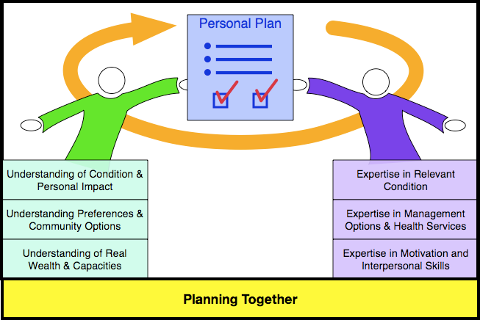
Notes:
GEMMA
This diagram illustrates the changed conversation in a different way and highlights what each party brings to the table when planning together. Each person has their own areas of expertise which come together to inform the personalised care and support plan so that the person can access the best and most effective goods and services that will enable them to live the life that they want to lead and achieve the outcomes that they want to achieve.

Slide 42
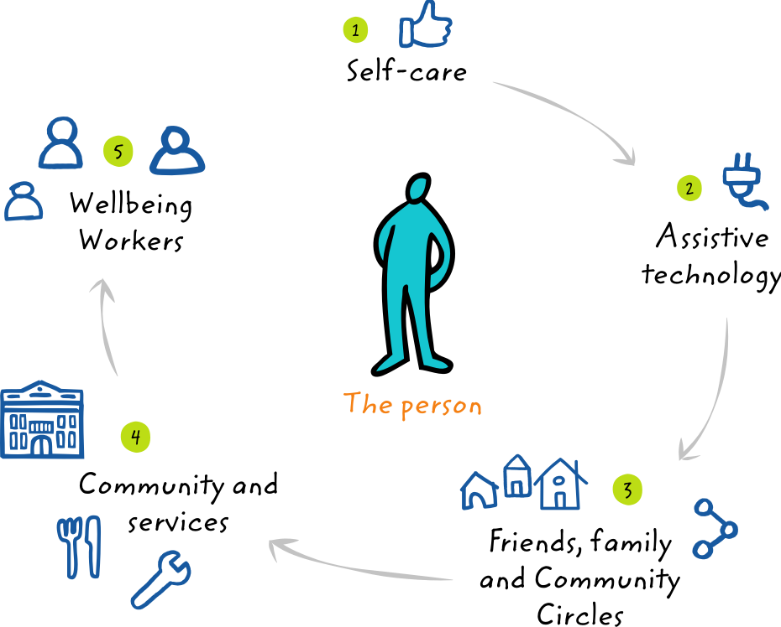
Support Sequence
The Support Sequence
Paid
support
Notes:
GEMMA
When developing a personalised care and support plan discussions should include consideration of all of the different types of support that may be available including self care, assistaive technology, freidns, family and community circles and community services. As I have previously said, a phb, which could be used to pay support workers should only really be considered where it is evident that the person has needs that could be met in a more creative / personalised way and they can’t or won’t access commissioned services.

Slide 43
Personalised Care and Support Planning – Key features
Perspective
The changed relationship and different conversation will mean that the person:
is empowered and builds knowledge, skills and confidence
experiences hope and feels confident that the process and the plan will deliver what matters most to them
is central in developing their Personalised Care and Support Plan and will agree who is involved.
is seen as a whole person within the context of their whole life, valuing their skills, strengths, experience and important relationships
is valued as an active participant in conversations and decisions about their health and well being.
Notes:
GEMMA
The changed relationship and different conversation will mean that the person:
is empowered and builds knowledge, skills and confidence
experiences hope and feels confident that the process and the plan will deliver what matters most to them
is central in developing their Personalised Care and Support Plan and will agree who is involved.
is seen as a whole person within the context of their whole life, valuing their skills, strengths, experience and important relationships
is valued as an active participant in conversations and decisions about their health and well being.

Slide 44
Personalised Care and Support Planning – Key features
Process
A good personalised care and support planning process will mean that the person:
has the time and support to develop their plan in a safe and reflective space
is able to access information and advice that is clear and timely and meets individual information needs and preferences
feels prepared, knows what to expect and is ready to engage in planning supported by a single, named coordinator
is listened to and understood in a way that builds trusting and effective relationships with key people
is able to agree the health and well-being outcomes (and learning outcomes for children and young people with education, health and care plans) they want to achieve, in dialogue with the relevant health, education and social care professionals
has the chance to formally and informally review their personalised care and support plan.
Notes:
GEMMA
A good personalised care and support planning process will mean that the person:
has the time and support to develop their plan in a safe and reflective space
is able to access information and advice that is clear and timely and meets individual information needs and preferences
feels prepared, knows what to expect and is ready to engage in planning supported by a single, named coordinator
is listened to and understood in a way that builds trusting and effective relationships with key people
is able to agree the health and well-being outcomes (and learning outcomes for children and young people with education, health and care plans) they want to achieve, in dialogue with the relevant health, education and social care professionals
has the chance to formally and informally review their personalised care and support plan.

Slide 45
Personalised Care and Support Planning – Key features
The Plan
There is no national template but a personalised care and support plan is:
a way of capturing and recording conversations, decisions and agreed outcomes in a way that makes sense to the person.
proportionate, flexible and coordinated and adaptable to a person’s health condition, situation and care and support needs.
including a description of the person, what matters to them and all the necessary elements that would make the plan achievable and effective
Notes:
GEMMA
There is no national template but a personalised care and support plan is:
a way of capturing and recording conversations, decisions and agreed outcomes in a way that makes sense to the person.
proportionate, flexible and coordinated and adaptable to a person’s health condition, situation and care and support needs.
including a description of the person, what matters to them and all the necessary elements that would make the plan achievable and effective

Slide 46
Personalised Care and Support Planning – Key features
Whole Family Approach
A holistic view of the person’s needs is required
We must identify how the needs for care and support impact on family members and others in their support network.
People should be considered in the context of their families and support networks, not just as isolated individuals with needs
We should take into account the impact of an individuals need on those who support them, and take steps to help others access information or support.
Notes:
GEMMA
The personalised care and support planning process should also take a whole family approach and include the needs and outcomes of all the people that are in the patients life. People should be considered in the context of their families and not just as isolated individuals with needs. Other people involved in their life should be supported to access information or support too.

Slide 47
Options to manage the budget
Notional Budget Money is held by the NHS | Third Party Budget Money is paid to an organisation that holds the money on the person’s behalf | Direct Payment Money is paid to the person or their representative
Notes:
GEMMA
The personalised care and support plan should also detail how the person will receive their phb. There are three ways in which a phb can be managed:
A notional budget – where the person knows how much money they have available, they have choice and control over how it is spent, but the CCG spends the money on the patient’s behalf. No money therefore changes hands.
A third party budget, where the CCG transfers the patients budget to a third party organisation that is independent from the NHS. This organisation organises and manages the patients support and budget on their behalf. If the patient would like to employ PAs, then the third party organisation is the employer of the PAs.
And finally a direct payment where the patients budget is paid directly to the patient into a separate bank account. The patient then manages the budget in accordance with their agreed care plan. If the patient would like to employ PAs, then they are the employer of the PAs. Help and support is available for people with a direct payment. This can be through a managed account, and/or help with payroll.

Slide 48
Any Questions?

Slide 49
Step 5 - Organising Care and Support
Notes:
TAS

Slide 50
Organising Care and Support
Involves setting up the care and support as described in the agreed care plan. Between step 4 and 5 there is also the technical aspect of setting up a direct payment. This process will vary from place to place.
Notes:
TAS
Once a personalised care and support plan has been written, it will need to be approved or agreed by the local STP. The way this is done varies from place to place and may involve a panel.
Once the personalised care and support plan has been agreed the goods and services detailed will need to be organised. This also includes the technical aspect of setting up a direct payment, if required. Again this will vary from place to place.

Slide 51
Organising care and support – things to consider
Recruitment and employment of P.As
Equipment (outside of existing provider contracts)
Training – health and care tasks
Final budget paperwork
DP agreement
Third party paperwork
Direct Payment Support Services
Payroll support
Notes:
TAS
Things to consider when organising care and support include:
Recruitment and employment of P.As
Equipment (outside of existing provider contracts) including ownership and maintenance
Training – health and care tasks
Final budget paperwork
DP agreement
Third party paperwork
Direct Payment Support Services
Payroll support

Slide 52
Step 6 - Monitoring and Review
Notes:
GEMMA
Finally step 6 is monitoring and review

Slide 53
Monitoring and review – things to consider
Proportionate
Outcomes focussed care plan review
Financial monitoring
Budget review
PHB holder experience
Evaluation
Notes:
GEMMA
Monitoring and review includes both the outcomes for the person and financial monitoring if the person is receiving a direct payment.
Any monitoring and review should be proportionate to the personal health budget that the person is receiving. You wouldn’t expect to go through an extensive review process for a one off budget of £50 for example.
The review of the plan should focus on whether or not outcomes detailed in the personalised care and support plan have been achieved.
Financial monitoring, if required, should focus on whether or not the money has been spent in accordance with the agreed care plan and if there was any surplus money in the account. Is the budget sufficient to meet outcomes? Is the person able to spend the money as planned?
STPs should also consider monitoring and reviewing the phb holder’s experience so that they can address any issues raised regarding the phb systems and processes that they have put in place.

Slide 54
Success indicators
Reviews show outcomes have been achieved
People resolved own issues using contingency planning
Less or no medical interventions required compared to prior to a PHB
Less complaints to the relevant service
Notes:
GEMMA
Review success indicators include:
Outcomes detailed in the personalised care and support plan being achieved
People resolving their own issues/crises using contingency plans and funds
Less medical interventions required as people are able to manage their condition more effectively and
Less complaints to the relevant service.

Slide 55
Have you got any final questions? Did we cover everything?!
Notes:
GEMMA

Slide 56
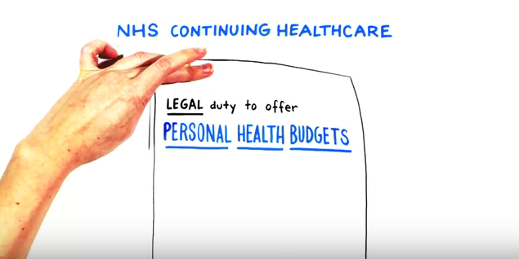
https://www.youtube.com/watch?v=9xw6pWJV0kQ
Notes:
Jonathan is 56 years or and has complex disability needs – from the age of 10 Jonathan live in an institution – now after 40 years he is out and living in the community – and this is his story - 5.44 mins

Slide 57
The Training Hub
https://form.123formbuilder.com/5940529/
Notes:
A training hub will be launched next month which will include lots if information , resources and guidance specifically designed for advocates to support you when working with someone with a phb. Please sign up using the link on this slide to be first to access this information when the hub is launched.

Slide 58
Gemma Robinson
Senior Programme Manager Personalised Care (PHBs)
Gemma.robinson10@nhs.net

