Slide 1
IMHA Experiences from Victoria, Australia
Emma Wilcox-Davies
Senior Advocate for Melbourne
Notes:
‘

Slide 2
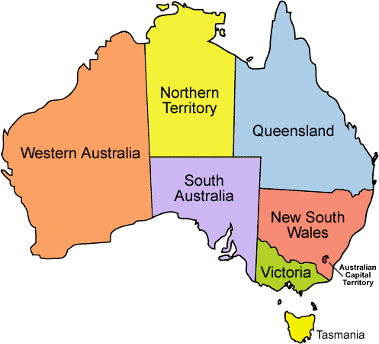
IMHA in Victoria, Australia
Notes:
6 states and 2 territories
Victoria is second smallest State in Australia

Slide 3
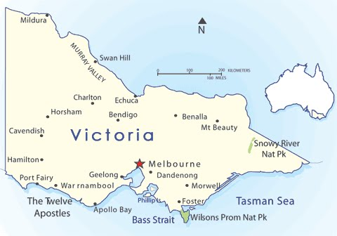
IMHA in Victoria, Australia
Victoria has a population of 7 million people and is 91,000 square miles in size which equates to the same size as England, Wales and Scotland.

Slide 4
IMHA: Who are we?
Free statewide non-legal advocacy service
Funded by DHHS (Department of Health and Human Services)
Set up as part of the Mental Health Act 2014 reforms
What do we do?
Support consumers to understand and exercise their rights under the Act
Provide information on rights/options (second opinion, advance statements etc) - supporting self-advocacy
Advocate to treating teams
Connect to other services such as SPOS (Second Psychiatric Opinion Service), MHCC (Mental Health Complaints Commissioner)
IMHA team
Notes:
DHHS is similar to DoH (Department of Health) in England.
Within Victoria, local councils have no involvement in the commissioning of advocacy services this is only commissioned by State funding that comes through the DHHS.

Slide 5
IMHA: what we look like in Victoria
Melbourne
One Senior Advocate and Five Advocates
Manager & Admin Officer
Project Officer
Bendigo
One Senior Advocate and Three Advocates
Consumer Consultant & Speaking From Experience
Geelong
One Senior Advocate and Three Advocates
DandenongOne Senior Advocate and Four Advocates
Notes:
The IMHA service in Victoria consists of a total of 1 overall Manager and then 4 teams each with a Senior Advocate, total of 15 Advocates and then a project officer and a Consumer Consultant (Lived Experience Representative)

Slide 6
IMHA: Mental Health Act 2014
Context
Mental Health Act 1986 ➔ Mental Health Act 2014
United Nations Convention on the Rights of People with a Disability (UNCRPD)
What does the Act say?
MH Principles: supported decision making, recovery, least restrictive
Capacity should be respected – informed consent
Updated regime for lawful compulsory treatment
Notes:
How did IMHA come about? From Reforms to MH Act in 2014 which include the following:
provide the services to implement supported decision making mechanisms & working with regard to the MH Act principles
ensure people are supported to make, or participate in, decisions about their assessment, treatment and recovery.
working with the mental health sector to improve outcomes for consumers and help realise the objectives of the Act.
Independent- IMHA sits outside mental health services, hospitals and government so that there is no conflict of interest

Slide 7
IMHA: Eligibility in Victoria
Free service
All people on compulsory treatment orders or at risk of being placed on a compulsory treatment order
Priority groups include Aboriginal and Torres Strait Islander consumers as well as those who are receiving ECT and consumers who are receiving compulsory treatment for the first time.
Notes:
Priority Groups- Aboriginal and Torres Strait Islander, CALD, Dual Disability, Assistance with Communication, voluntary inpatients at risk of becoming compulsory, ECT -1st time, subject to restrictive interventions e.g. bodily restraint, seclusion, people in SECU, experiencing homeless

Slide 8
Accessing IMHA in Victoria
Call or provide our phone line number :1300 947 820 (9:30am-4:30pm – Monday to Friday)
Visit our website – www.imha.vic.gov.au
Email (with consent): contact@imha.vic.gov.au
Consumers can also meet with an advocate during outposts at services or arrange to meet at community clinics.
Notes:
IMHA visits all public health psychiatric hospitals in the State of Victoria and this is usually in person at least every other week – these are regular planned outposts and advocates will spend the day at the hospital and meet with consumers as needed.
In addition, consumers can contact IMHA through their phone line and can be provided with self advocacy resources or information or have Intake completed where details obtained and file opened and then allocation sent to relevant Senior who will then pass onto advocate within the team. Response times for allocations are 3 days for consumers who are inpatient and 5 days for consumers who are in the community. A large amount of advocacy is completed by telephone due to distances between locations of services and IMHA offices.
Intake Line is supported by all advocates on a roster basis

Slide 9
Impacts of Delivery of Service due to Covid
As all services there have been some impacts on delivering IMHA as all face to face meetings have needed to stop for the time being. All advocates are working from home at present.
Therefore, advocates are having video calls where possible or telephone calls. In addition, advocates are holding Rights Groups via video .These are being set up during outpost times and are for inpatient consumers. Information about consumer rights is shared, then should consumers wish to speak with an advocate on a one to one basis afterwards this is arranged.

Slide 10
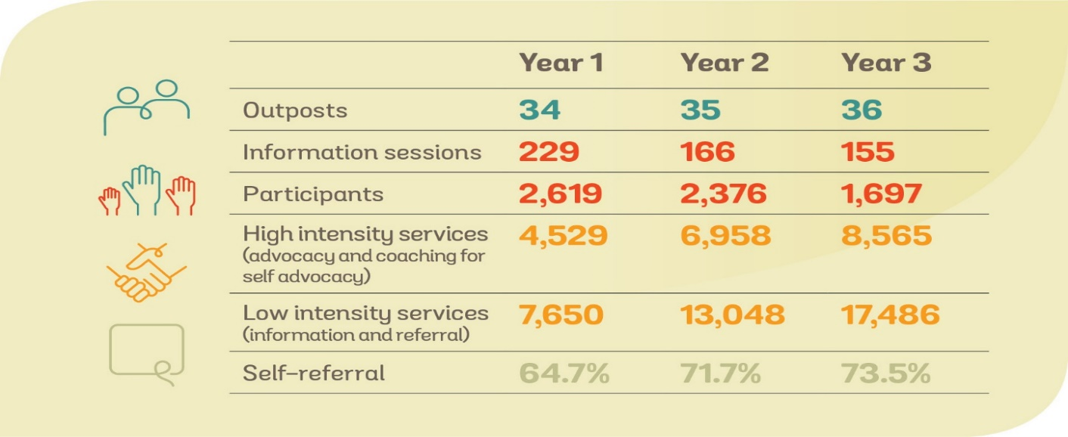
Our First Three Years of Service
Notes:
Year 4 tracking at much high rates of High and Low intensity services

Slide 11
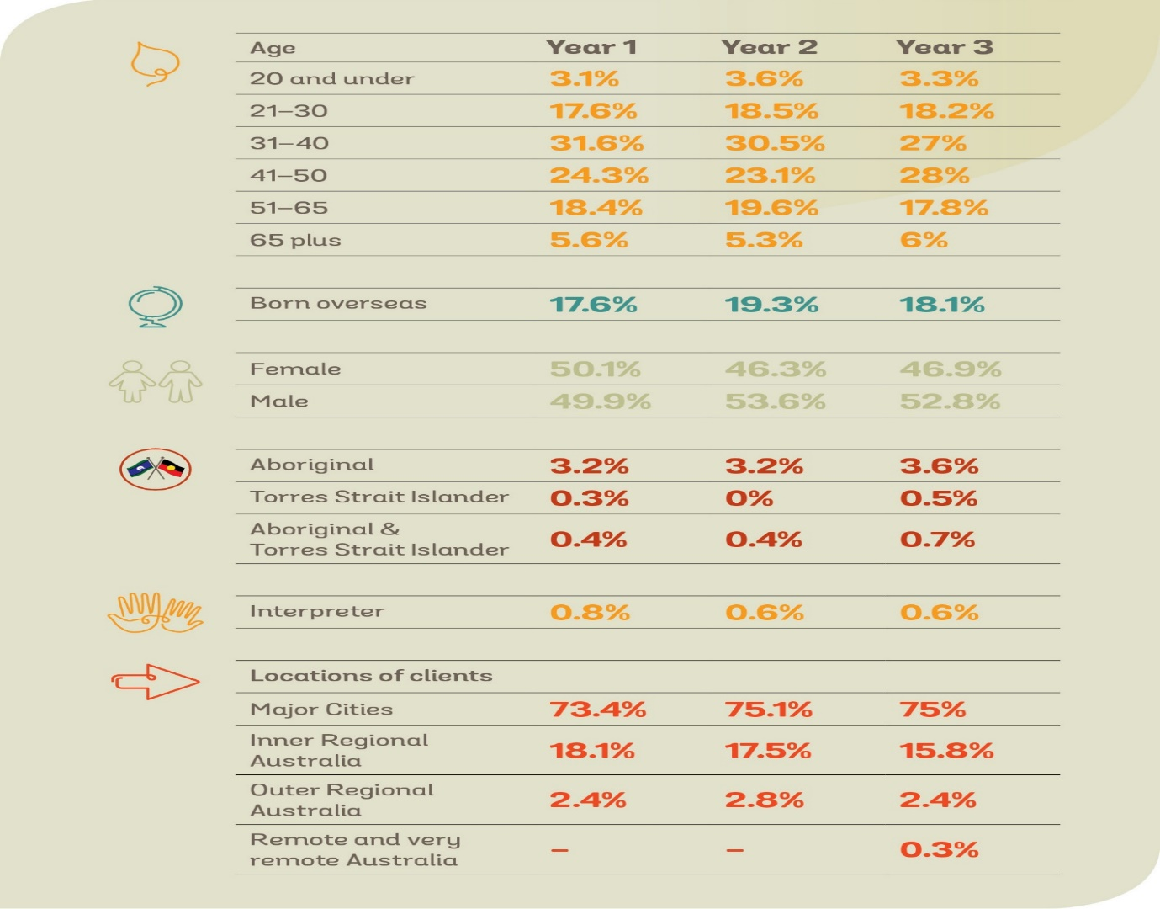
Our First Three Years of Service, cont.
Notes:
Consistent in Year 4

Slide 12
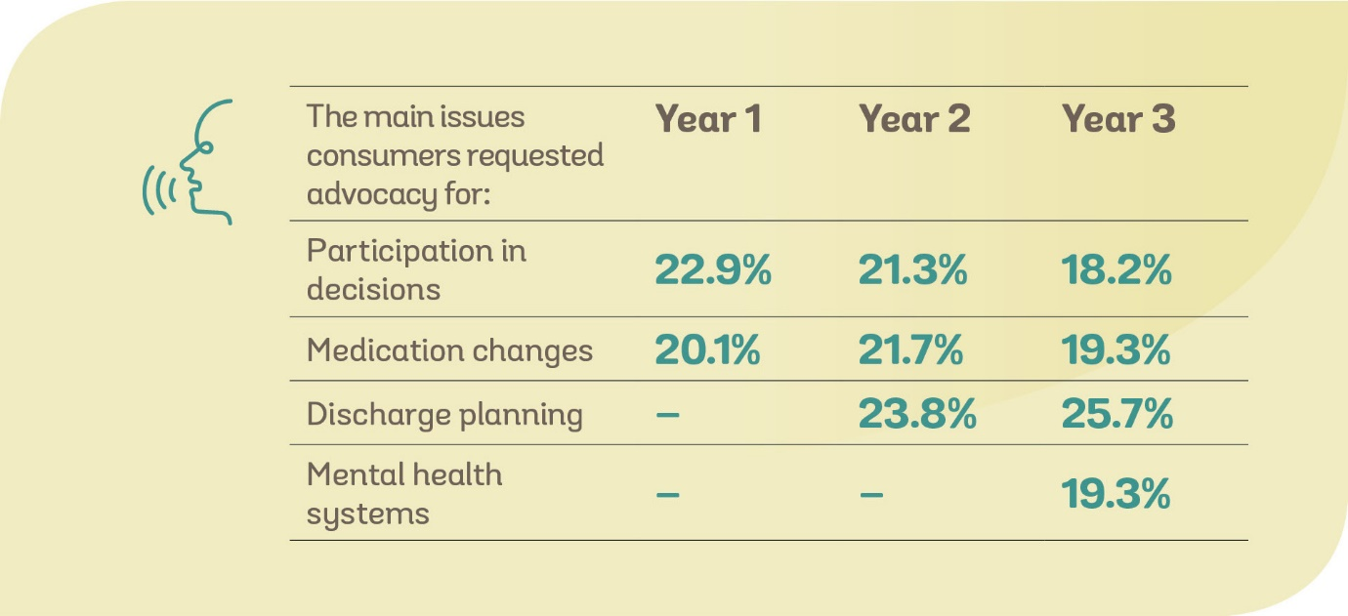
Our First Three Years of Service, cont.

Slide 13
Our independent evaluation: Results
IMHA is instrumental to the maintenance of the rights of people who are
subject to compulsory treatment. To ensure IMHA’s continued success and
address system-level issues, four main actions must be taken:
1. Referral to IMHA must be automatic for any person subject to compulsory treatment through an ‘opt-out’ system
2. IMHA must be adequately resourced to meet demand
3. IMHA must continue to improve sector awareness and understanding of advocacy
4. Oversight and funding bodies must coordinate and adequately invest to ensure that services comply with legislation, are recovery-oriented and least-restrictive, and that consumers are supported to make decisions
Notes:
Evaluation of first three years of IMHA Aug 2015 – August 2018, RMIT – coproduced with a team of legal, clinical, consumer, research professions
69 IMHA consumers; 40 consumers who had not used IMHA (to compare experiences of the system without an advocate); 292 clinicians; 9 oversight/safeguard body/funder representatives; consumer and carer peak bodies;
31 mental health lawyers and 16 IMHA staff
Key findings
IMHA has proven to be very successful in a challenging context. After three years in operation, it has become an established part of the broader mental health service system. Consumers highly valued IMHA because it maintained their rights and because advocates treated them with dignity and respect. Irrespective of whether IMHA advocates achieved the outcome the consumer identified, consumers appreciated an advocate being present. Professionals who had worked with IMHA generally held it in high regard.
To successfully maintain the rights of people subject to compulsory mental health treatment IMHA must be accessible to everyone who is eligible for it. This requires the adoption of an opt-out system where every person made subject to compulsory treatment is offered advocacy. This will require increased resourcing for IMHA to be able to respond to increased demand.
With or without an opt-out system IMHA will require significantly more resourcing to ensure equitable access to advocacy via service promotion, and ensure referral pathways. Across the sector, but particularly in community mental health services, awareness of IMHA and understanding of the IMHA model is low. An opt-out system will reduce the need to address this and enable IMHA to focus on providing advocacy services instead of promoting the service.
Achieving IMHA’s key objective of maintaining the rights of consumers will require a whole of system approach with political and public sector leadership.
Oversight and funding bodies, led by DHHS and including VLA, the Office of the Public Advocate, the Second Psychiatric Opinion Service, the Mental Health Complaints Commissioner, the Mental Health Legal Centre, the Victorian Mental Illness Awareness Council, Tandem, the Office of the Chief Psychiatrist and the Mental Health Tribunal, must invest and coordinate with mental health services to ensure that services comply with legislation, are recovery-oriented and least-restrictive in practice, and people are provided with the support they need to make decisions. The evaluation identified an enormous amount of goodwill in the sector, but little in terms of tangible outcomes or improved experiences for consumers. IMHA is working towards this goal but is hindered by inaction and resistance in some parts of the sector. Sector leadership will be required to address these systemic issues going forward. The 2019 review of the Mental Health Act 2014 and the proposed Royal Commission into Mental Health in Victoria provides an ideal opportunity for this.

Slide 14
IMHA: Consumer Consultant and Speaking from Experience Group
IMHA started delivering services in August 2015 so has just celebrated 5 years as a service.
During the establishment of the service then a Consumer Consultant was employed to ensure that the service was focussed on consumers needs – this is an ongoing paid role and is currently Wanda who has been with IMHA since the beginning.
In addition, IMHA has a Speaking from Experience Group who are all consumers of mental health services and most of the group have also accessed IMHA at some stage over the past 5 years.
Notes:
SFE are involved with the shaping of the IMHA service at all levels so from recruitment of staff to policies and procedures as well as coproducing resources that are available. Lived Experience is highly valued. In addition, self advocacy resources have been created and coproduced with consumers and are available printed and also online to download and access.

Slide 15
IMHA and the Royal Commission into Victoria’s Mental Health System
The Royal Commission into Victoria’s Mental Health System was established because there is widespread acknowledgment that mental health services have reached crisis point. Many people living with mental illness are not receiving the treatment, care and support when and where it would offer the greatest benefit.
IMHA has participated in a submission to the Royal Commission and some meetings have been held with IMHA and Speaking from Experience Group.
Notes:
Royal Commission is similar to an Enquiry in the UK but this is a Statewide commission so specific to Victoria rather than all of Australia. The commission was formed in Feb 2019 with an interim report being published in November 2019, the final report is due in February 2012 as has been delayed due to Covid.
There have been public hearings as well as witness statements and submissions from peak bodies, the Victorian government has stated that they will implement all recommendations from the royal commission.

Slide 16
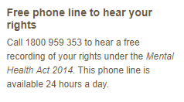
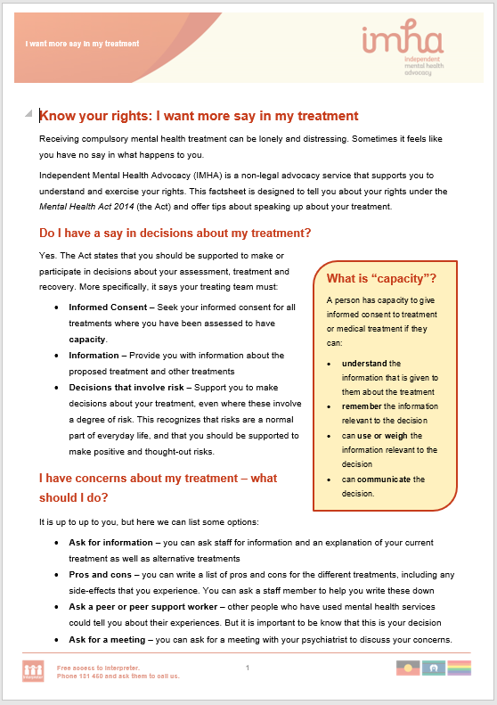
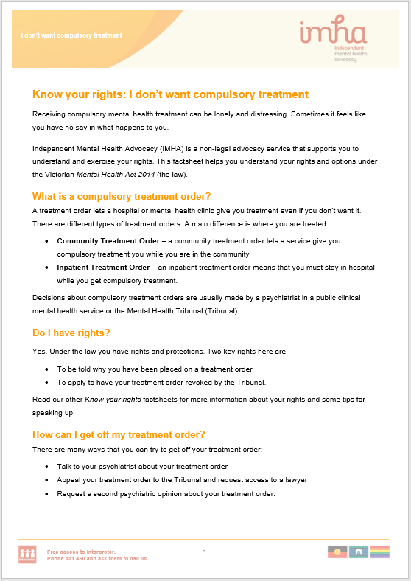
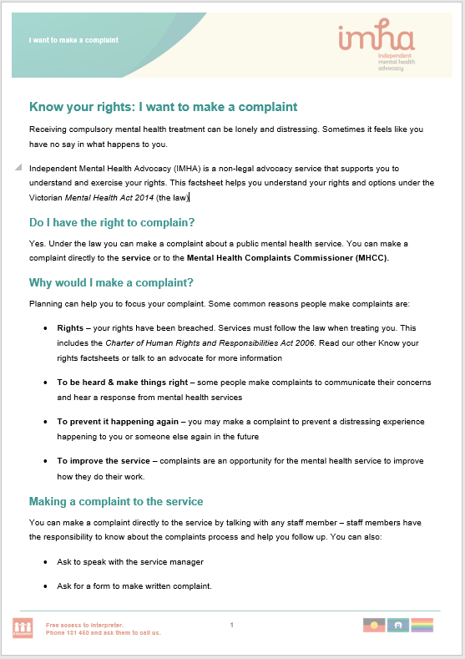
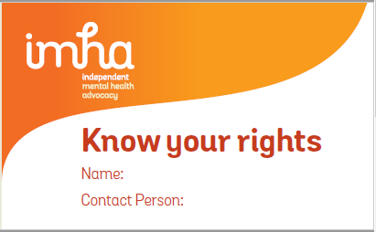
Our self-advocacy resources
Self-advocacy…
An online self-advocacy tool
Audio recording
1800 959 353
A self-advocacy workshop
7 videos
Advance Statement / Nominated Person Guides (video & written)
19 written factsheets
(https://www.imha.vic.gov.au/know-your-rights)
A wallet card (with our basic info)

Slide 17
Any Questions?
If you are interested in reading further about IMHA in Victoria then please access the website:
www.imha.vic.gov.au
And if you would like to ask any questions or make contact with me then please do email me on:
Emma.wilcoxdavies@imha.vic.gov.au

