Slide 1

Stopping over medication of people with a learning disability, autism or both
October 2018
Advocates Conference
Birmingham
Carl Shaw, Hazel Griffiths and Dave Gerrard NHS England STOMP team
Jonathan Senker Voiceability
Notes:
General introduction – personal and STOMP

Slide 2

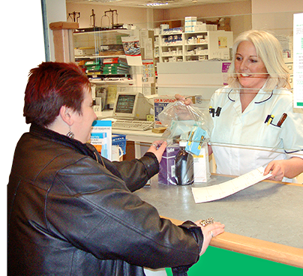
Why have STOMP?
Public Health England says every day about 30,000 to 35,000 adults with a learning disability are being given psychotropic medicines when they do not have a diagnosed mental health condition. This is often to manage behaviour which is seen as challenging.
It includes medicines used to treat psychosis, depression, anxiety, sleep disorders and epilepsy.
These medicines are right for some people, but over medication or using them for the wrong reason puts people at risk of weight gain, health problems and even premature death
www.england.nhs.uk/stomp
Notes:
Carl

Slide 3

Aims
Improve the quality of life of children, young people and adults with a learning disability, autism or both, who are prescribed psychotropic medicines.
Make sure people are only given them for the right reason, in the right amount, for as short a time as possible.
Improve everyone’s understanding of these medicines and give everyone the confidence to ask why they are needed.
Make more non-drug treatments and support available.
Make sure the person with their family and paid carers are involved in any decisions to start, stop, reduce or continue taking them.
Notes:
Carl

Slide 4
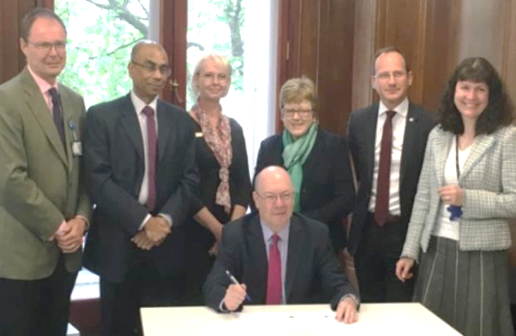
National call to action
In 2016 the call to action led to a STOMP pledge to stop over medication by:
Royal Colleges of Nursing, Psychiatrists and GPs
Royal Pharmaceutical Society
British Psychological Society
NHS England
Then Minister Alistair Burt
Since then, other bodies have signed up including the Learning Disability Senate, Voluntary Organisations Disability Group (VODG), the Royal Colleges and Associations for social workers, speech and language therapists, music, art and drama therapies, dietetics and occupational therapists
Notes:
Carl

Slide 5
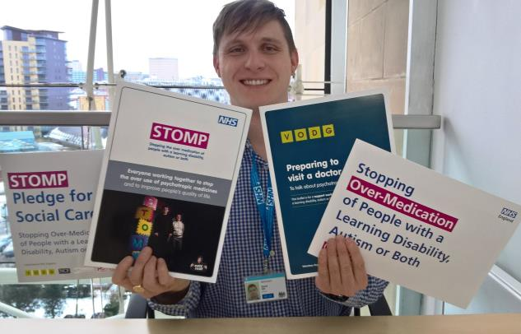
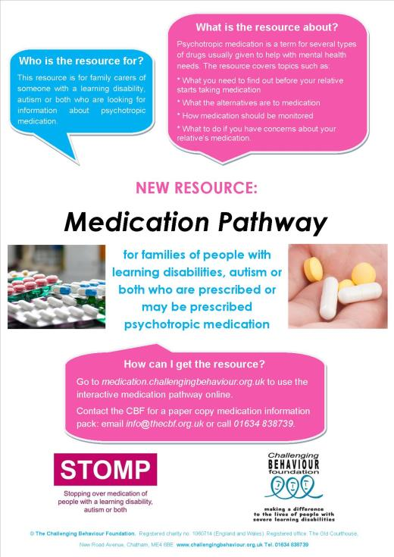
Growing all the time
Visit www.england.nhs.uk/stomp for lots of downloads and links for professionals, people and families
New CBF resources for carers
visit medication.challengingbehaviour.org.uk
For information and advice each step of the way
Find out how to order a printed copy of the Medication Information Pack from the Challenging Behaviour Foundation at www.challengingbehaviour.org.uk/contact
Notes:
Carl

Slide 6



Provider Pledges
SOCIAL CARE
HEALTHCARE
Notes:
Dave

Slide 7


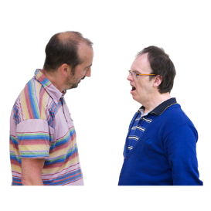
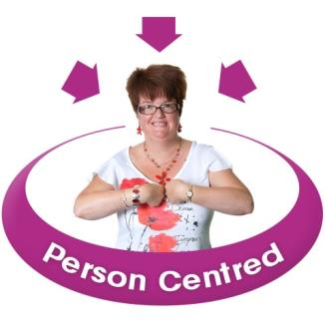

Pledge commitments
To look for other ways of supporting people, such as PBS training for support staff, talking therapy and doing things that help people feel better
To make sure people, families and carers know about the medicine and are involved in decisions about the person’s care
To make sure staff know about the medicine too, such as why it is being used and what the side effects can be
Notes:
Dave

Slide 8

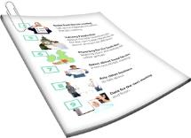


Pledge commitments
To make sure people can speak up if they have a question or are worried about the medicine
To keep good records about the person’s health, wellbeing and behaviour
To follow all the laws and rules about how the medicine is used
To work with people with a learning disability, autism or both, their families, care teams, health professionals, commissioners and others to stop over medication
Notes:
Dave

Slide 9
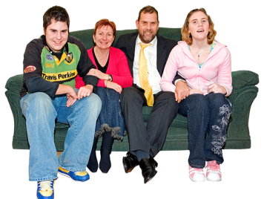
STAMP
Coming soon – for children and young people
STOMP-STAMP – supporting treatment and appropriate medication in paediatrics.
The Royal College of Paediatricians & Child Health and the Academy of Childhood Disability partnering with NHS England, with other pledge partnerships under development.
STOMP-STAMP is led by the NHS England Children and Young People’s team for learning disability, autism or both.
Expected launch in the Autumn.
Notes:
Dave

Slide 10
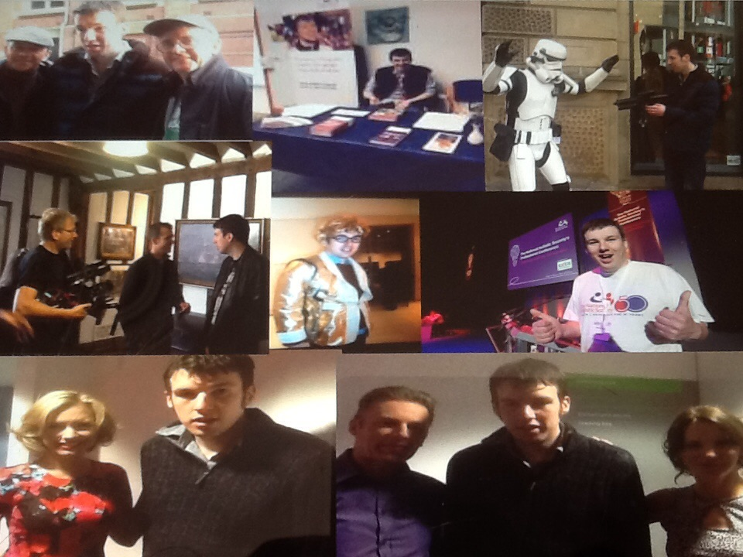
HAZEL AND MARK’s STORY
We will now hear from Hazel Griffiths a family carer expert who works with the NHS England team about her experience with her son Mark
Notes:
Hazel

Slide 11

ASK LISTEN DO
Ask Listen Do easy read leaflet easy read leaflet about the Ask, Listen, Do project and its aims.
Ask listen Do film for organisations and professionals https://www.youtube.com/watch?v=ANxS91mn1YQ&t=10s
Ask Listen Do film for autistic people, people with learning disabilities, their families and carers https://www.youtube.com/watch?v=qOkAdvAkigk
Ask Listen Do Whole School SEND leaflet for families and carers Whole School SEND project
Ask Listen Do Top Tips for families and carers top tips for family and carers
Notes:
ASK LISTEN DO a key principle – Carl to give a brief overview of what ALD is.

Slide 12
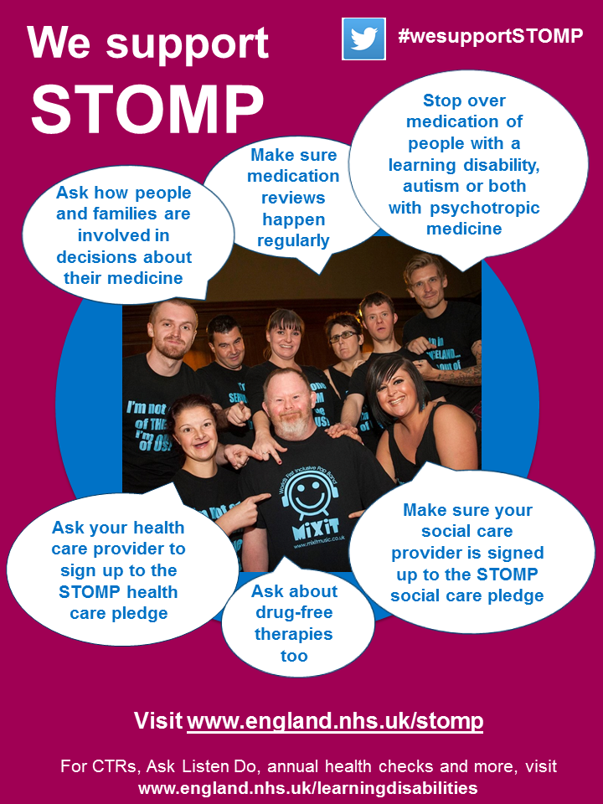
Everyone can get involved in some way
Visit
www.england.nhs.uk/stomp
Or email england.wesupport.stomp@nhs.net
Notes:
Carl – to show the link rather than to explain it

Slide 13

The NHS England learning disability programme
Visit www.england.nhs.uk/learningdisabilities
Ask Listen Do
STOMP – stopping over medication with psychotropic drugs
Care (Education) and Treatment Reviews
Annual health checks
Summary care records
Right Care for people with epilepsy, heart disease and swallowing difficulties
Quality Checkers
Transforming Care
Always events
Mortality reviews
and more

Slide 14
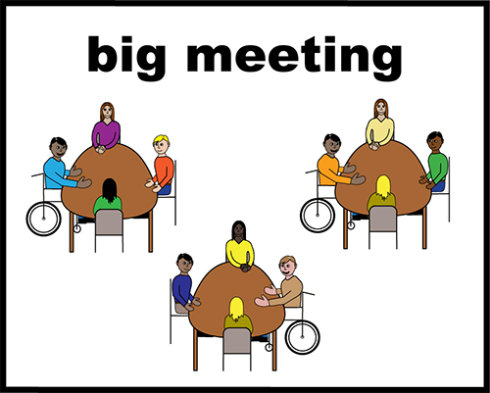
ADVOCATES
Become STOMP aware
Think of how you can help the people you support to challenge medication use
Share experiences with each other to build confidence and awareness
More information available at
https://www.england.nhs.uk/learning-disabilities/improving-health/stomp/
Notes:
Dave
Then handover to Jonathan

