Slide 1
The UN Convention on the Rights of Persons with Disabilities: a primer for advocates
Oliver Lewis
Doughty Street Chambers
@DrOliverLewis

Slide 3
Notes:
Fastest negation over 4 years
Adopted by the UN General Assembly in 2006

Slide 4
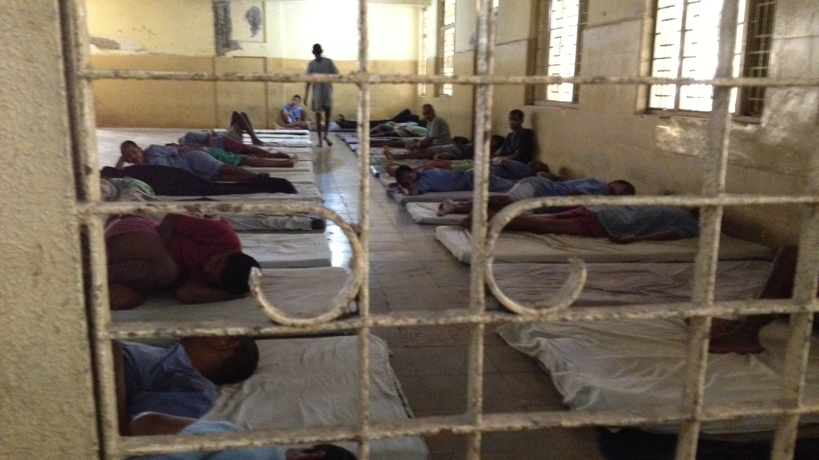

Slide 5
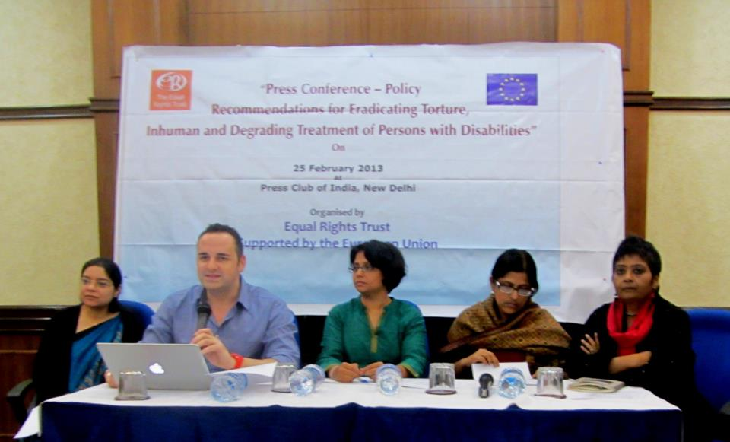

Slide 8
CRPD Committee
18 members
Meets twice per year
Examine each state, produce Concluding observations
Inquiry reports
Individual complaints
General comments

Slide 9
CRPD in the UK
UK ratified CRPD in 2009
The European Convention on Human Rights (ECHR) is incorporated into English law via the Human Rights Act 1998
The CRPD is not incorporated, but can be used as an interpretive aid: R (On the Application of Davey) v Oxfordshire CC [2017] 354 (Admin)
The Court of Protection has also used it: Cornwall Council v NP and BKP [2020] EWCOP 44

Slide 10
Key concepts in the CRPD
Full and effective participation
Inclusion
Non-discrimination (incl reasonable accommodation)
Accessibility
Persons with disabilities include those who have long-term physical, mental, intellectual or sensory impairments which in interaction with various barriers may hinder their full and effective participation in society on an equal basis with others

Slide 11
Three key rights
Legal capacity
Living independently and being included in the community
Life

Slide 12
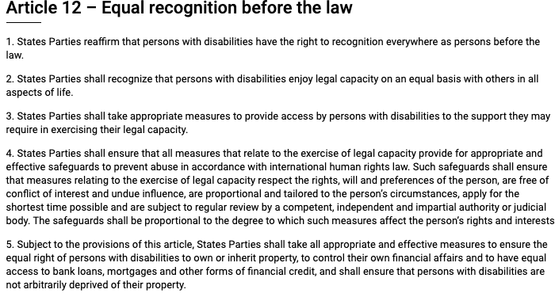

Slide 13
Legal capacity
“The prevalence of substituted decision-making in legislation and in practice, and the lack of full recognition of the right to individualized supported decision-making that fully respects the autonomy, will and preferences of persons with disabilities” [CRPD Committee’s Concluding Observations on the UK, 2017, para. 30b]
“The high number of black people with disabilities who are compulsorily detained and treated against their will” [para. 30d]
Committee urged UK government “to step up efforts to foster research, data and good practices in the area of, and speed up the development of, supported decision-making regimes” [para. 31]
Committee was concerned of “Reports of persons with psychosocial and/or intellectual disabilities who do not receive appropriate support in exercising their legal capacity and access to justice” [para. 32b]

Slide 14
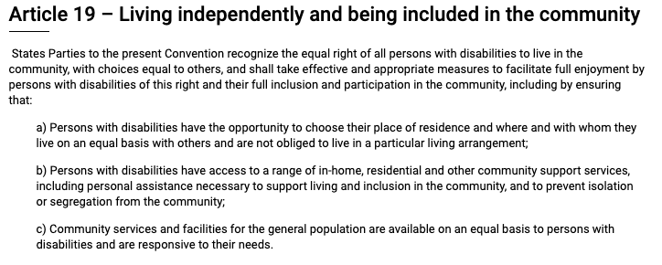

Slide 15
Article 19 in the UK
“legislation fails to recognize living independently and being included in the community as a human right that enshrines individual autonomy, control and choice as intrinsic aspects of that right” [para. 44a]
“responsibility for supporting independent living has been transferred to the devolved administrations and local authorities without providing appropriate and earmarked budget allocation” [para. 44c]
“many persons with disabilities are still institutionalized and deprived of the right to live independently and be included within the community, when: (i) they lack the financial resources to afford personal assistance; (ii) local authorities are of the opinion that they can provide assistance within care homes; and (iii) the cost rationale constitutes the main parameter of an assessment” [para. 44d]

Slide 16
Advocates using Article 19 CRPD
P is being denied their right to living independently and be included in the community
Support services are unavailable, inaccessible, unaffordable, unacceptable, unadaptable or are insensitive to the living conditions of P
No local strategy for social support and living independently
The local authority lacks adequate earmarked funding to enable P to live independently and be included in the community and to exercise their right to choose their place of residence and where and with whom to live
No local plan aimed at the deinstitutionalization of disabled people and no community-based independent living schemes, with input of education, childcare, transport, housing, employment and social security
Notes:
It’s not just Whorlton Hall and Yew Trees where abuse occurs. Institutionalisation is discrimination. Institutionalisation is a violation of rights. Advocates can play a part in documenting clients’ experiences and make the case for reform. Refer to the CRPD – it applies in the UK. It is a piece of binding international human rights law.

Slide 17
Right to life
Article 2 ECHR / Article 10 CRPD
Negative and positive duties
Residents of congregate care settings at increased risk of becoming infected with Covid-19
Older and disabled people at increased risk of worse outcome

Slide 18
Best interests?
For a person lacking capacity, the best interests decision-maker “must consider all the relevant circumstances”: MCA s.4(2)
The state (local authority) is obliged to take steps to prevent a deprivation of liberty of which the authorities have or ought to have knowledge: Storck v. Germany, para. 102
A DoL is only lawful if the best interests qualifying requirement is met. If P’s health and life is threatened by continuing to live in a congregated care, make an s.21A MCA application

Slide 19
Emergency deinstitutionalisation
“[C]oncerted efforts should be made by all relevant authorities to resort to alternatives to deprivation of liberty” This includes an effort to “reassess the need to continue psychiatric detention; transfer people out of social care facilities into community care” (European Committee for the Prevention of Torture, 21 March 2020)
“Reduce the number of people in psychiatric hospitals, wherever possible, by implementing schemes of early discharge, together with provision of adequate support for living in the community” (WHO, 26 March 2020)
“[A]ccelerate measures of deinstitutionalization of persons with disabilities from all types of institutions” (Chair of the CRPD Committee and the Special Envoy of the UNSG on Disability and Accessibility, 1 April 2020)

Slide 20
“Discharge and release persons with disabilities from institutions and promptly ensure provision of support in the community through family and/or informal networks, and fund support services by public or private service providers” (OHCHR, 29 April 2020)
“Reduce the number of people within institutions. It is important to take immediate action to discharge and release persons with disabilities from institutions, whenever possible. Deinstitutionalization strategies need to be accelerated and reinforced with clear timelines and concrete benchmarks” (UN Sec-Gen, 6 May 2020)
“Where possible, reduce care home occupancy to facilitate management of potential outbreaks, or increase designated spaces in the community and hospitals to manage different stages of virus transmission” and “Consider short-term transfer of residents to alternative accommodation” (WHO-Europe, 28 May 2020)

Slide 21
Summary
CRPD has useful concepts and language that advocates can use
Rights not incorporated in the UK, but are in use in social care and Court of Protection
Right to legal capacity
Right to independent living and being included in the community
Good luck!

