Slide 1
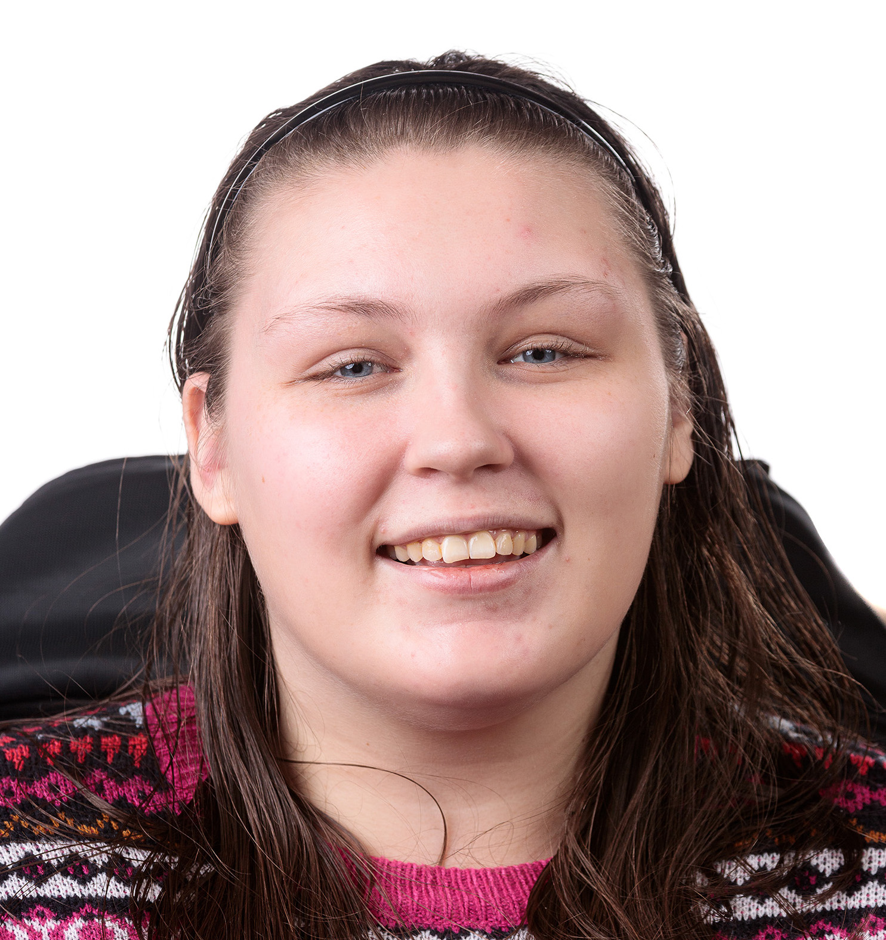
Lucy Watts MBE MUniv FRSA
Personalised Care: An Insight into PHBs, Advocacy and Lived Experience
www.lucy-watts.co.uk

Slide 2
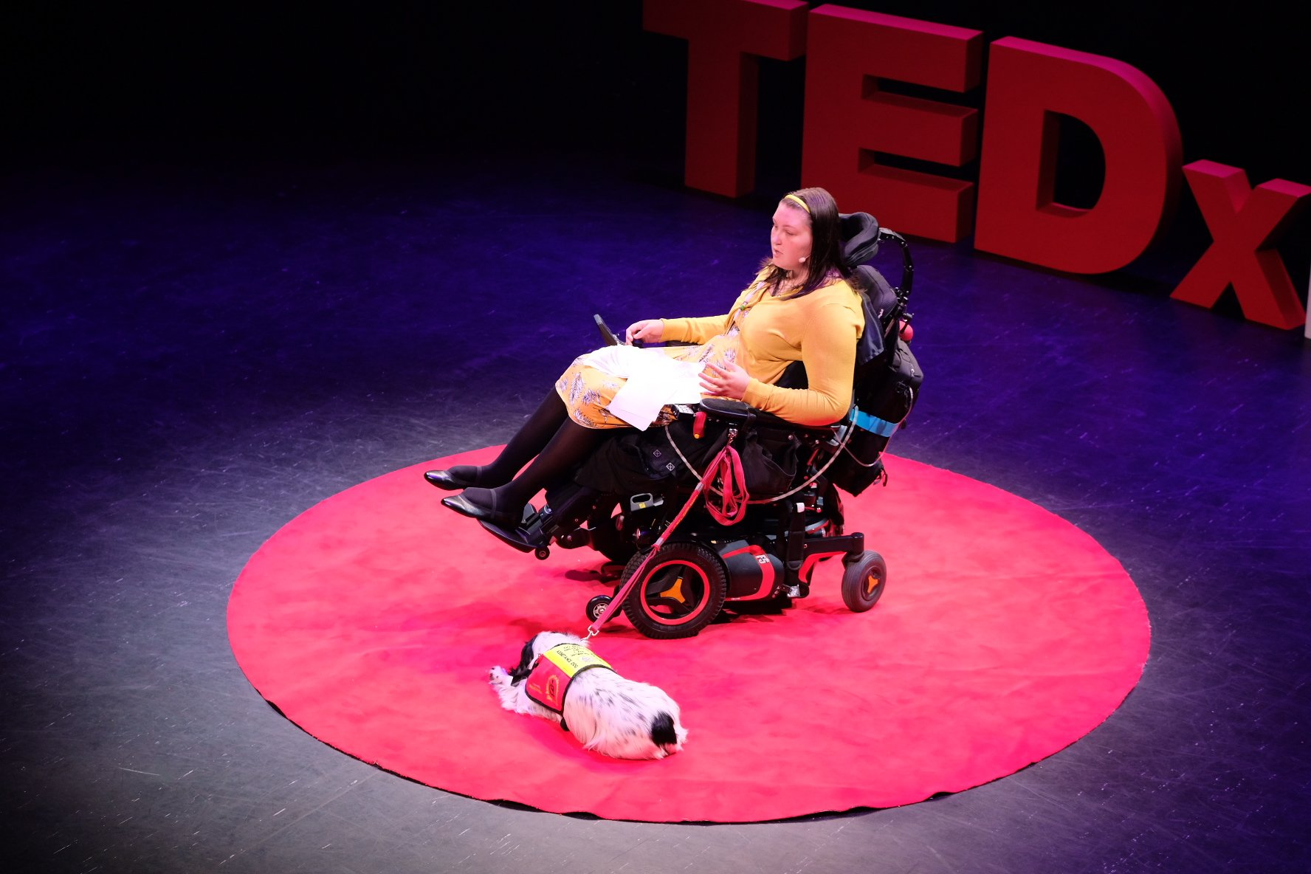
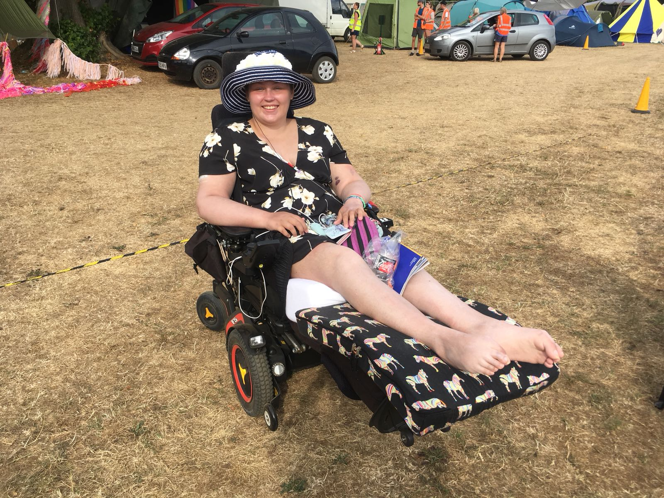
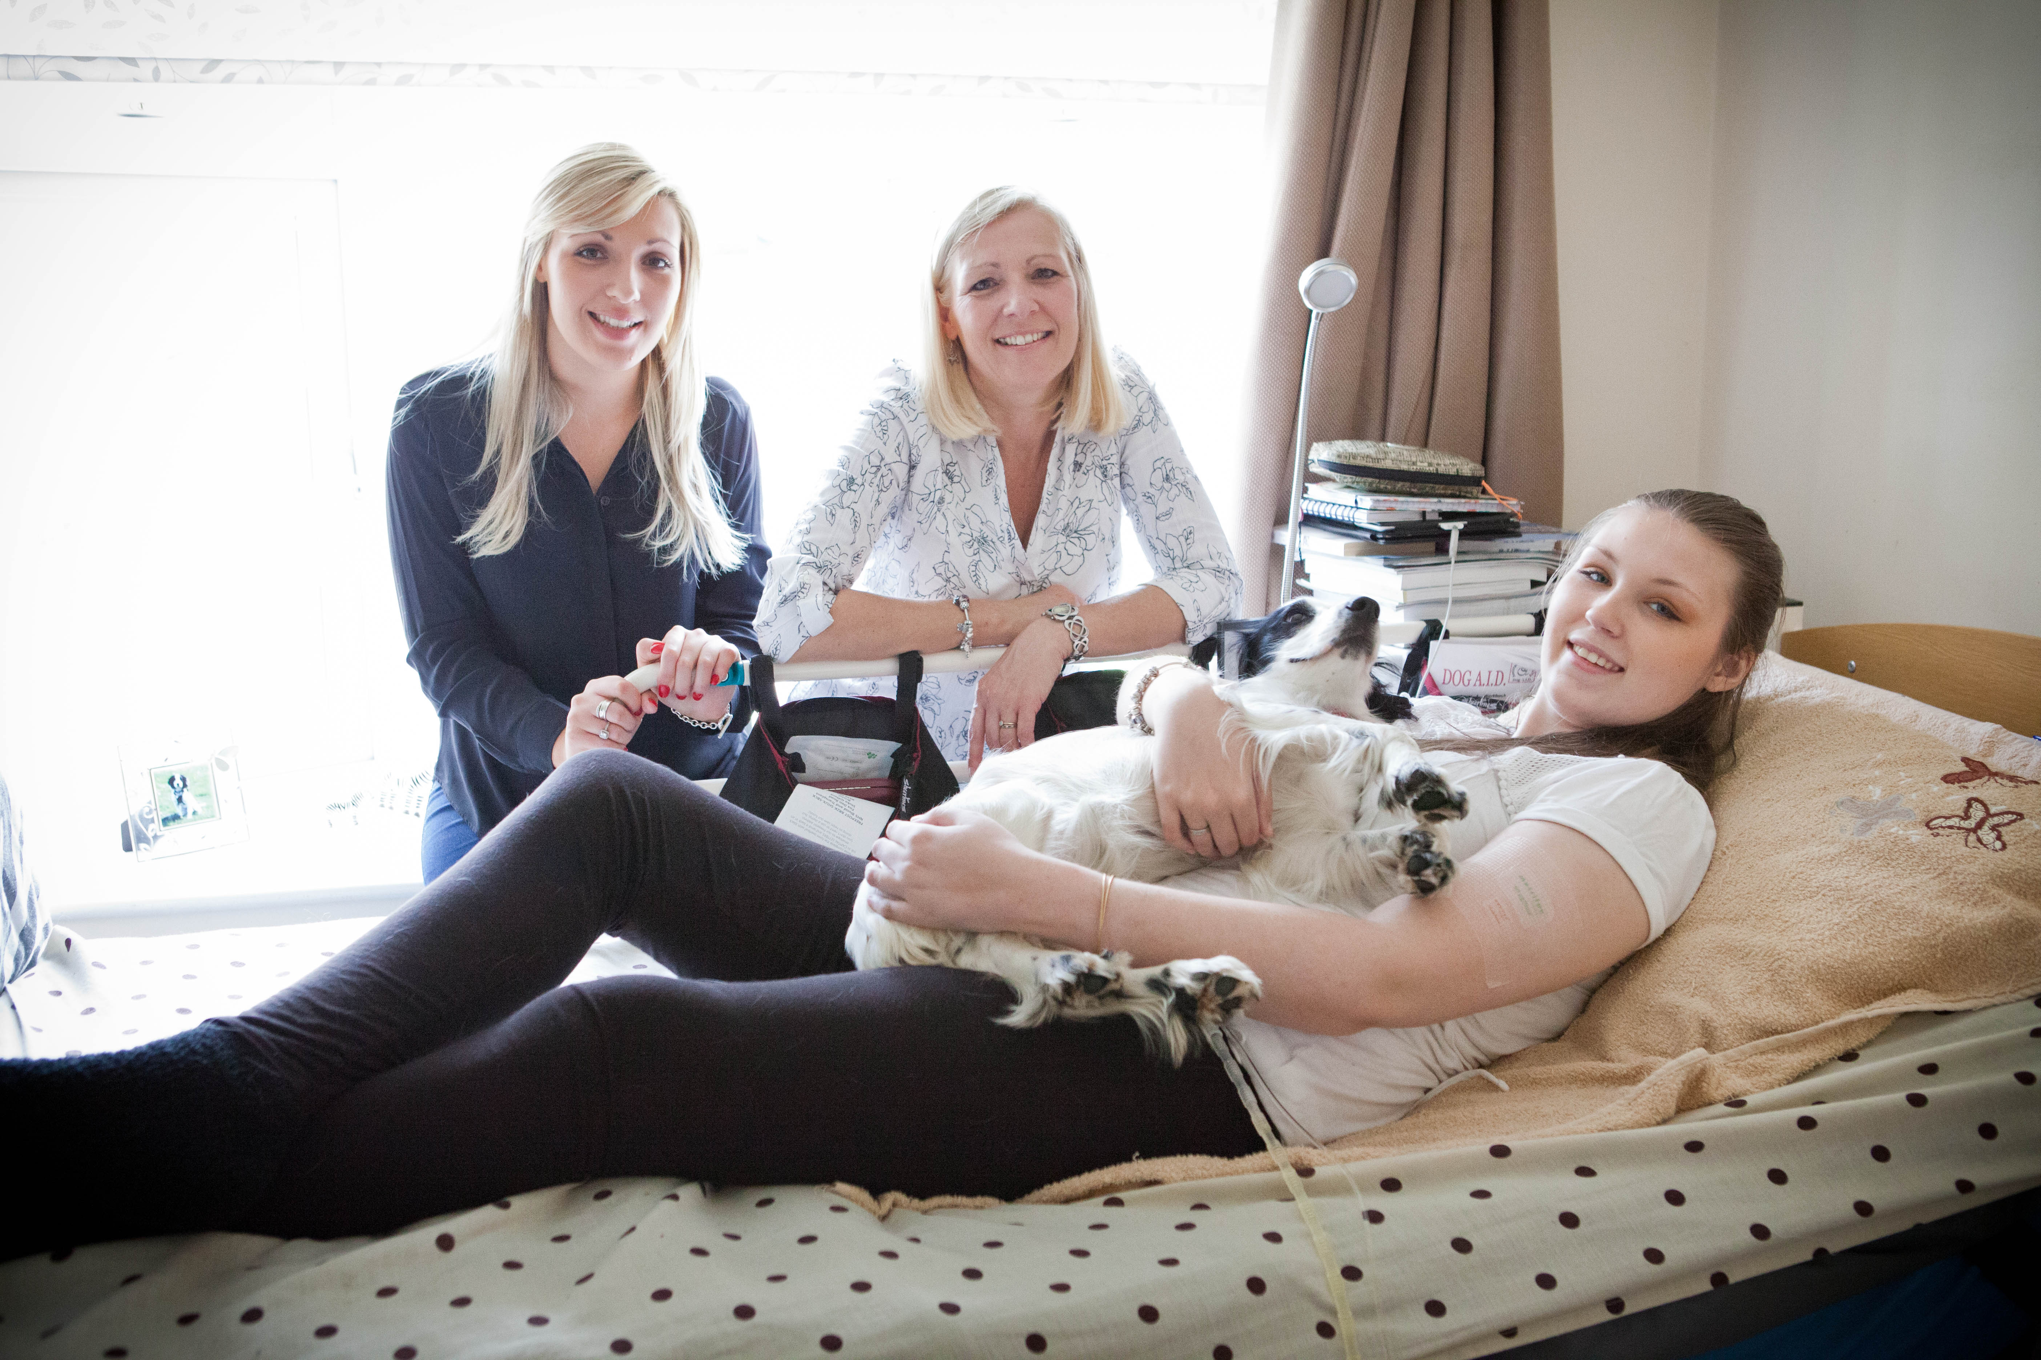
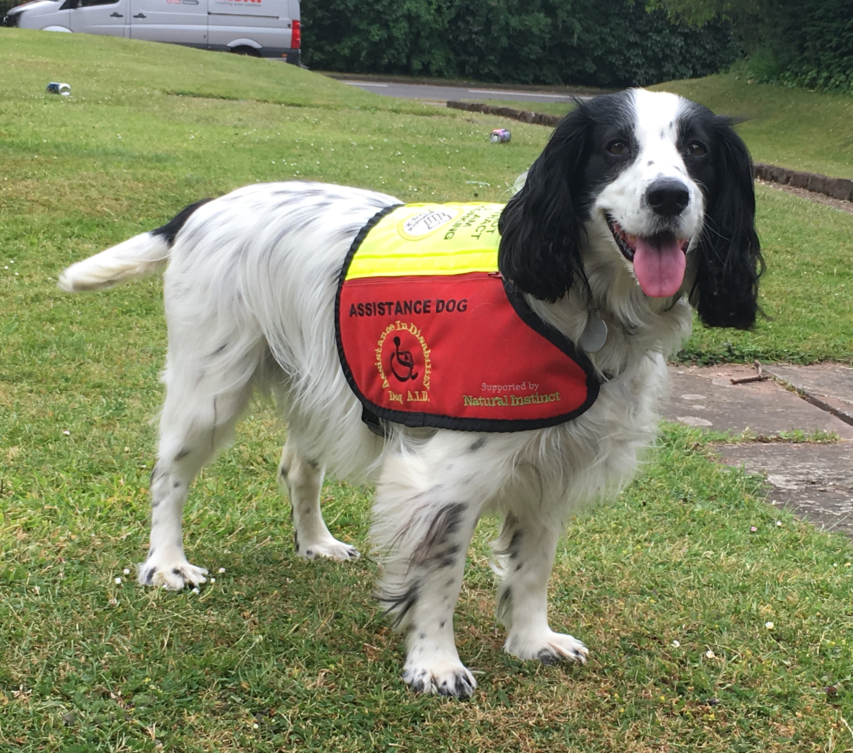
Who Am I?
Public Speaker
(inc. TEDxNHS 2019)
Festival-goer
(with Festival Spirit)
Daughter, Sister, Friend
Mum to the
infamous #MollyDog
(Molly, Dog With A Blog)
My Assistance Dog
A person with lived experience: living with a life-shortening illness, a syndrome without a name (SWAN), with complex medical needs and a physical disability
Also a business owner, Support Broker, Independent Advocate, consultant, public speaker, patient/peer leader, charity trustee and co-researcher

Slide 3
Personalised Care: An Approach To Care
Personalised care is now integral to moving our health and social care system(s) forward.
Personalised care is about looking at the individual as a whole person, about “what matters to you”, about seeing individuals as people with skills and assets as well as people in need of support or care, and about putting the individual and their needs, wishes and preferences at the centre.
However we must ensure it is truly personalised – no tokenism!

Slide 4
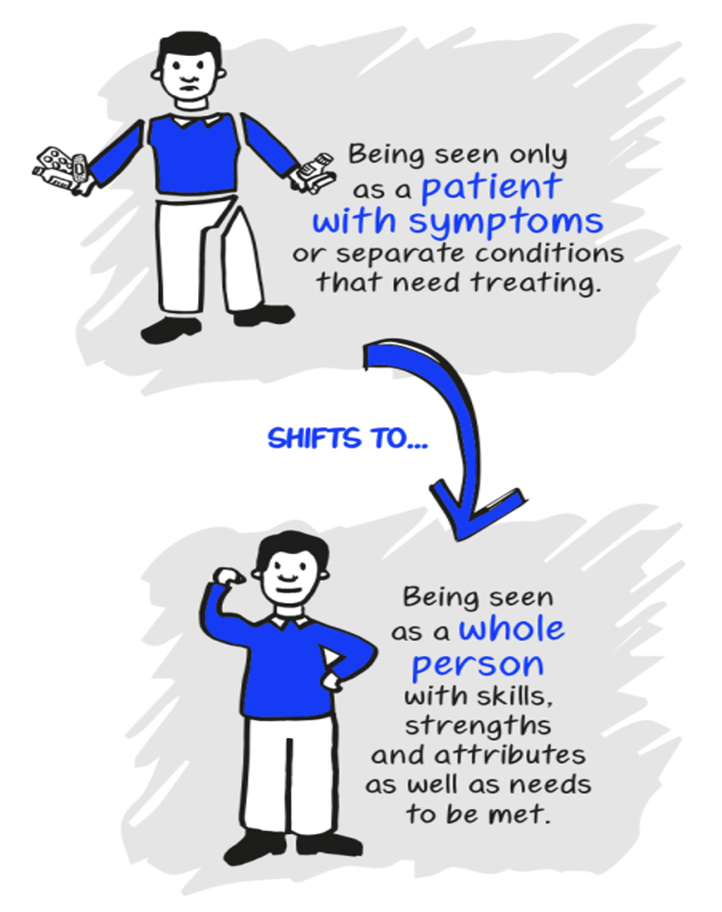
A shift in relationships lies at the heart of personalised care, and of Personal Health Budgets
Images © the NHS England Personalised Care Group / Lived Experience Team

Slide 5
Personal Health Budgets (PHBs)
A different approach to commissioning, providing and managing care and support which puts the individual (or their representative) in the driving seat of their care, builds the care and support around them, gives them greater choice and flexibility over how the funding is spend and how the care is provided, and allows people to make their care work for them, rather than fitting their care, needs and lives into available services.
The person with a personal health budget (or their representative) should:
Be central in developing their personalised care and support plan and agree who is involved
Be able to agree the health and wellbeing outcomes they want to achieve, together with relevant health, education and social care professionals
Get an upfront indication of how much money they have available for healthcare and support
Have enough money in the budget to meet the health and wellbeing needs and outcomes* agreed in the personalised care and support plan
Have the option to manage the money as a direct payment, a notional budget, a third party budget or a mix of these approaches
Be able to use the money to meet their outcomes in ways and at times that make sense to them, as agreed in their personalised care and support plan.

Slide 6
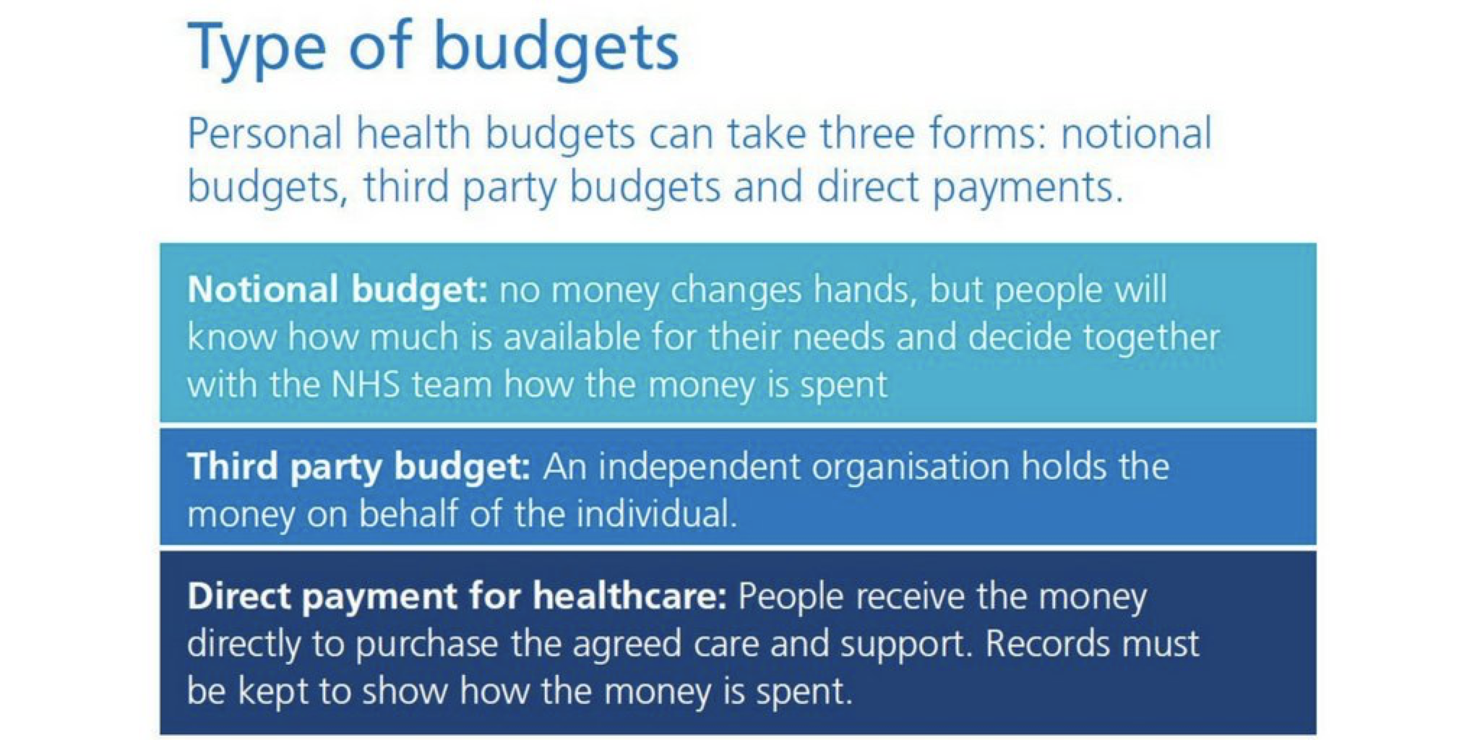
Ways of managing a Personal Health Budget

Slide 7
My Personal Health Budget
My PHB covers 24-hour care in my home:
16 hours per day with a Registered Nurse (RGN)
8 hours overnight with a Personal Care Assistant (PA)
6 hours of 2:1 care with a PA alongside the nurse during the day
I manage this via a direct payment, employing and managing my staff myself, with a company doing the payroll aspect for me.
I am the legal employer, and I manage the package and make the decisions around the spending of my budget in line with my personalised care and support plan.

Slide 8
My PHB Plan
Built around “what matters to you?”
Gives a clear understanding of me, my life, goals and desired outcomes
Summarises my needs, how to meet my needs and important information
Gives a 24 hour-by-hour breakdown of my needs and care given
How the package will be managed
How I will manage my staff, hourly rate, shifts
Identifies risks and how to mitigate them
Lays out the training needed for staff and core competencies
Financial costs up all aspects of my package, including training, DBS, etc.
It includes a solid contingency plan
I also have a separate notional budget with the CCG which manages
my contingency for my nurses with an identified agency,
and 7 days respite funding per year.

Slide 9
How I manage training of staff and clinical governance for my PHB
I have a senior nurse employed on the PHB, who acts as the clinical governance and oversight manager and delivers some of the training to staff, as well as responsibility for checking and maintaining staff competency.
Detailed care plan for home use with comprehensive information and information pack including care procedures and protocols.
Shadow shifts are used for new staff where possible.
Training includes:
Up to 3 hours, per nurse, per year, for 8-10 nurses, for training and competencies in central lines (CVADs), TPN, IVs
Online mandatory training
Stoma care training (free from local hospital)
Specialist training in holistic, person-centred and palliative care provided by Saint Francis Hospice
Staff get-together for ongoing training or social and CPD opportunities
Unusual request – aromatherapy massage training for my staff to aid pain relief (funded)

Slide 10
Why is my PHB so important to me?
It gives me choice, control, freedom and flexibility to manage my care to meet my needs and to ensure my package works around my life and enables me to do the things that matter to me, as well as giving me greater autonomy over my life overall.
I get to choose the people I have around me everyday – my staff – who are in our home home 24/7, as I am able to select candidates that work well with me, my family, my life and my needs.
I can make the package work for me, use the funding (in line with my support plan) to best meet my needs, decide which staff member works, when, what we do, what hours they work, giving me the ability to continue my paid employment, running my business, as well as my voluntary, advocacy and committee work.
It’s me and my team. Not an endless round of people an agency chooses to send.

Slide 11
How does advocacy fit into this picture?
Advocates have supported me in my life and made tremendous impact.
Originally, I had a children’s advocate who was the first person who showed me I had my own voice – and that not only was I able to challenge poor care or treatment, but that it was important to do so. She changed the course of my life, bringing stories of her disabled daughter a few years older than me, that helped me see I had a life ahead of me. Unfortunately, the service changed its criteria/commissioned services, and I lost this advocate. Since then, I ceased to fit into statutory advocacy provisions in my local area.
Fortunately, about 4 years later, when we had an issue, we asked the help of a friend, who is a trained advocate, who fought for me and helped me secure my PHB I have today.
I am knowledgeable, educated, articulate, able to speak for myself and (though I hate it) to challenge things, but even I have benefitted from having an advocate.

Slide 12
Beneficiary into provider
Over the years, I started to provide peer advocacy and peer brokerage. My ”caseload” began to grow and before I knew it, I was being referred people for my support. I completed a Level 2 Award in Independent Advocacy to support this.
Now I have my business and I work as an Independent Advocate with a specialist interest in NHS Continuing Healthcare, Personal Health Budgets, integrated budgets/funding, NHS advocacy and Care Act Advocacy.
I also began to work as an Independent Support Broker with particular expertise in Personal Health Budgets, including being repeatedly commissioned by one CCG and working on cases across England on Personal Health Budgets, with different funding arrangements, and recently, building a care package for an individual privately as they are able to self-fund their care, through their family.

Slide 13
Importance of Using Lived Experience
My lived experience has enabled me to do so many things, bringing a unique perspective and enhancing organisations and work being done through helping professionals, services, charities, the NHS and government to better understand the difficulties faced by and experiences of people on the receiving end of services or support, or of people working with them.
We all have lived experience, and this informs our thoughts, our values, our perspectives, and how we react to things.
Think about how your lived experience informs your decisions, actions and beliefs? Do you see it as an asset, as a help, or as a hindrance?
The thing is, lived experience is never invalid and it is always valuable. We need to see lived experience as a valuable asset to be utilised – and to use it for best impact.
As so aptly put by Warner Slack, the visionary physician:
“Patients are the largest and least utilised resource in healthcare.”

Slide 14
Ready for questions or a discussion?
There’s no such thing as a silly question.
So please – ask away!
Lucy Watts MBE MUniv FRSA
www.lucy-watts.co.uk

