Slide 2
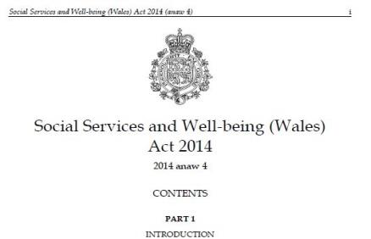
Tips and tricks in using community care law legislation to promote choice

Slide 3
Jess Flanagan
Health & Welfare Court of Protection
Community Care
Senior Associate
Clarke Willmott LLP
t: 0345 209 1160 e: jess.flanagan@clarkewillmott.com

Slide 4
Rebecca Stickler
Barrister and head of Public Law team
Guildhall Chambers
t: 0117 930 8980
e: rebecca.stickler@guildhallchambers.co.uk

Slide 5
Introductions

Slide 6
Statutory overview
Care Act 2014
Regulations
Statutory Guidance
Social Services and Well-being Act 2014
Regulations….
Codes of Practice and Statutory Guidance
Mental Capacity Act 2005
Code of Practice
DOLS Code of Practice
National framework for NHS continuing healthcare and NHS-funded nursing care (October 2018)
Continuing NHS Healthcare The National Framework for Implementation in Wales (June 2014)
Mental Health Act 1983 (as amended) and Code of Practice

Slide 7
Who are we supporting?

Slide 8
What are the challenges?

Slide 9
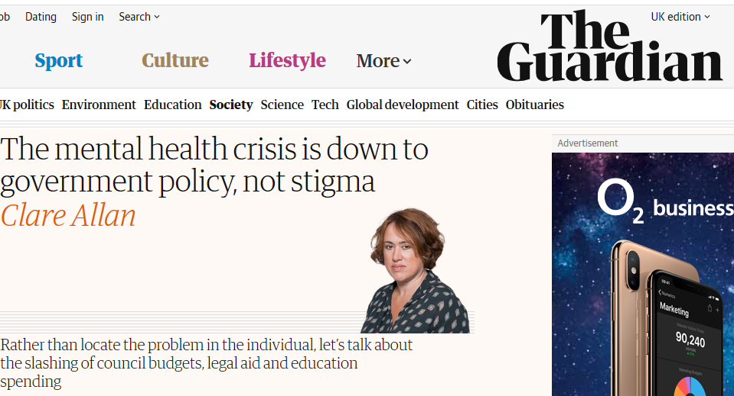
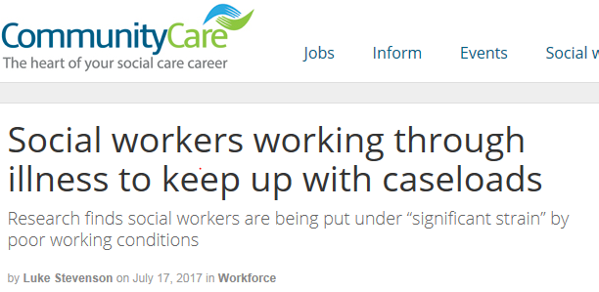

Slide 10
But that cannot be an excuse!
The Law!!!
Duties
Powers
Rights

Slide 11
The law helps us with choice!

Slide 12
Care Act 2014
Assumption that the individual is best-placed to judge the individual's well-being
P’s wishes and feelings, beliefs and values
Decisions are made having regard to all the individual's circumstances – no unjustified assumptions
Ensuring P enabled to fully participate in decisions about them
Need to protect people from abuse and neglect
Minimum necessary restriction on rights or freedom of action

Slide 13
The law helps us with choice!

Slide 14
Social Services and Well Being Act (Wales) 2014
the importance of beginning with the presumption that the adult is best placed to judge the adult's well-being,
wishes and feelings, beliefs and values
have regard to the characteristics, culture and beliefs of the individual (including, for example, language),
the importance of promoting the adult's independence where possible.
have regard to the importance of promoting and respecting the dignity of the individual,
Importance of participation

Slide 15
The law helps us with choice!
In summary -
Promote well-being
The individual being best placed to judge their own well-being
Ascertain and have regard to wishes and feelings
Promote dignity of the individual
Advocacy
Choice to refuse assessment and support

Slide 16
Limitations on choice – Care Act 2014
R(Davey) v Oxfordshire CC [2017] EWCA Civ 1308
The Queen on the Application of VI v London Borough of Lewisham [2018] EWHC 2180 (Admin)
R. (on the application of MG) v Brent LBC [2018] EWHC 1777 (Admin)
CP v North East Lincolnshire Council [2018] EWHC 220 (Admin)

Slide 17
The law helps us with choice!

Slide 18
Principles

Slide 19
The Principles
Section 1:
(2)A person must be assumed to have capacity unless it is established that he lacks capacity.
(3)A person is not to be treated as unable to make a decision unless all practicable steps to help him to do so have been taken without success.
(4)A person is not to be treated as unable to make a decision merely because he makes an unwise decision.
(5)An act done, or decision made, under this Act for or on behalf of a person who lacks capacity must be done, or made, in his best interests.
(6)Before the act is done, or the decision is made, regard must be had to whether the purpose for which it is needed can be as effectively achieved in a way that is less restrictive of the person's rights and freedom of action.

Slide 20
Weight to attach to P’s wishes and feelings – must have regard to:
a) the degree of P's incapacity, for the nearer to the borderline the more weight must in principle be attached to P's wishes and feelings: Re MM; Local Authority X v MM (by the Official Solicitor) and KM [2007] EWHC 2003 (Fam), [2009] 1 FLR 443, at para [124]; b) the strength and consistency of the views being expressed by P; c) the possible impact on P of knowledge that her wishes and feelings are not being given effect to: see again Re MM; Local Authority X v MM (by the Official Solicitor) and KM [2007] EWHC 2003 (Fam), [2009] 1 FLR 443, at para [124]; d) the extent to which P's wishes and feelings are, or are not, rational, sensible, responsible and pragmatically capable of sensible implementation in the particular circumstances; and e) crucially, the extent to which P's wishes and feelings, if given effect to, can properly be accommodated within the court's overall assessment of what is in her best interests.
ITW v Z, M & Various Charities [2009] EWHC 2525 (Fam) (per Munby J)

Slide 21
Weight to attach to P’s wishes and feelings – must have regard to:
"The purpose of the best interests test is to consider matters from the patient's point of view. That is not to say that his wishes must prevail, any more than those of a fully capable patient must prevail. We cannot always have what we want. Nor will it always be possible to ascertain what an incapable patient's wishes are. Even if it is possible to determine what his views were in the past, they might well have changed in the light of the stresses and strains of his current predicament. In this case, the highest it could be put was, as counsel had agreed, that "It was likely that Mr James would want treatment up to the point where it became hopeless". But in so far as it is possible to ascertain the patient's wishes and feelings, his beliefs and values or the things which were important to him, it is those which should be taken into account because they are a component in making the choice which is right for him as an individual human being".
Aintree University Hospitals NHS Foundation Trust v James and others [2013] UKSC 67 (at paragraph [45]):

Slide 22
Wishes feelings, beliefs and values
The issue of wishes and feelings was again carefully considered by Peter Jackson J in Wye Valley NHS Trust v B [2015] EWCOP 60
The learned judge clearly highlighted that the utmost importance should to be placed on the wishes and feelings of an incapacitous person in circumstances where their beliefs and values are an inextricable part of their personality structure, and that without such consideration, a person would be looked at in the abstract which is as meaningless as speaking of “an unmusical Mozart” (Peter Jackson J, paragraph 13.)

Slide 23
Limitations on choice – Mental Capacity Act 2005
N v ACCG [2017] UKSC 22

Slide 24
Human Rights Act 1998 (s6)

Slide 25
Key tips to keep in mind

Slide 26
Choice of Care – Direct Payments
Care Act 2014: sections 31-33
Care and Support (Direct Payments) Regulations 2014
SSW(W)A 2014: sections 50-53
The Care and Support (Direct Payments) (Wales) Regulations 2015
The Conditions…
REMEMBER: DUTY to make direct payments if conditions are met

Slide 27
Choice of Accommodation – social care
Care Act 2014: section 30
Care and Support and After-care (Choice of Accommodation) Regulations 2014/2670
SSW(W)A 2014: section 57
Care and Support (Choice of Accommodation) (Wales) Regulations 201
The Conditions…
REMEMBER: Local Authority MUST provide or arrange for the provision of the preferred accommodation if conditions are met

Slide 28
Choice – NHS Continuing Healthcare
National Framework for NHS Continuing Healthcare
Primary Health Need
Nature, Intensity, Complexity, Unpredictability
Is CHC really better?
Take choice into account BUT need only meet assessed needs
No right to top ups
Personal Health Budget in home environment

Slide 29
Co-operation
Part 9 of the SSW(W)A -“co-operation and partnership”
Sections 162 – 165 prescribe specific duties of co-operation between Local Authorities and their “relevant partners” which include “a Local Health Board for an area any part of which falls within the area of the authority”
Mirror provisions in the Care Act 2014
Sections 6 & 7

Slide 30
Fundamental Standards of Care
In England - Health and Social Care Act 2008 (Regulated Activities) Regulations 2014
In Wales - Regulated Services (Service Providers and Responsible Individuals) (Wales) Regulations 2017/1264
Person-centred care
Dignity and Respect
Consent
Safety
Safeguarding from Abuse
Good governance
Fit and Proper Staff

Slide 31
Care Act 2014 – assessments, tips for getting the best assessment

Slide 32
Care Act 2014
Section 9:
(1)Where it appears to a local authority that an adult may have needs for care and support, the authority must assess—
(a)whether the adult does have needs for care and support, and
(b)if the adult does, what those needs are.
(3)The duty to carry out a needs assessment applies regardless of the authority's view of—
(a)the level of the adult's needs for care and support, or
(b)the level of the adult's financial resources.
(4) A needs assessment must include an assessment of—
(a)the impact of the adult's needs for care and support on the matters specified in section 1(2),
(b)the outcomes that the adult wishes to achieve in day-to-day life, and
(c)whether, and if so to what extent, the provision of care and support could contribute to the achievement of those outcomes.
(5) A local authority, in carrying out a needs assessment, must involve—
(a)the adult,
(b)any carer that the adult has, and
(c)any person whom the adult asks the authority to involve or, where the adult lacks capacity to ask the authority to do that, any person who appears to the authority to be interested in the adult's welfare.
(6)When carrying out a needs assessment, a local authority must also consider—
(a)whether, and if so to what extent, matters other than the provision of care and support could contribute to the achievement of the outcomes that the adult wishes to achieve in day-to-day life

Slide 33
Eligibility
Section 13:
(1) – (4) set out the duty of the LA to meet needs that meet the eligibility criteria
(5) if no needs meet the eligibility criteria the LA must give written advice and information to the adult as to how s/he might meet those needs and prevent or delay the development of those needs.
Eligibility criteria are set out in regulations and replace FACS 2002

Slide 34
Care and Support (eligibility criteria) Regulations 2015
2.—(1) An adult’s needs meet the eligibility criteria if—
(a)the adult’s needs arise from or are related to a physical or mental impairment or illness;
(b)as a result of the adult’s needs the adult is unable to achieve two or more of the outcomes specified in paragraph (2); and
(c)as a consequence there is, or is likely to be, a significant impact on the adult’s well-being.

Slide 35
Care and Support (eligibility criteria) Regulations 2015
(a)managing and maintaining nutrition;
(b)maintaining personal hygiene;
(c)managing toilet needs;
(d)being appropriately clothed;
(e)being able to make use of the adult’s home safely;
(f)maintaining a habitable home environment;
(g)developing and maintaining family or other personal relationships;
(h)accessing and engaging in work, training, education or volunteering;
(i)making use of necessary facilities or services in the local community including public transport, and recreational facilities or services; and
(j)carrying out any caring responsibilities the adult has for a child.

Slide 36
Care and Support (eligibility criteria) Regulations 2015
(3) …an adult is to be regarded as being unable to achieve an outcome if the adult—
(a)is unable to achieve it without assistance;
(b)is able to achieve it without assistance but doing so causes the adult significant pain, distress or anxiety;
(c)is able to achieve it without assistance but doing so endangers or is likely to endanger the health or safety of the adult, or of others; or
(d)is able to achieve it without assistance but takes significantly longer than would normally be expected.

Slide 37
Care and Support Plans
Section 24:
(1)Where a local authority is required to meet needs under section 18 or 20(1), or decides to do so under section 19(1) or (2) or 20(6), it must—
(a)prepare a care and support plan or a support plan for the adult concerned,
(b)tell the adult which (if any) of the needs that it is going to meet may be met by direct payments, and
(c)help the adult with deciding how to have the needs met.
Section 25:
(1)A care and support plan or, in the case of a carer, a support plan is a document prepared by a local authority which—
(a)specifies the needs identified by the needs assessment or carer's assessment,
(b)specifies whether, and if so to what extent, the needs meet the eligibility criteria,
(c)specifies the needs that the local authority is going to meet and how it is going to meet them,
(d)specifies to which of the matters referred to in section 9(4) the provision of care and support could be relevant or to which of the matters referred to in section 10(5) and (6) the provision of support could be relevant,
(e)includes the personal budget for the adult concerned (see section 26), and
(f)includes advice and information about—
(i)what can be done to meet or reduce the needs in question;
(ii)what can be done to prevent or delay the development of needs for care and support or of needs for support in the future.

Slide 38
Care and Support Statutory Guidance

Slide 39
Not all doom and gloom as cases frequently settle without going to court….

Slide 40
When to call a lawyer!
Local resolution before assessment / support plan signed off
Could have phone discussion for initial advice and guidance and copy solicitor in to correspondence
Complaints procedures
If it is particularly complex
Legal Help funding is available
Ombudsman
Again, if it is particularly complex
Legal Help funding is available
Not sure of how helpful the LGO is being at the moment
Letter before claim – successful cases are unreported!
Judicial Review
Legal Aid is available but the funding structure makes it high risk legal action

