Slide 1
Open Justice in the Court of Protection: Opportunities for Advocates
Gill loomes- Quinn
National Advocacy Conference
27th October 2020

Slide 2
Talk Outline
The Court of Protection and Transparency
The Project: What We Do
The Project
Twitter
The Website
The Blog
Observer Feedback Form
Observers’ Experiences
Why Observe the CoP in Action?

Slide 3
The Court of Protection
&
Transparency

Slide 4
The Court of Protection
Established in current form by the Mental Capacity Act 2005
Makes determinations about mental capacity
Makes Best Interests decisions on behalf of incapacitous adults
Impairments – e.g. dementia, learning disability, autism, psychiatric
Wide range of cases (health, welfare, property and affairs, DoLS)
Significant implications for Disability Justice
Sits in London (RCJ and First Avenue House) and Regions
Approx. 30 hearings scheduled per day
High percentage of adjournments/vacations (impact on observers)
Low numbers of published judgments (2015: 85, 2016: 66, 2017: 31, 2018: 38, 2019: 58 – out of 1000s of hearings each year. Most hearings are Directions etc but this is a lot of court work not available to be scrutinised via reading published judgments)

Slide 5
Transparency: Promises and Parsnips
Lord Justice Toulson R (Guardian News and Media Ltd) v City of Westminster Magistrates’ Court [2012] QB 618
Open justice. The words express a principle at the heart of our system of justice and vital to the rule of law. The rule of law is a fine concept but fine words butter no parsnips. How is the rule of law itself to be policed? It is an age old question. Quis custodiet ipsos custodes - who will guard the guards themselves? In a democracy, where power depends on the consent of the people governed, the answer must lie in the transparency of the legal process. Open justice lets in the light and allows the public to scrutinise the workings of the law, for better or for worse.
Jeremy Bentham said in a well known passage quoted by Lord Shaw of Dunfermline in Scott v Scott [1913] AC 417, 477:
"Publicity is the very soul of justice. It is the keenest spur to exertion and the surest of all guards against improbity. It keeps the judge himself while trying under trial."

Slide 6
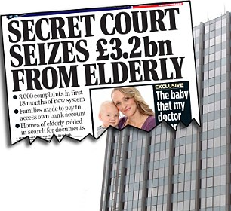
Transparency
From 2007 most hearings held in private (except Serious Medical Treatment and Committal).
From 2009 press gained access (public access still prohibited – balance between public interest and maintaining dignity and privacy of P).
Court of Protection Transparency Pilot launched in 2016 and formalized in 2017.
Assumption that most hearings would be public with Reporting Restrictions (Transparency Order).
“Transparency is central to the culture of the Court of Protection”. (Mr Justice Hayden)
Low public attendance at hearings.
Access challenges (particularly publicizing hearings).

Slide 7
Transparency: Practicalities
Short notice – Listings published evening before.
Significant number of hearings vacated/adjourned.
Inaccurate contact details listed.
Lack of information – Time estimates, case details, impairments concerned etc.
Under-resourced courts – overstretched staff.
Delays in responding to observers’ requests.
Delays for judges receiving requests.
Last-minute access arrangements.
Delays – late starts and late finishes.
Observers may want a specific geographic location or judge (these are possible to facilitate).

Slide 8
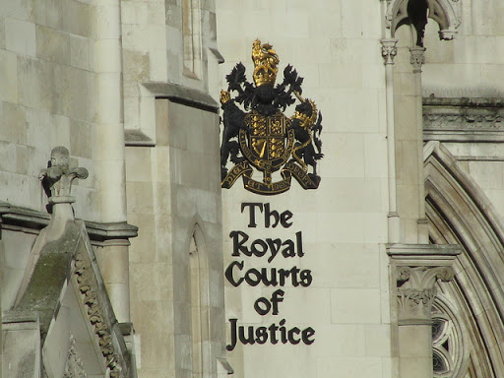
Where Hearings are Listed and Held
Family Division of the High Court (Royal Courts of Justice)
https://www.justice.gov.uk/courts/court-lists/list-family
Central Family Court (First Avenue House)
https://www.justice.gov.uk/courts/court-lists/list-cop
Regional courts (listings on Courtserve)
https://www.courtserve.net/

Slide 9
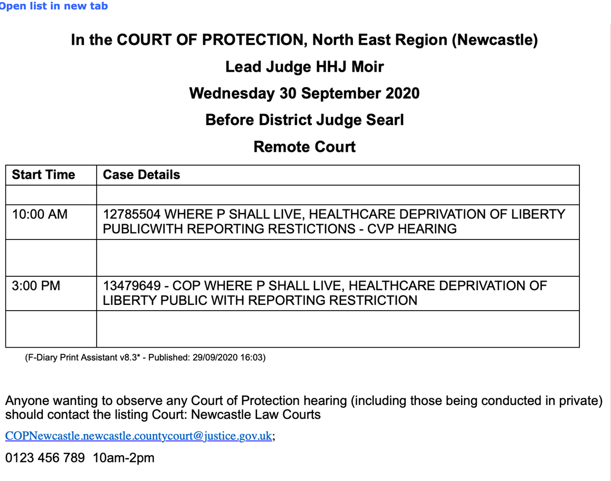
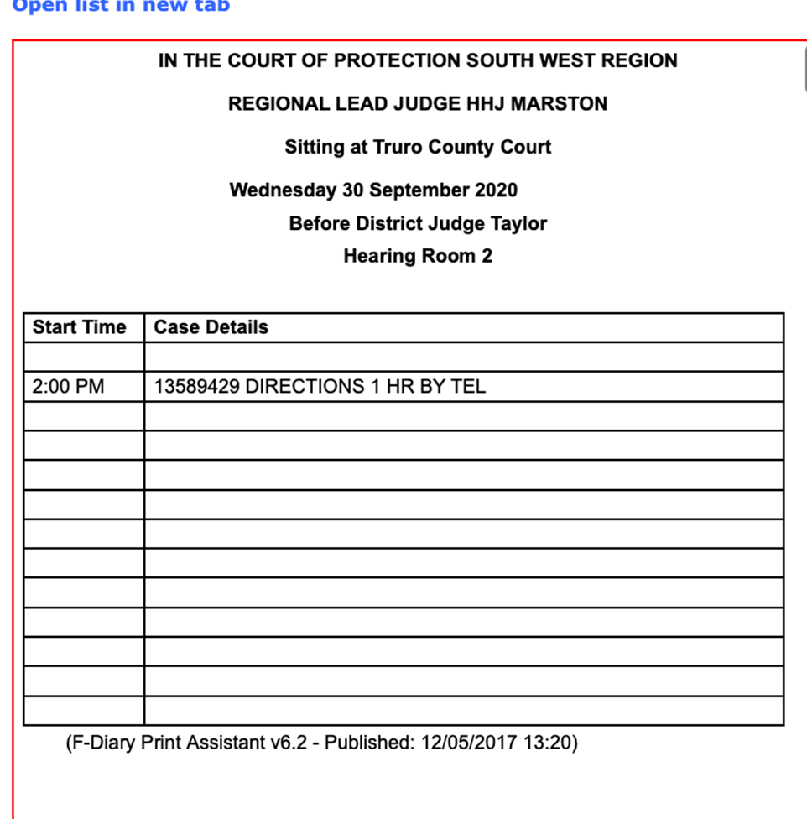
How Hearings are Listed

Slide 10
The Project:
What We Do

Slide 11
The Project
Provides information and practical support to Public Observers
Shares updates on developments in the CoP
Reports on hearings we’ve observed
Uses our experiences to impact the development of Open Justice in the CoP
Launched 15th June 2020
Shares court listings
Provides links to published judgments

Slide 12
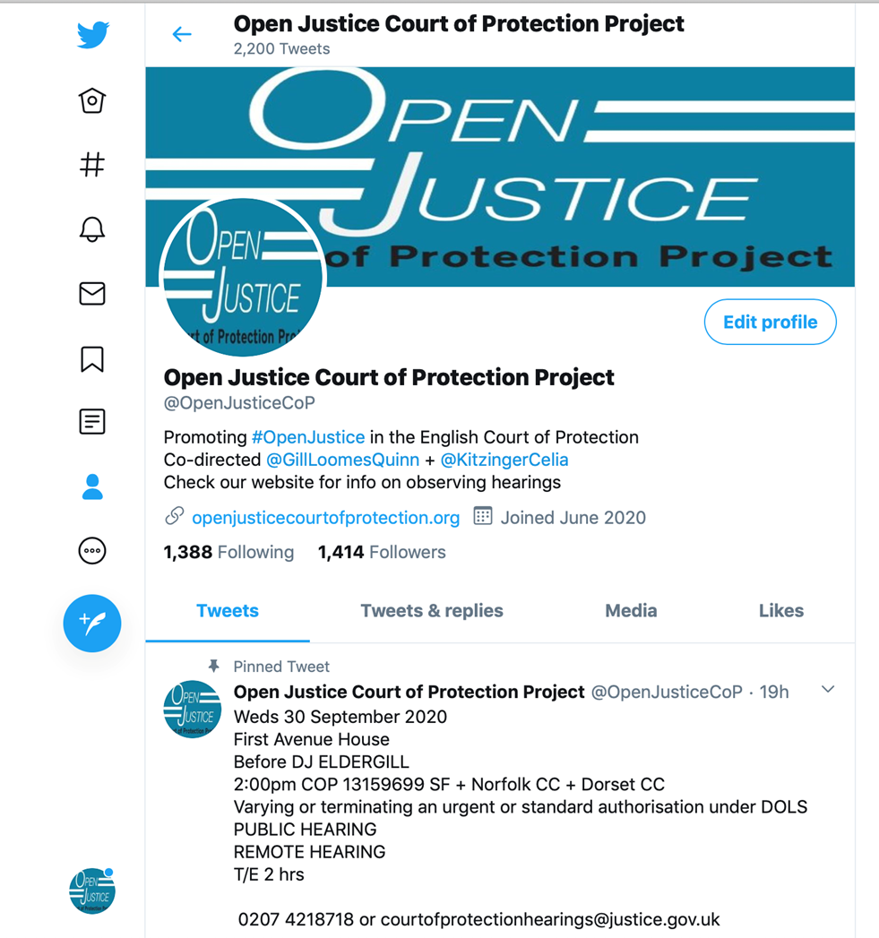
Twitter
@OpenJusticeCOP

Slide 13
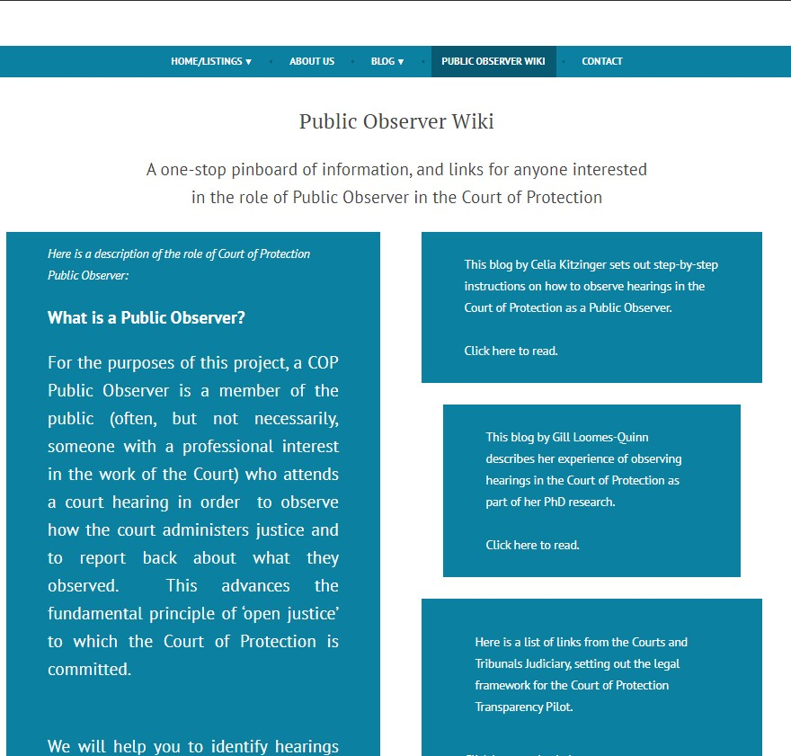
The Website
Publicising CoP hearings
Featured Hearings
Complexities: Short notice, incoherent/inconsistent, lack of details (issues, impairments etc)
Providing support and information to Public Observers about what to expect during a CoP hearing.
In particular how to access CoP hearings remotely.
openjusticecourtofprotection.org

Slide 14
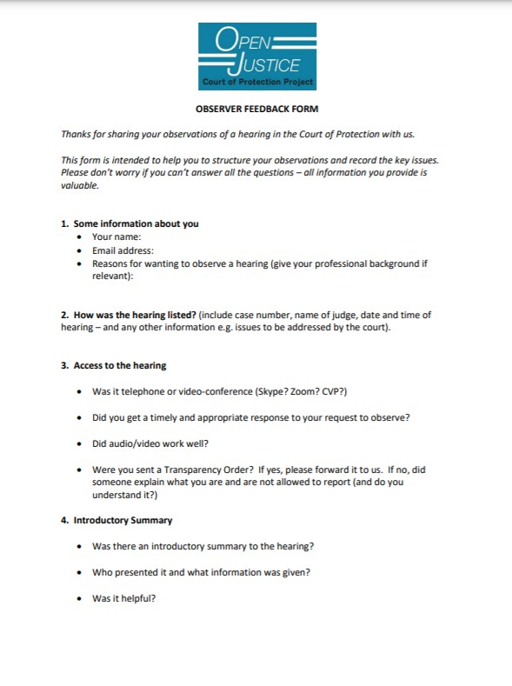
Observer Feedback Form
How was the hearing listed?
How did you access the hearing? (Phone? MS Teams? CVP?)
Response to your request?
Were you sent a Transparency Order?
Introductory summary (Was there one? By whom? Did you find it helpful?)
Structure of the hearing
Who was the applicant? Who was the respondent?
Were there any disagreements between them?
Were any witnesses called? What happened?
What did the judge decide?
Were any further hearings scheduled?

Slide 15
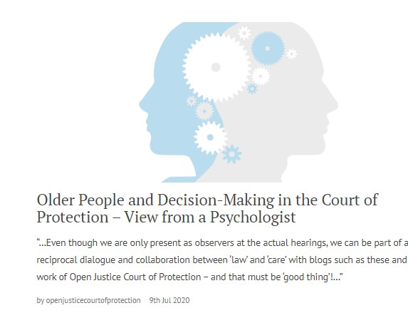
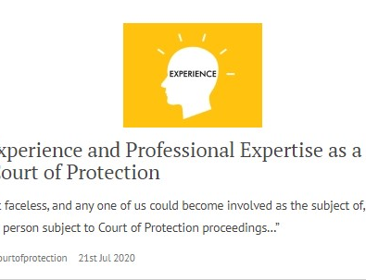
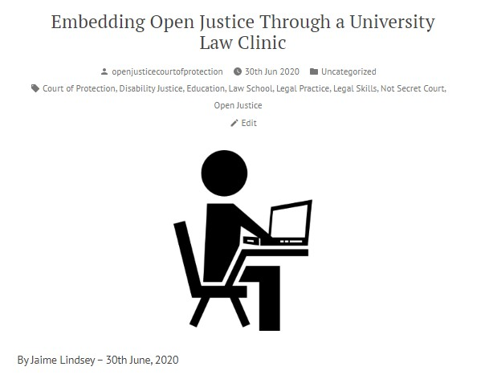
The Blog
Public Observer Reports Over 60 blog posts published since 15th June 2020
Public Observers Mostly health/social care professionals, then (aspiring) lawyers, and then family members – others include MCA 2005 trainers, and voluntary sector stakeholders
‘Explainers’ Commissioned on aspects of Court of Protection practice – explaining the work of the court and specific key roles (e.g. transparency orders, court bundles, how BSL interpreters work).
Project News – Including details of short-term collaborations with other organizations and projects.

Slide 16
Observers’ Experiences

Slide 17
What Do Observers Find?
Person-centred decision making:
“Human Rights has become real and applied. I can see more clearly that down at the coal face, we have real opportunity to empower our service users. And based on what I have observed, I have confidence that if the situation of our service users should ever require consideration by the Court of Protection, the judge will ensure their right to participate is facilitated and their right to self-determination, if at all possible, is respected.” (Louise Burrell, social worker)

Slide 18
What Do Observers Find?
Person-centred decision making:
“As a nurse my main focus is that the person remains at the centre of everything. It was so reassuring to see that this also was the primary focus within a formal court hearing for Mr Justice Hayden. The person-centred approach to this hearing epitomises and reflects exactly what I believe the Mental Capacity Act is all about.” (Sara Shorten)
“Mr Justice Williams maintained unwavering focus on what is right for P and preventing him being exposed to a toxic atmosphere … I left feeling reassured that person-centred decision-making, an issue I feel strongly about, prevailed” (Upeka de Silva)
“In this virtual courtroom with Mr Justice Hayden the law enabled a person with a learning disability to access the same rights and healthcare as any other citizen. This give me a huge sense of relief that my family member will be safe and listened to with these structures in place, and free to live the life he chooses.” (NB)

Slide 19
What Do Observers NOT Find?
It can be challenging for observers to make sense of what they see in court, especially without:
An introductory summary
Position statements and draft orders (sometimes read out by judge)
A working knowledge of the ‘structure’ of hearings and the different ‘roles’ participants play (e.g. the applicant, the OS)
Sufficient knowledge of the principles of the MCA (esp. capacity and best interests) and relevant case law
Sufficient knowledge of details of the MCA (e.g. what’s a s.49 report)
Acronyms and initialisations (what’s an “aylar”?)

Slide 20
Why Observe the CoP in Action?

Slide 21
Why Observe the Court in Action?
In terms of my role as an IMCA or RPR, I learnt that it is essential to be even-handed and remain as calm as possible, when contributing in court. There can be many emotions involved for family members, and as a professional it is essential that all the evidence is available before the Judge can make a decision in the best interests of the person at the centre of the proceedings.
(Hilary Paxton, trainee IMCA)

Slide 22
Why Observe the Court in Action?
I have found the whole observation experience very beneficial. The googling, looking up of legislation, reading up of quoted case law – both during and after the court attendance – has given me a crash course in legislation, that I now realise, I only thought I understood. Listening to a talk about how the Mental Capacity Act is implemented in the courts is one thing – actually observing it as it happens is very different!
(Louise Burrell, social worker)

Slide 23
Why Observe the Court in Action?
Observing the hearing was interesting and made me reflect on my own experience of conducting capacity assessments and the extent to which they would hold up in court. I do wish, though, that the judge or the applicant had done a proper introduction to the issues to be covered in court so that I would have been better placed to understand what was happening and use the experience more effectively for professional development.
(Jacqui Bond, social worker)

Slide 24
Informed Critique: Advocacy Values
The Court of Protection makes decisions that observers (and other members of the public) can find distressing:
ordering that P must remain in a place they don’t want to live
separating a husband and wife against their wishes, by placing one in a care home
prohibiting contact for 6 months between a mother and her adult daughter
declining a family member’s request to act as a deputy for P
preventing P from having sexual relations
compelling P to have medical treatment against their wishes

Slide 25
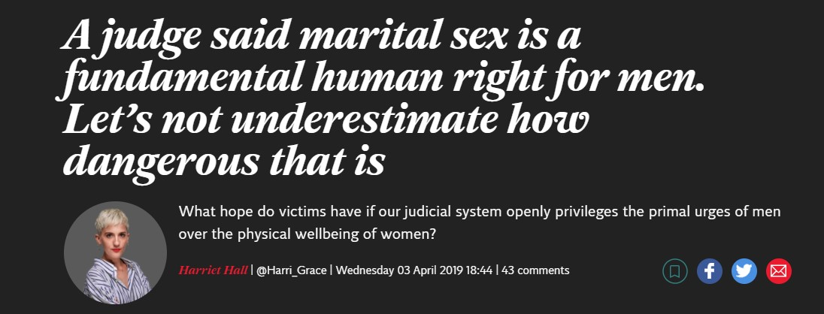
Informed Critique: Advocacy Values
These issues are often poorly reported in the media) and lead to perception of COP as a secret court making arbitrary and draconian decisions
Observing a hearing permits understanding of context, multi-disciplinary perspectives, concrete ethical dilemmas, real-world contingencies, least-worst options – texture and nuance
Court judgments and processes can still be criticized and debated but in a more informed way

Slide 26
Informed Critique: Advocacy Values
Two clinical psychologists, Claire Martin and Alan Howarth, criticized a judge for authorizing covert medication for a dementia patient
…without apparently adequate exploration of less restrictive alternatives
… without discussion of P’s wishes and feelings (previous or current)
And included anti-psychotics (side effects, strokes + death)
Is dishonest + means staff have to lie.
Not clear that decision complies with best practice e.g. in British Psychological Society Guidance re. alternatives to antipsychotic medication for people with dementia.

Slide 27
Informed Critique: Advocacy Values

Slide 28
Why Observe the CoP in Action?
See justice being done – Public scrutiny
Learn how the court may work with your clients, and how the MCA 2005 may be applied
“CPD”
See how witnesses are engaged with by legal professionals
Observe professional roles and interactions
Develop legal literacy – and work on embedding this in public and political contexts
Engage in debates from a more informed perspective – understand the nuanced, textured, contextualised background to a case, and contribute to public advocacy
Personal impact (6 million people per year impacted by MCA 2005, either as P or as carers – a small proportion directly encounter CoP, but need to understand its role in the “grand scheme”).

Slide 29
Further Details and Contact
Website:
openjusticecourtofprotection.org
Twitter:
@OpenJusticeCoP
The Open Justice Court of Protection Project is co-directed by Celia Kitzinger and Gill Loomes-Quinn.
This presentation was compiled by GLQ – any errors, inaccuracies or omissions are her responsibility alone.
Email:
OpenJustice@yahoo.com

