Slide 1
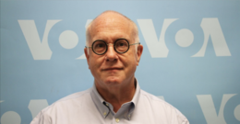
Godwin’s Law
Who is this man?
Notes:
Who here has heard of Godwin’s Law? Make use of your icons and raise your hands!
His name is Mike Godwin American attorney and author.
Godwin's law (or Godwin's rule of Hitler analogies)^{[1][2]} is an Internet adage asserting that "As an online discussion grows longer, the probability of a comparison involving Nazis or Hitler approaches 1";^{[2][3]} that is, if an online discussion (regardless of topic or scope) goes on long enough, sooner or later someone will compare someone or something to Adolf Hitler or his deeds, the point at which effectively the discussion or thread often ends.
It has since extended to any public discussion or speech, including presentations!
Let’s see how far I can make it by this presentation…

Slide 2
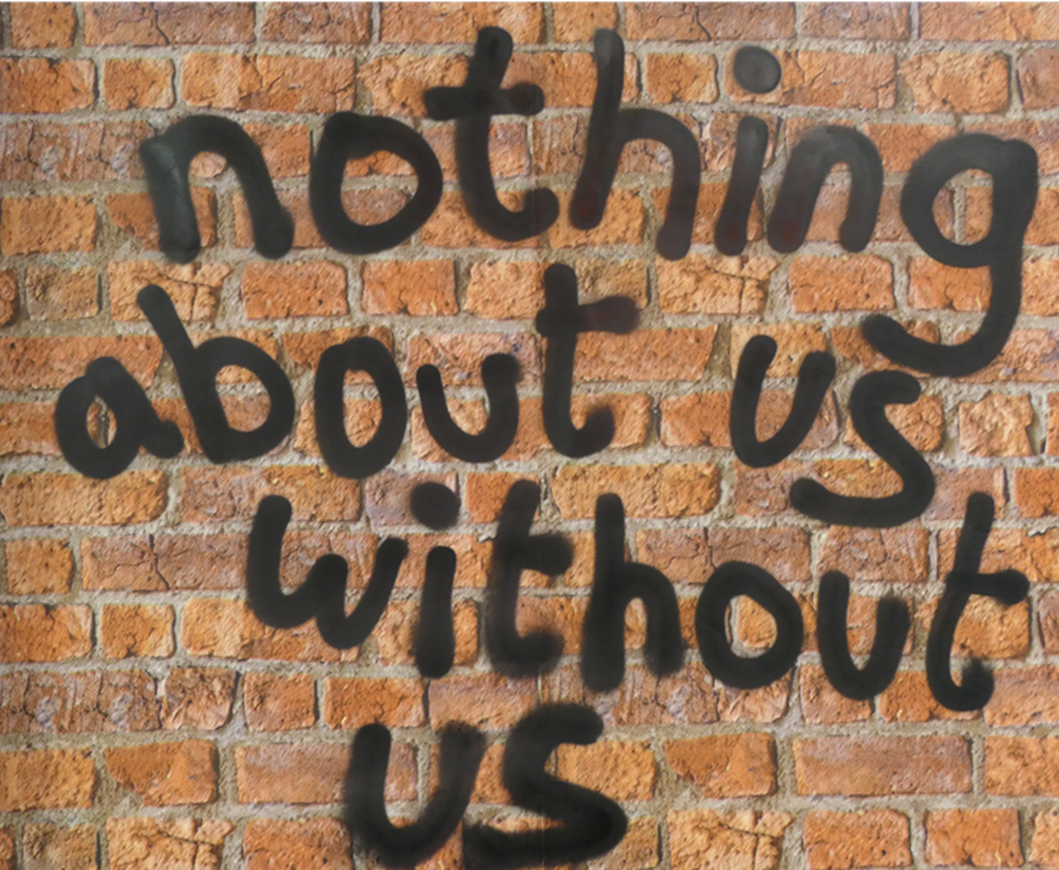
Support and Strengthen Deaf & Disabled People’s Organisations
Disability Hate Crime Project.
Or
If you want to understand Disability Hate Crime, work with Disabled people.
Notes:
Louise Holden, Hate Crime Partnership Project Manager at Inclusion London.
As our name suggests, we mainly focus on London. However, we also part of Reclaiming our Futures Alliance, which campaigns on a national and international level for Disabled people’s Rights in UK legislation and the UN Convention on the rights of Disabled people.
Inclusion London was set up in 2008 – The Hate Crime Project has been running since April 2018, building on the work of the Disability Hate Crime Network started in 2016.
Pan-London Deaf & Disabled People’s Organisation – the only one that is led by and for Disabled people that campaigns and provides capacity building for other DDPOs.
This presentation touches on some theories as to why Disabled people are treated differently in society, we will look at some research and afterwards you are invited to have an open and honest discussion about the issues raised and what you can do as advocates to be allies with Disabled people.
I will read out each slide then discuss in more detail. I am happy for you all to have copies of this presentation including my notes.
My alternative title for this presentation is your key takeaway for DHC. And who are these Disabled people?

Slide 3
Disabled with a capital D
Generally the term “Disabled” covers
Physical impairments
Sensory impairments
Learning Difficulties
Long term Mental trauma / distress
Long term health conditions
Hidden impairments / conditions
Neuro diversity
Notes:
We use the term Disabled with a capital D as a political statement aligned with the Disabled People’s Rights Movement.
As society progresses (and it does slowly), many people with impairments do not want to identify as having a disability due to its negative connotations. Being Disabled has a slightly different but important meaning.
Think of the word Disabled with a capital D as shorthand for the barriers people with impairments and conditions face to live to their fullest potential.
During Covid, what barriers have you been facing to live fully? Being restricted to home, not able to access fresh food, working from home, difficulties accessing health care, being reliant on family or friends for support if you got ill. All things more of you may be able to personally relate to due to recent events and all things many Disabled people have had to deal with for many years.

Slide 4
Building on work of the DDPO Hate Crime Network
Network set up in 2016 in partnership with the police, to be a “critical friend”
Disability Hate Crime Matters Initiative
Currently 22 DDPOs are working with over approx. 25,000 Disabled People across London.
5 of those have existing specialist hate crime services
Aim of new partnership, funded for 4 years -
Develop a consistent, pan London, collaborative DDPO response to hate crime/violence against Disabled people.
Notes:
Network and Partnership is supported by DDPO Partners already involved in HC.
Anne Novis MBE, independent advisor and chair of IL and Ruth Bashall, CEO of Stay Safe East.
Ruth and Anne were both instrumental with the set up of the Police Initiative Disability Hate Crime Matters, which led to a 300% increase in 2016-17. Since this stopped DHC reports have reduced significantly. We are currently campaigning for the Met to make more use of this with their new Hate Crime Coordinators and general police training.
Merton CIL – leading on development of evaluation and monitoring, conducting research on hc
Inclusion London – providing overall centralised management, representation at key stakeholder meetings and campaigns and policy work

Slide 5
Why have a Pan-London DDPO Disability Hate Crime Partnership?
Other types of hate crime have dedicated support
98% of hate crime against Disabled people went unreported in 2015/6, according to MCIL research
Systemic problems with recording, investigation and prosecution
Specific needs of Disabled people
Local holistic services with different ways to access support, not just centralised phone service
Notes:
“Nothing About Us Without Us”
There needs to be many different ways for people to have safe options to explore about what DHC is, how to report and where and how to recover from DHC.
Having a centralised phone line is important but not enough.
There are Disabled people experiencing DHC who do not recognise it as such.
By being in contact with a DDPO, a Disabled People is more likely to feel comfortable to share their experiences and feel supported to report through trusted relationships through other services.
If a DP doesn’t recognise DHC, they are not going to contact a HC service.
98% of hate crime going unreported may be linked to the low level of confidence Disabled people have in the police, according to the recent Police victim satisfaction survey

Slide 6
What’s wrong?
Official figures state that 8,256 disability hate crimes were recorded by police in 2018/19 in the UK. However, The National Crime Survey estimates a true figure of 70,000.
Independent research suggests that as many as 7 out of 10 Disabled people experience hostility, harassment and abuse. For some daily.
There is currently an estimated 1.2 million disabled people in London
THE FIGURES JUST DON’T ADD UP!
Notes:
It is mostly agreed that DHC is severely underreported. The reasons are complex and include Disabled people just accepting the abuse as part of everyday life as a Disabled person.
They may have reported before and had a negative experience.
They may have reported and there was not enough evidence to pursue the case.
For Disabled people that think that abuse is part of every day life, they may even not recognise HC so won’t report.
An officer may not realise that they can flag as a HC if they perceive it to be regardless of what the victim perceives. The list goes on.
That is a huge number of Disabled people just accepting that they have to put up with being treated less than on a daily basis.
,
And DDPOs trying to get funding for frontline services are often usurped by larger charities not led by Disabled people and not local to victims.
So what can you do to get more funding for DDPOs and improve reporting? I have two ideas but I am happy for you to come up with others!

Slide 7
Systemic Issues affecting negative bias
Historic segregation of Disabled people
Not just seen as inferior to non-Disabled people but treated as such
Discrimination in all areas of public and private life
Others define who we are, if we are vulnerable, an easy target, being taken advantage of.
Internalisation of negative perceptions by individuals. Becomes the social norm.
Weak application of legislation (i.e. Equality Act)
Policies & Practices linking Disability & Vulnerability
Notes:
Disabled people have been treated differently throughout history. In our living memory think about how Disabled children are separated from their peers into ‘special’ schools, how Disabled adults are excluded from the workplace and placed in ‘special’ work schemes.
Who knew we were all so special?
We are talking about how out of sight out of mind becomes the norm. How Disabled children are not considered to have similar aspirations as their non disabled peers and how ignorance and mistrust and even hostility and hatred can creep into a person’s mind when thinking about Disabled people.
Who here thinks of Disabled people as needing our help, vulnerable or deserving of our pity?

Slide 8
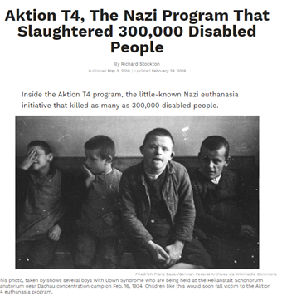
Systemic Issues affecting negative bias
Notes:
According to Godwin’s Law, this is where my presentation ends. I have already fallen into the trap of blaming everything on the Nazis during the war.
However, way before the second world war and any triggering of Godwin’s Law, the Enlightenment around the 1900s gave rise to the eugenics movement, originating in the UK. To paraphrase, These ideas were based in racial inequality but also physical and mental differences, or defects that had to be eradicated.
All this is vital if you want to really understand how systemic issues affect Disabled people today.
But seriously, this is a great example of how dialogue and debates are shut down about complex social issues. How uncomfortable conversations are dealt with, or not.
Surely we have moved on from this?

Slide 9
Systemic Issues affecting negative bias
Notes:
Well, not so much.
This was a statement made by Baroness Jane Campbell, a long time Disabled activist at an online event about the impact of COVID19 on policy responses relating the treatment of Disabled people in healthcare settings.
Can we really believe that Disabled people would be treated like this in the 21st century?

Slide 10
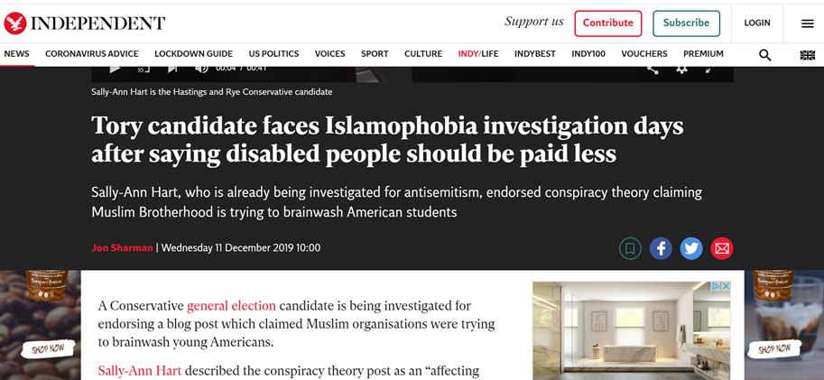
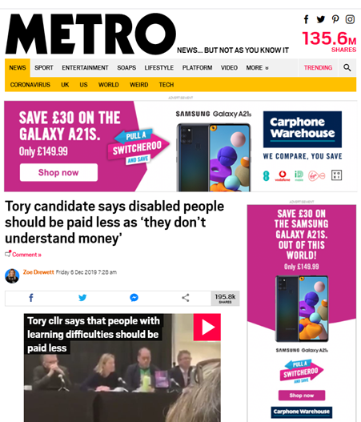
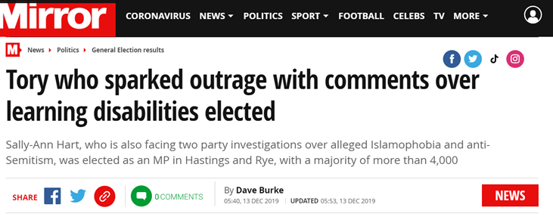
Systemic Issues affecting negative bias
Notes:
This are all news stories from last year relating to one particular MP who said that her comments were taken out of context.
No matter, the way it was reported has already done the damage and feed into the narrative that Disabled people are inferior and therefore can be treated differently.
And it’s not really fair of me to pick on just one MP with a non story about something she said she didn’t say is it?

Slide 11
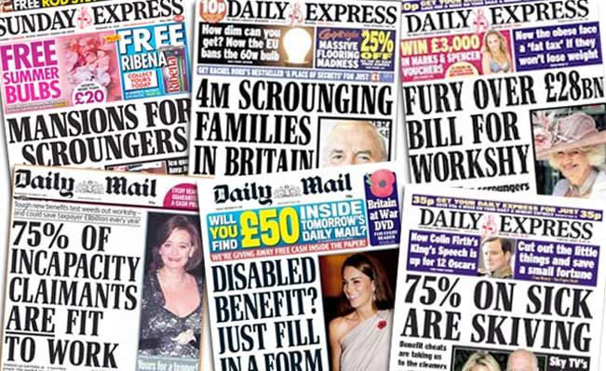
Systemic Issues affecting negative bias
Comparing 2004-5 with 2010-11
Significant increase in levels of reporting
More politicisation of reporting
Less positive real life stories, more focus on benefit fraud, “less deserving” hidden Disabilities
Focus groups reported that they thought benefit fraud was a lot higher than it actually is. Articles were having an affect on public attitude toward Disabled people.
Notes:
In 2010 Inclusion London commissioned the Glasgow Media Group and the Strathclyde Centre for Disability Research to carry out a study to analyse changes in the way the media are reporting disability and how it has Impacted on public attitudes towards disabled people. In carrying out the study they compared and contrasted media coverage of disability in Five papers in 2010‐11 with a similar period in 2004‐5 and ran a series of Focus groups. The study found:
Increased level of reporting – that sounds good?
Politicians influencing news? That doesn’t sound so good.
Disability benefit fraud must be huge!
These news stories are reporting on political rhetoric that uses language to describe ‘benefit scroungers’ ‘life choices’ ‘fraudsters’ and links these negative terms to Disabled people.
Has anyone here heard of the adage, we are what we eat? What about what we read?
These are the main popular newspapers in
the UK and they don’t have much to say about Disabled people that is positive?
I hope you are starting to see a link between the systemic issues and how these still prevail in how Disabled people are viewed, spoken about and reported on. All affecting policy and practice on every level.
We are keen to work with the Travelers Movement and Rene Cassin on their Cut it Out Campaign that launched last year to highlight the link between political rhetoric and negative public perceptions of targeted communities.

Slide 12
Turning the tide – our work
Parity in HC Law Campaign
Submissions of evidence based on what DDPOs tell us
Work with social media companies
Support DDPOs to set up local HC services
Support DDPO staff dealing with HC
Represent London DDPO HC Partnership
Training Resource for frontline staff (in development)
Annual Big Learning Event focused on DHC
Notes:
IL’s capacity building as part of the Hate Crime Project includes Specialist Advocate support, HC Advocate Secondments, submissions on HC issues, for example, online harms select petitions committee, impact of covid, business support for fundraising and structuring services, making sure Disabled people have a voice at key stakeholder meetings, MOPAC Met Police, CPS etc.
Our big learning event is open to all and the next one will be in February 2021, probably online! But hopefully not. An opportunity to hear directly from the local DDPOs about the challenges and achievements over the year.
We are also developing a series of training modules for frontline staff, to be delivered by disabled trainers. This is currently delayed due to Covid.
Having a sustainably funded local DDPO not only helps prevent HC, it also strengthens communities and improves inclusion and diversity, which are the key aspects of a healthy society. Dismantling those long held prejudices that other and demean Disabled people.

Slide 13
New report launched this week
Still Getting Away with Murder, written by Dr Laura Chapman
6 Key Findings:
Disabled people are still overwhelmingly likely to be victims of crime
Disabled people are still seen as unreliable witnesses
Using a Human Rights based approach is aiding increased understanding of Disabled people’s experience
Institutional Disablism creates space for hate crime
Disablism has the same characteristics as other ‘isms’ & more work is needed to improve understanding
Coproduction with Disabled people works
Notes:
1. Disabled people are still overwhelmingly likely to be victims of crime
Owing to the quasi-ubiquitous nature of disability hate crime, a single decade has been too little to achieve radical change. Yet the mounting evidence suggests that these crimes are as common as ever, and if anything, methods of qualifying and quantifying them suggest a steady increase that is not yet fully articulated.
2. Disabled people are still seen as unreliable witnesses
Disabled victims still feel they are not taken seriously on the whole, and when reporting the incidents resulting in more serious injuries they often remain dismissed as unreliable witnesses, sometimes even perceived as perpetrators, and routinely denied access to justice.
3. Using a Human Rights based approach is aiding increased understanding of Disabled people’s experience
Disability hate crime is now better understood, and therefore better qualified and quantified. It is beginning to be recognised as having a dual nature, that is, one of public violence and another of more intimate abuse in shared spaces and behind closed doors. Definitions have evolved which spell out the hostility of the perpetrators and dampening the characterisation of Disabled people as weak and needy. A human rights perspective is helping bring disability hate crime to the minds of professionals as a crime of opportunity. In statements though, Disabled victims still say their identity remains a focus, when in fact they’d prefer an understanding of those supporting victims. There is a pattern that often precedes attacks against Disabled people, akin to those seen in coercive control in domestic violence incidents. Hostility often grows from low-level harassment: name-calling, intimidation and vandalism frequently escalate into more serious crimes.
4. Institutional Disablism creates space for hate crime
This is articulated in evidence of its scale on public transport and on social media, and its occurrence in segregated institutional facilities and in cuckooing and mate crime. ‘Opportunity’ characterises both the institutional discrimination and technological advances that have generated spaces in which Disabled people are particularly powerless, and online, where they can be targeted without fear of detection.
5. Disablism has the same characteristics as other ‘isms’ & more work is needed to improve understanding
A positive change has been the move to understand the cultural discrimination and societal inequality (which gives disability hate crime its specific characteristics) as similar to racist, sexist, religious, transgender and homophobic motivations, yet more focus is needed to appreciate the subtle differences as well as the similarities involved.
6. Coproduction with Disabled people works
Viewing Disabled people as actively working against disability hate crime rather than as passive, weak and needy victims is enabling individual resilience and safer communities. Prejudice and bias, such as the infantilisation of Disabled people, is apparent in the words used to describe the crimes against them, and plays a big part in trivialising their impact. A growing acknowledgement of Disabled people’s inclusion along with a human rights grounding in the development of policies and organisational practices across agencies has enabled locality living. In turn, according to the wellbeing literature, this creates opportunities for the relationships that could secure greater safety. Partnerships involving multiple agencies, sectors and members of the public have leveraged huge advances. Understood as working-with, not working-on, co-production has been the source of effective change, with Disabled People’s Organisations, victims and allies having their experiences taken seriously.
In brief, more needs to be done to build a fluency around culture and society, an understanding of disablism and ableism and of practice and policy, in line with the principle of ‘Nothing About Us, Without Us’.

Slide 14
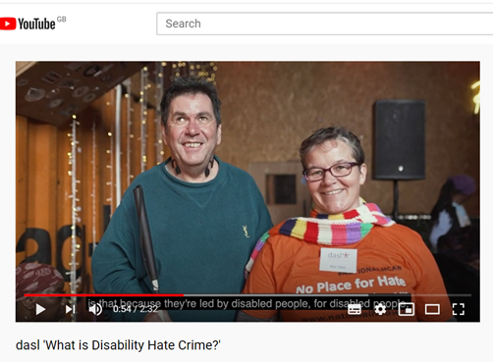
DDPOs are key to tackling DHC
This video was funded by the Home Office Building Stronger Britain Together in-kind support and shows how a local DDPO can work to tackle hate crime locally in partnership with police, council and health.
The DDPO is called DASL and is based in Lambeth.
https://www.youtube.com/watch?v=OH9AyAykyrA&t=2s
Building up trust through lived experience.
Support to report with specialist knowledge.
Recovering by linking into the wider community.
Notes:
It is now widely recognised that BME Projects are more effective when they are run by people from that community.
The same with Women’s projects. Being run by women for women makes sense.
So why not services for Disabled people? Hammersmith and Fulham are a best practice model on how to effectively coproduce with Disabled people. It saves money and has multiple social value benefits.
“Nothing About Us Without Us”
Unfortunately, DASL then lost their funding for their specialist HC advocacy Service although they still help Disabled people to report and access support via CATCH Partnership. They also continue to run a regular local HC partnership.
This leads me onto my final slide, how can we work together – councils, police and health.
By being in contact with a DDPO, a Disabled People is more likely to feel comfortable to share their experiences and feel supported to report through trusted relationships through other services.
If a DP doesn’t recognise DHC, they are not going to contact a HC service.
98% of hate crime going unreported may be linked to the low level of confidence Disabled people have in the police, according to a recent Police victim satisfaction survey

Slide 15
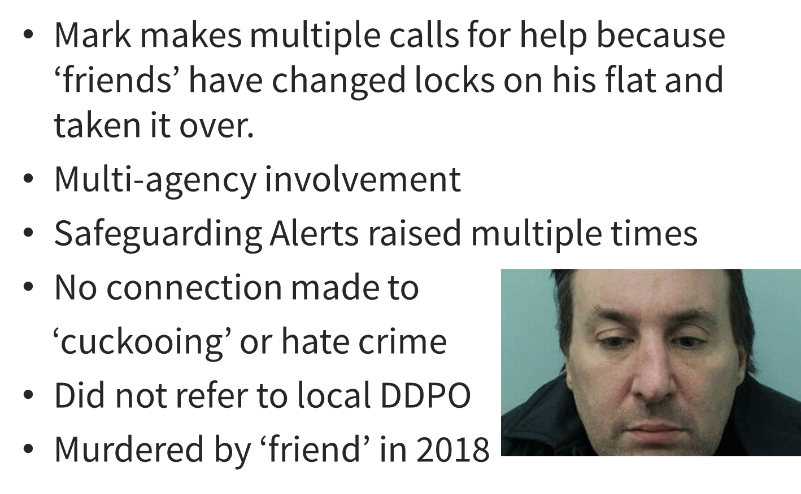
Mark Smith
Notes:
Waltham Forest conducted a Safeguarding Review in 2019 after series of failures for joined up working.
NHS, Police, Housing Association and social services were all involved in supporting Mark but no one made the connection to hate crime.
If they had they would be referred to Stay Safe East, a DDPO known to them for supporting victims of hate crime and cuckooing.
This is a shocking example of the type of cases that can start ‘low level’, be mistaken for something else, and escalate.
Part of DDPOs roles are to recognise ‘low level’ signs sooner and prevent escalations.
I know that Ruth Bashall from SSE has since been in touch with local agencies and will be working with them to try and identify cases like these sooner.

Slide 16
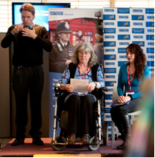
Message from Anne Novis
Extract from speech made during DHC Matters conference held in 2016 at New Scotland Yard
“Making a lasting and consistent difference is my goal. It’s no good if I leave as an advisor, or officers move on and the work stops. It has to be integrated into everyday practice for all police services.
Third party reporting, multi agency work in boroughs, advocacy, support for victims through the justice system, can only be successful if Deaf and disabled people, victims and our own organisations get involved in this work.”
Notes:
This is a powerful statement made by Anne Novis who received an MBE for her tireless campaigning on combating DHC.
I feel that what she says relates to all agencies and organisations not just police services.

Slide 17
Keys for combatting Hate Crime
We are all affected by negative bais, being aware is the first step.
Working with Disabled people breaks down barriers.
Integrated strategies across commissioning for community, police and health.
Mind your language!
Notes:
We are really encouraged by the engagement we have had with the Met. Police and the Crown Prosecution Service.
Discussions around the use of social model of disability and changes in use of terms like vulnerability all start the building process to bridge those barriers.
We hope that when our frontline training programme becomes available next year, you are able to book yourselves on and start.

Slide 18
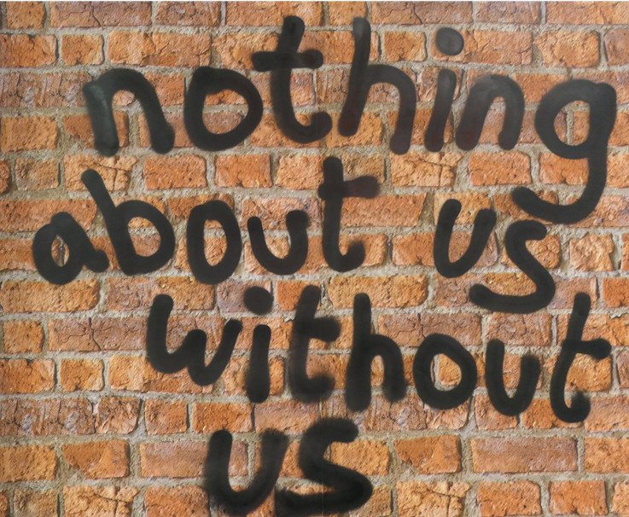
Notes:
DDPOs are known for delivering local services with a holistic approach, which aids victim recovery.
And if you remember one thing from today, working with disabled people is the best way to combatting hate crime against us. Employ us, fund DDPOs and develop integrated strategies.
Thank you.

Slide 19
We look forward to your questions…
For more information about Hate Crime Project, please contact
Louise Holden, Hate Crime Partnership Project Manager
louise.holden@inclusionlondon.org.uk
Mobile: 07741 733 993
For Campaigns & Policy, please contact
Svetlana Kotova, Director of Campaigns
svetlana.kotova@inclusionlondon.org.uk

