Slide 1
Legal Remedies for those with ASD and/or LD within in-patient services

Slide 2
About me
Kirsty Stuart – Public law and human rights solicitor
Who I represent
Background - MH Law
Lead in the firm on cases involving those in Assessment and Treatment Units
Part of the #right2home campaign group
Co-drafted the Toolkit guidance around leave restrictions https://right2visit.info/

Slide 3
Increase in legal challenges overall?
More press coverage – stark human element
Greater awareness and use of social media
BBC Panorama highlighted a lot of issues
Winterbourne View
Whorlton Hall
Yew Trees hospital

Slide 4
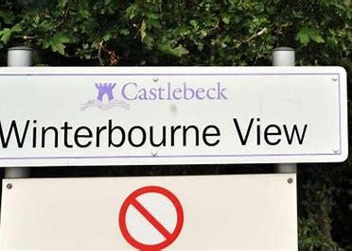
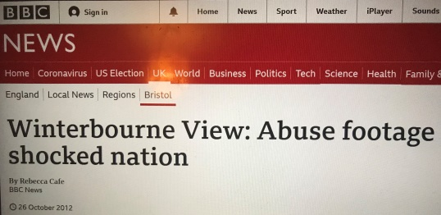
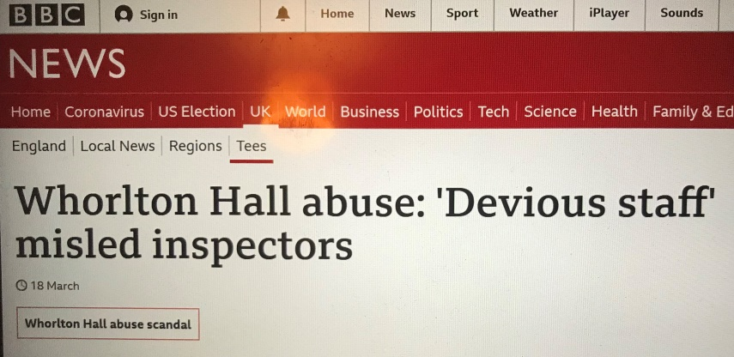
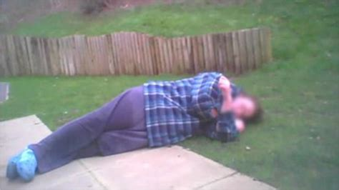

Slide 5
The options for legal challenge
First-Tier Tribunal
Judicial Review
Court of Protection
Human Rights Act claims

Slide 6
First-Tier Tribunal
Only applies to those detained under the Mental Health Act 1983
Eligibility periods will depend on which section the person is detained under e.g. within the first 14 days if subject to section 2 whereas it is anytime in first 6 months, 2nd 6 months then annually for section 3
Non-means tested legal aid is available for FTT
Usually (Pre-Covid) takes place within the hospital but most are currently held by video link
Decision is usually same day unless the panel do not have sufficient information
The panel can decide on immediate discharge, deferred discharge, recommendations, continue the section but consider a CTO
Notes:
Immediate discharge – if criteria for section not met – depends on section and whether under part 2 or 3 (s72)
Deferred discharge for e.g. forensic patient – conditional discharge until such arrangements as appear to the tribunal to be necessary for that purpose have been met (s73)
Recommendations for care including s17 leave with a view to future discharge planning, transfer to another hospital – can reconvene to review why recommendation not complied with
Consider CTO if subject to section 3
Can instruct and use independent experts e.g. psychiatrist, ISW, OT

Slide 7
Judicial Review
Process by which the Admin Court can review decisions of public bodies to act or failure to act on behalf of individuals
This includes the government and the NHS – bodies that deliver a public service
Remedy of last resort
Complex, costly and sometimes lengthy cases which require permission to issue with strict rules around aspects such as pre-action protocol
Limited number of remedies – quashing order, prohibiting order, mandatory order, declaration, declaration of incompatibility, damages, injunction
All remedies are discretionary – even if court finds public body acted wrongly, does not have to grant the remedy
Must be brought promptly and within 3 months of decision/action being challenged
Notes:
Quashing order – overturns or undoes the decision being challenged – most common outcome of a successful JR
Prohibiting order – stops a public body from taking an unlawful decision or action that it has not yet taken
Mandatory order – court can direct a public body to take an active step e.g. take a new decision within a specific period of time – more unusual
Declaration – order stating what the law is – Judges reluctant to do this as they believe that their written judgment is adequate
Declaration of incompatibility – relates to when an act of parliament contravenes the human rights act – invitation to MPs to change the law to comply with the HRA
Damages – only if some other form of legal remedy is sought – 3 circumstances – 1 – where right to damages under private law but need JR to establish element of damages claim e.g. to show that a period of detention is unlawful, 2 – where there has been a breach of HR, 3 – where there has been a breach of your rights under European Union Law
Injunction – temporary order requiring a public body to do/not do something until a final decision is made
Discretionary – will make decision based on circumstances and what it considers to be appropriate, fair and practical

Slide 8
Judicial Review – case study example
Mr X – diagnoses of EUPD and ASD
Detained under section 3 MHA and appealed against his section
Tribunal due to be heard end of July 2020
Notified on Friday (7 days before transfer) that he was going to be moved on Monday at 9am to unit 120 miles from current hospital which is rated CQC ‘inadequate’
Received instructions evening of the Friday from MH solicitor
No correspondence from Mental Health Trust or CCG
Issued proceedings for injunctive relief to stop the move on Sunday morning OOO Judge heard case 7.30pm Sunday evening and injunction granted until after adjourned FTT at end of September
Grounds – impact on Tribunal, impact on diagnoses, art 8, irrationality

Slide 9
Court of Protection
Only applies if the person lacks capacity to make the relevant decisions
Can be either health and welfare decisions or property and financial affairs decisions
Court applies the rules that are laid out in the Mental Capacity Act 2005
Can relate to any decision
Declarations can be sought or challenged in respect of capacity and best interests
The person who lacks capacity should be at the centre of all decision making
Legal aid can be available – dependent on the application being made
Notes:
Court cannot make decisions on behalf of a person who has capacity
Will only cover health and welfare decisions
Examples of decisions include where the person lives, who they have contact with, their use of social media, if they can marry
if they lack capacity re care, are very likely to also be considered to be DoL’d if they are in the community, and that this fact can be used as a “gateway” to getting their case into the COP

Slide 10
Examples of Court of Protection cases
P is subject to a standard authorisation in hospital/in a unit and is unhappy and wishes to challenge this
s21A
P is in hospital (could be under MHA) but is going to be discharged into a non-CQC registered placement such as an ISL and so the court is required to authorise the legal deprivation of liberty
S16
P is in a non-CQC registered placement and is subject to an authorisation of the court which is reviewed annually but wishes to challenge the authorisation or an element of the restriction
S16

Slide 11
Interface between the MHA and MCA
Long standing issue
GJ v The FT and The PCT and the Secretary of State for Health (2009) EWHC 2972 (Fam), 20th November 2009)
Re E (Medical Treatment Anorexia) [2012] EWHC 1639 (COP)
AM v (1) South London & Maudsley NHS Foundation Trust (2) Secretary of State for Health [2013] UKUT 0365 (AAC)
Secretary of State for Justice v MM; Welsh Ministers v PJ [2017] EWCA Civ 194
Notes:
Long standing issue – considered within the MHT sphere – such as AM v (1) South London & Maudsley NHS Foundation Trust (2) Secretary of State for Health [2013] UKUT 0365 (AAC)
This case concerned AM who was being detained under section 2 of the Mental Health Act 1983 (MHA). An application was made to the mental health tribunal for AM to be discharged from her section.
It was not disputed that AM lacked capacity to make decisions about her care package and treatment. It was argued on her behalf that she should be assessed and treated under the Mental Capacity Act 2005 (MCA) and that if she was deprived of her liberty, this could be authorised under the Deprivation of Liberty Safeguards (DoLS) rather than needing to use the MHA.
Charles J considered that for decision-makers having to determine whether the MHA or the MCA should be used where the person requires assessment or treatment as an in-patient in a psychiatric hospital, there were 3 questions to consider:
Does the person have capacity to consent to admission as an informal patient?
Might the clinical team be able to rely on the provisions of the MCA to lawfully assess or treat the person?
If there is a choice between reliance on the MHA 1983 and the MCA 2005, which is the least restrictive way of achieving the proposed assessment or treatment?
Following this decision, even for those individuals who may come within the scope of the MHA, the MHA no longer has primacy and DoLS remains an alternative to be taken into account that should be considered. This is reflected in the new 2015 Code of Practice, which states that the choice of regime must be based on which is the least restrictive in the circumstances, rather than a preference or familiarity. If capacity is likely to be regained or fluctuating this should be taken into consideration.
The key point to take from this case is that decision-makers should aim to find the least restrictive way of achieving the desired objective.

Slide 12
Human Rights Act Claims
Whenever public officials interact with people, they have a legal duty to respect and protect human rights
These claims will overlap and be present in other applications such as COP
Can make a claim for damages if can prove negligence – County Court application
Should try and resolve through complaints procedure or ombudsman first
Mixed success – sometimes receive only nominal damages

Slide 13
Examples
Article 3 – right not to be tortured or treated in an inhuman or degrading way
Incudes inappropriate use of seclusion/physical or verbal abuse
Article 8 – right to respect for family life, home and correspondence
Includes visiting or restrictions – distance from family
Article 14 – right to be free from discrimination
Article 5 – right to liberty
Article 6 – right to a fair trial
Notes:
Damages for unlawful psychiatric detention PB v Priory Group Ltd [2018] MHLO 74 — A Part 36 offer of £11,500 plus legal costs was accepted in this claim brought for unlawful detention and breach of Article 5. The patient had been detained under s5(2) when not an in-patient, and this section had lapsed for nearly seven hours before detention under s2 began.
Seclusion and restraint policies could be JRs or HRA claims

Slide 14
Predictions for the future
Increase in cases overall due to the impact from social media
A move towards how there can be cross jurisdictional cases
Impact of Covid will increase cases through lack of contact with loved ones and increased opportunity for breaches/abuse
More coverage of events such as the 10 year anniversary of the first showing of Whorlton Hall next year (May 2021)
Continued work to hold the government to account for not adhering to previous set out timescales for moving those with ASD and/or LD out of Assessment and Treatment Units
Fallout from the CQC report https://www.cqc.org.uk/publications/themed-inspection/review-learning-disability-services

Slide 15
Questions?
Email kirsty.stuart@irwinmitchell.com
Twitter @mrsarcticride

