Slide 1
What really matters to you? What helps when life feels stressful? Who or what offers comfort? What makes for a good life for you?

Slide 2
A relentless focus on the person …no matter what!!
Nic Crosby, Programme Lead

Slide 3
A core of human rights
Supporting people with complicated lives, traumatic life histories, experiences of institutionalisation and complicated support needs
Supporting people ‘to move out of / or at risk of being placed in’, a secure/forensic long-stay institution
LINK to info
Article 19, United Nations Convention on the Rights of Persons with Disabilities
(this includes people with psycho-social disabilities, i.e. mental health support needs)
‘The Right to live independently and to be included in the community’
- Home
- Support
- Community

Slide 4
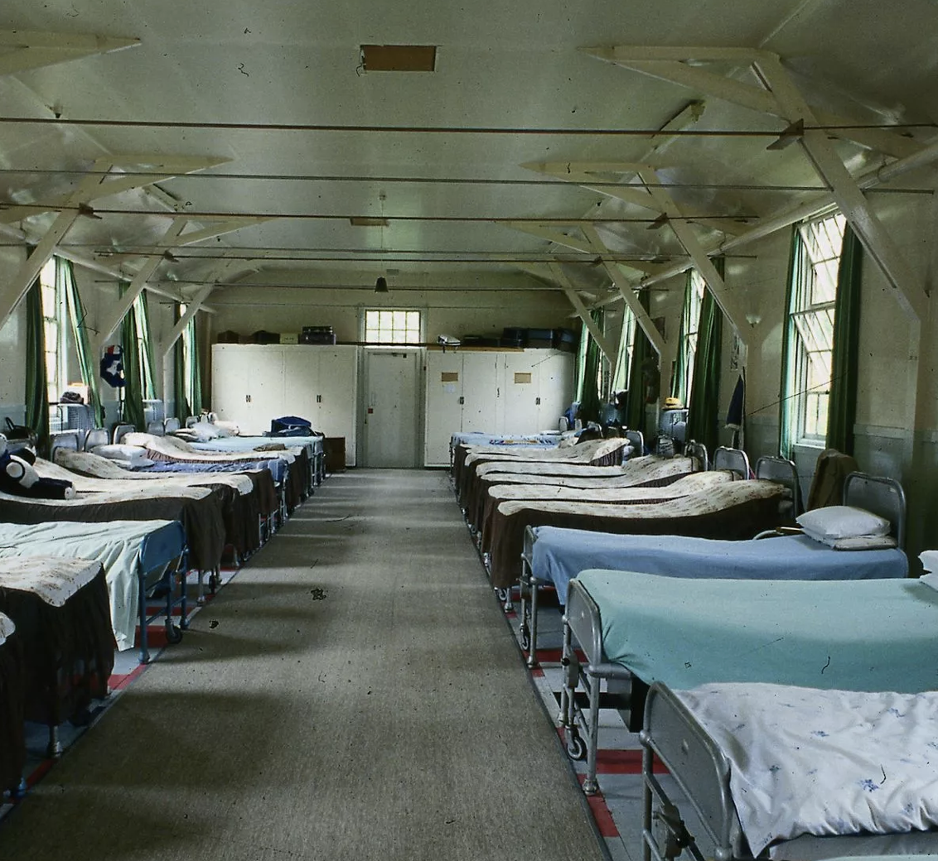
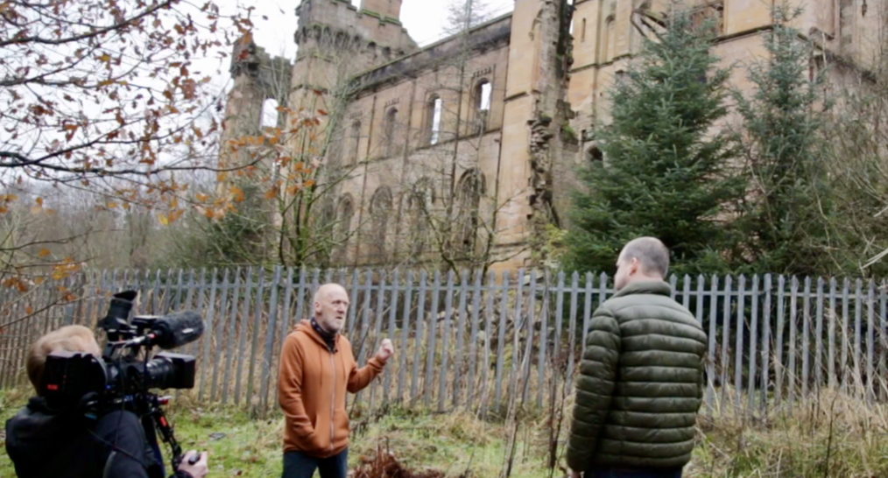
Our roots…
The closure of Lennox Castle Hospital, an institution for people with learning disabilities, Glasgow, 1990’s
Link to story and youtube video
Our partners:
Beyond Limits (LINK)
Positive Support for You (LINK)
C-Change (LINK)

Slide 5
What is a Small Support Organisation?
Supporting people with complicated lives, traumatic life histories, experiences of institutionalisation and complicated support needs
Supporting people ‘to move out of / or at risk of being placed in’, a secure/forensic long-stay institution
LINK to info
The person and their loved ones are at the centre
A team of people recruited to support the person
A home of their own
Investment in positive and supportive relationships
A person centred approach to safeguarding and risk
Great outcomes for people and families
Investing local area

Slide 6
Why ‘small’?
"Where, after all, do human rights begin? In small places, close to home – so close and small that they cannot be seen on any maps of the world. Yet they are the world.”
Eleanor Roosevelt
A common feature of successful support organisations working with this group of people (success = person centred, human rights at the core, sustaining long term support and relationships)
Central effort on developing and sustaining positive and supportive relationships with the whole team and the person – everyone knows everyone
Individual planning – Individual Funding – Individual support ‘relentless’ and ‘uncompromising’ person centred working

Slide 7
‘relentless’
’uncompromising’
…How?
Personal Budget / Personal Health Budget
Direct payments or Individual Service Fund
The person’s story, what works – the voice of the person and their loved ones
Service Design
My Home
My Life
Personal Plan
Working policies
Matching and recruitment
My Support
Individual planning – Individual Funding – Individual support
‘we never walk away’
(Doreen Kelly, Beyond Limits)
…if only it were as simple as a flow chart!!
Standing shoulder to shoulder with the person and their loved ones

Slide 8
Are you relentless and uncompromising?
Human rights?
Thinking about the trauma the person has been exposed to by being placed in an institution …and removed from familiar surroundings and important people …at a very difficult time?
What does all this mean if you are an advocate?

Slide 9
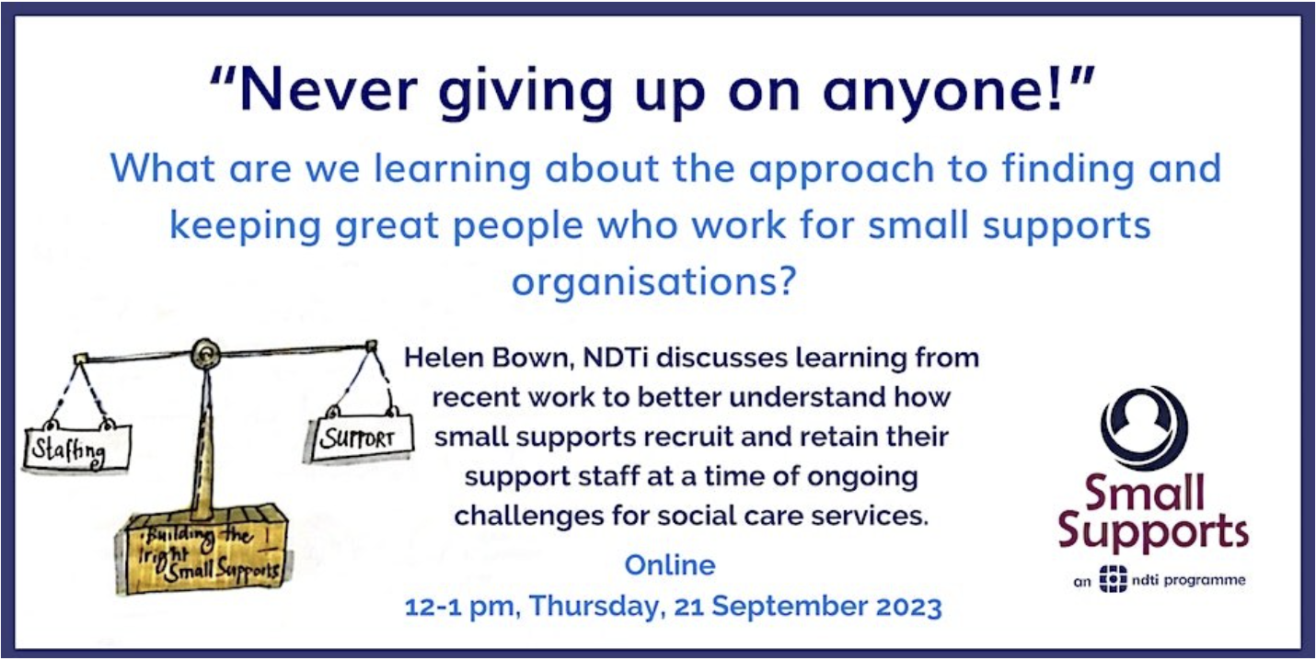
Small Supports
Big Differences
Better Lives
Our partners:
Beyond Limits (LINK)
Positive Support for You (LINK)
C-Change (LINK)
LGA (LINK)
Webpages:
Small Supports (LINK)
Link to information about the autumn series of lunchtime webinars
Nic Crosby – nic.crosby@ndti.org.uk
or phone 07854 331 487

