Slide 1
Where’s the oomph!
Lessons from research
Zeze Sohawon
Anne-Marie Glasby, November 2023

Slide 2
Why are we stuck in hospital?
University of Birmingham and Changing Our Lives
2 year study
Funded by the National Institute for Health and Care Research (NIHR) Health and Social Care Delivery Research (HSDR) programme

Slide 3
Background to research
Many people spend longer than they should in hospital
This means that they can not lead their chosen lives in the community
It also puts them at risk of harm
It is not a good use of public money

Slide 4
Methodology
We wanted to learn of people’s lived experience of being ‘stuck in hospital’
We spoke to 27 people with a learning disability and/or autistic people in 3 case study sites
Also spoke with families, front line staff, commissioners, advocates and community based providers
Reference group

Slide 6
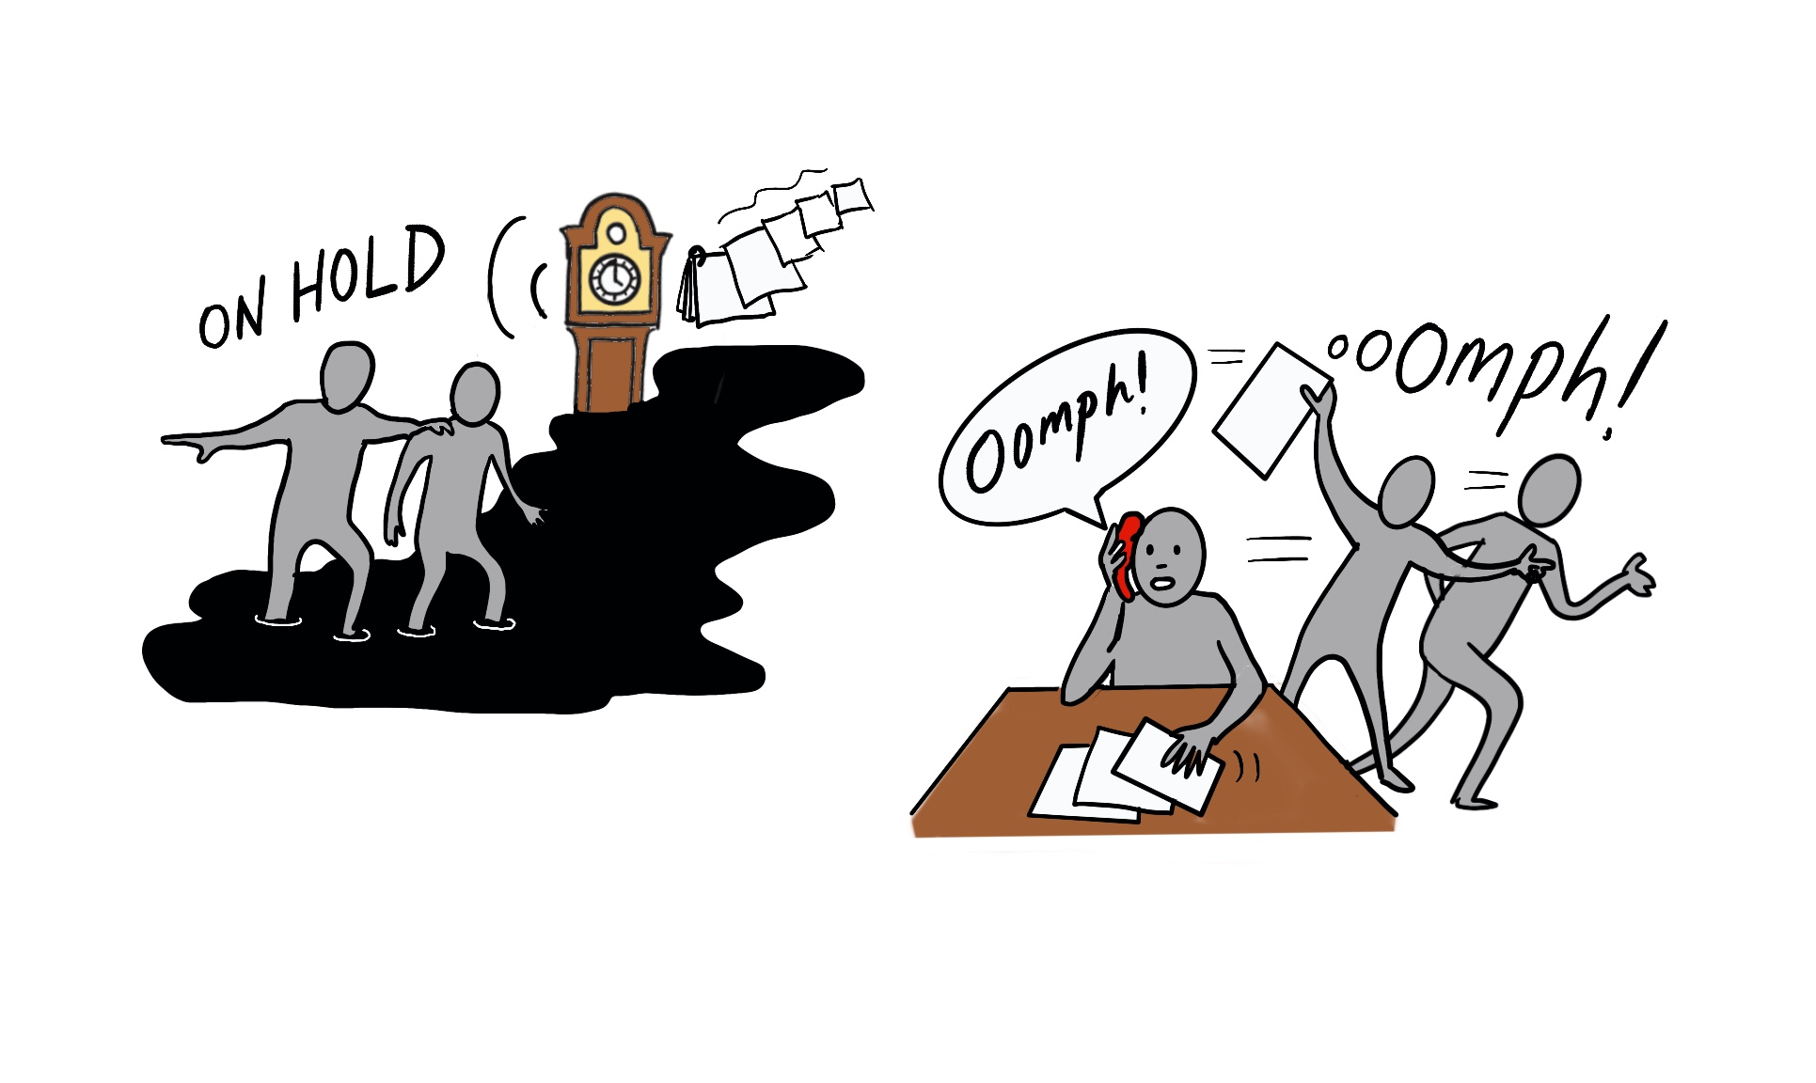
How can people become ‘unstuck’?
Our lives are on hold – do your jobs and get some ‘oomph’

Slide 7
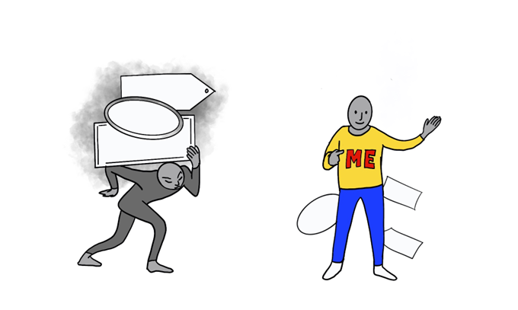
How can people become ‘unstuck’?
See the person behind the labels

Slide 8
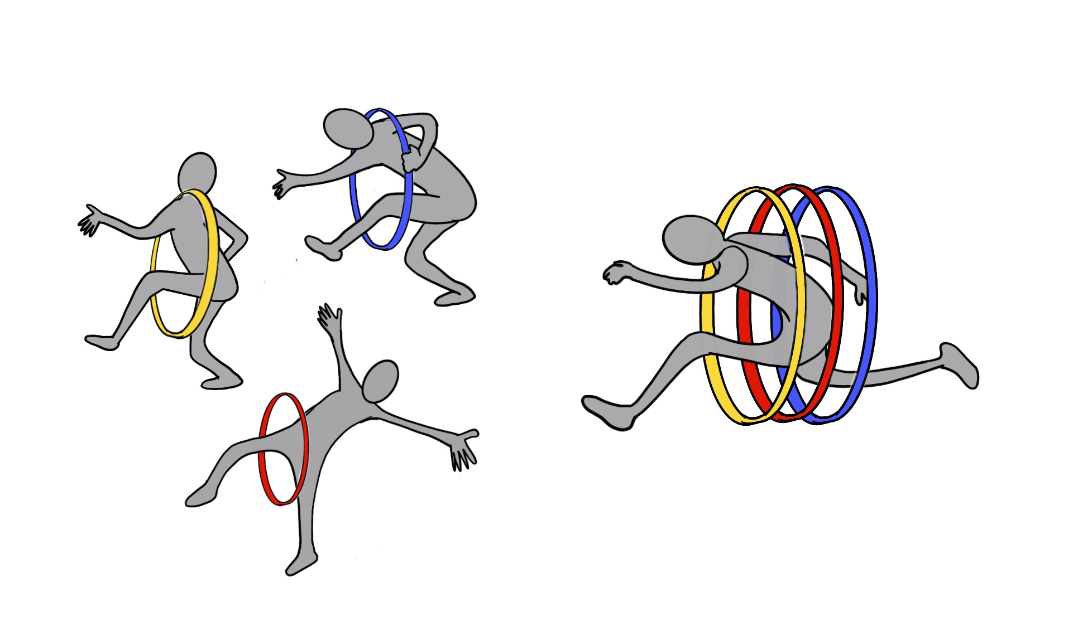
How can people become ‘unstuck’?
Don’t make me jump through more hoops than is really needed

Slide 9
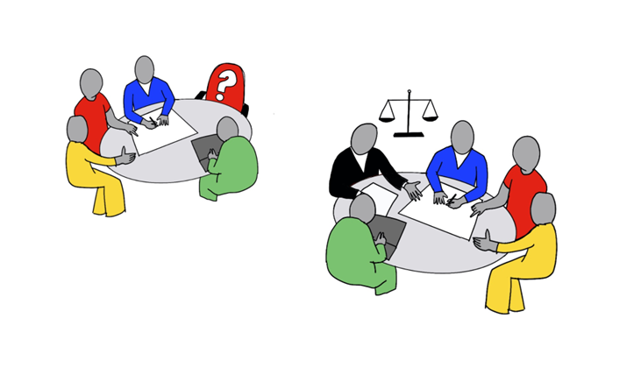
How can people become ‘unstuck’?
Make sure the criminal justice system is on board (if needed)

Slide 10
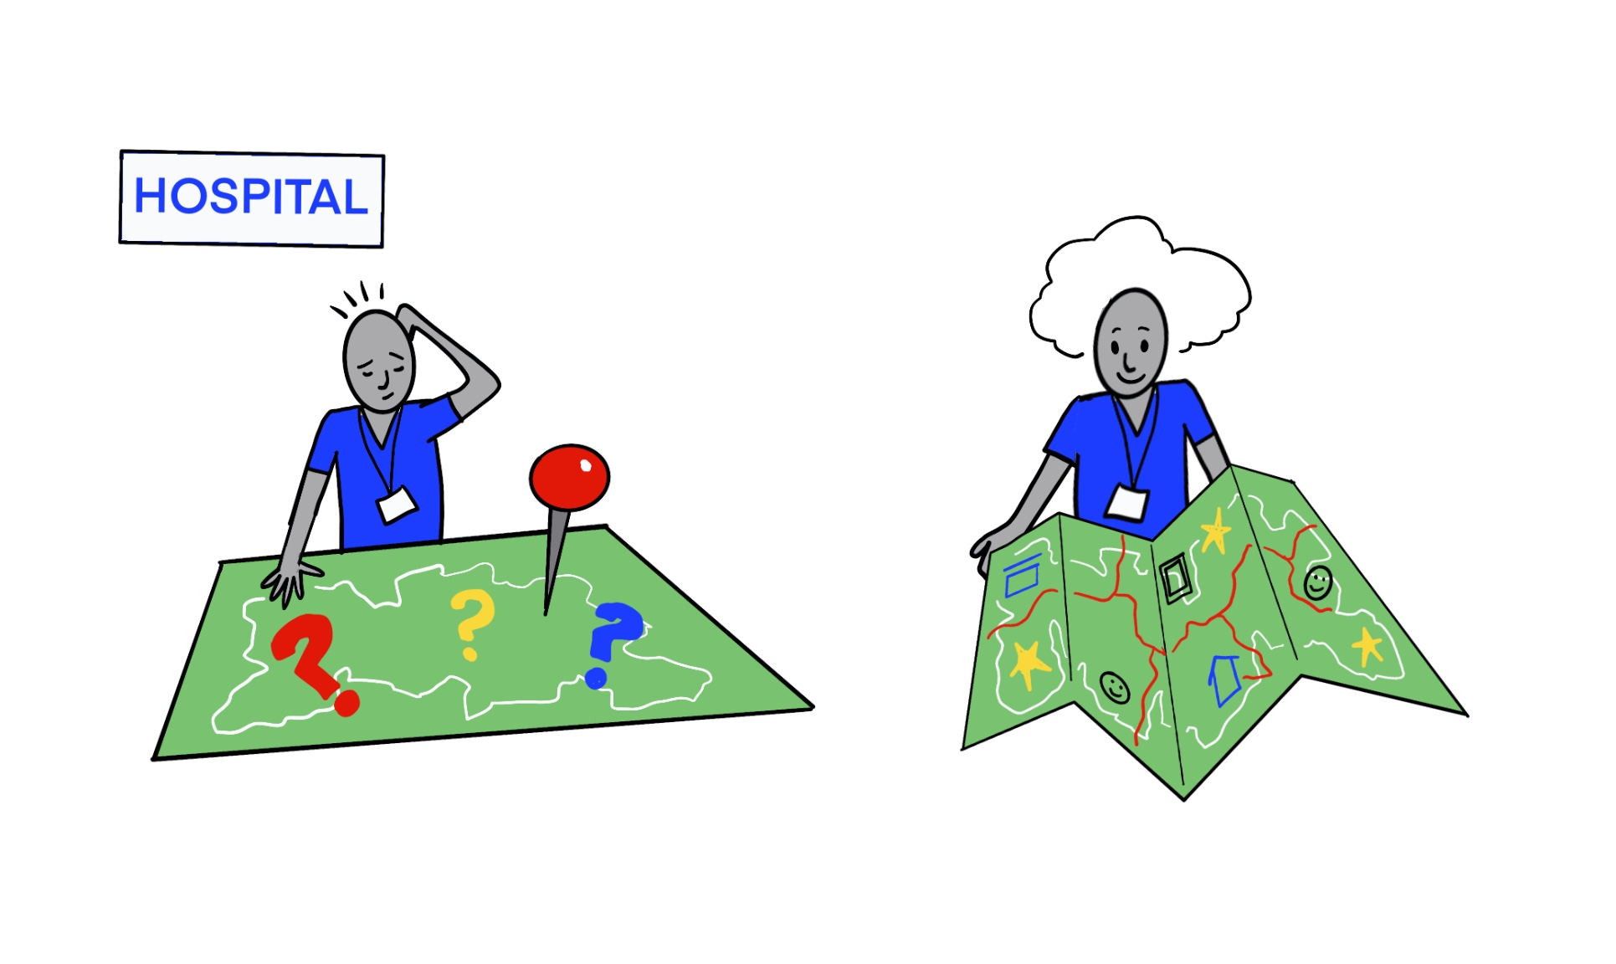
How can people become ‘unstuck’?
Help hospital staff know what’s available in the community

Slide 11
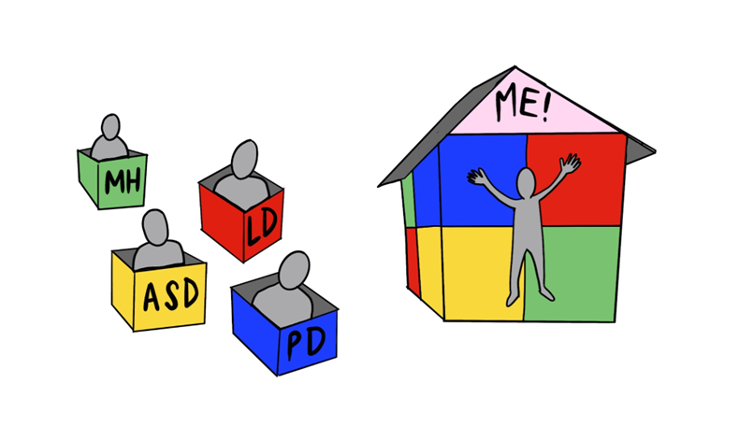
How can people become ‘unstuck’?
Don’t put us into boxes or ‘scatter-gun’

Slide 12
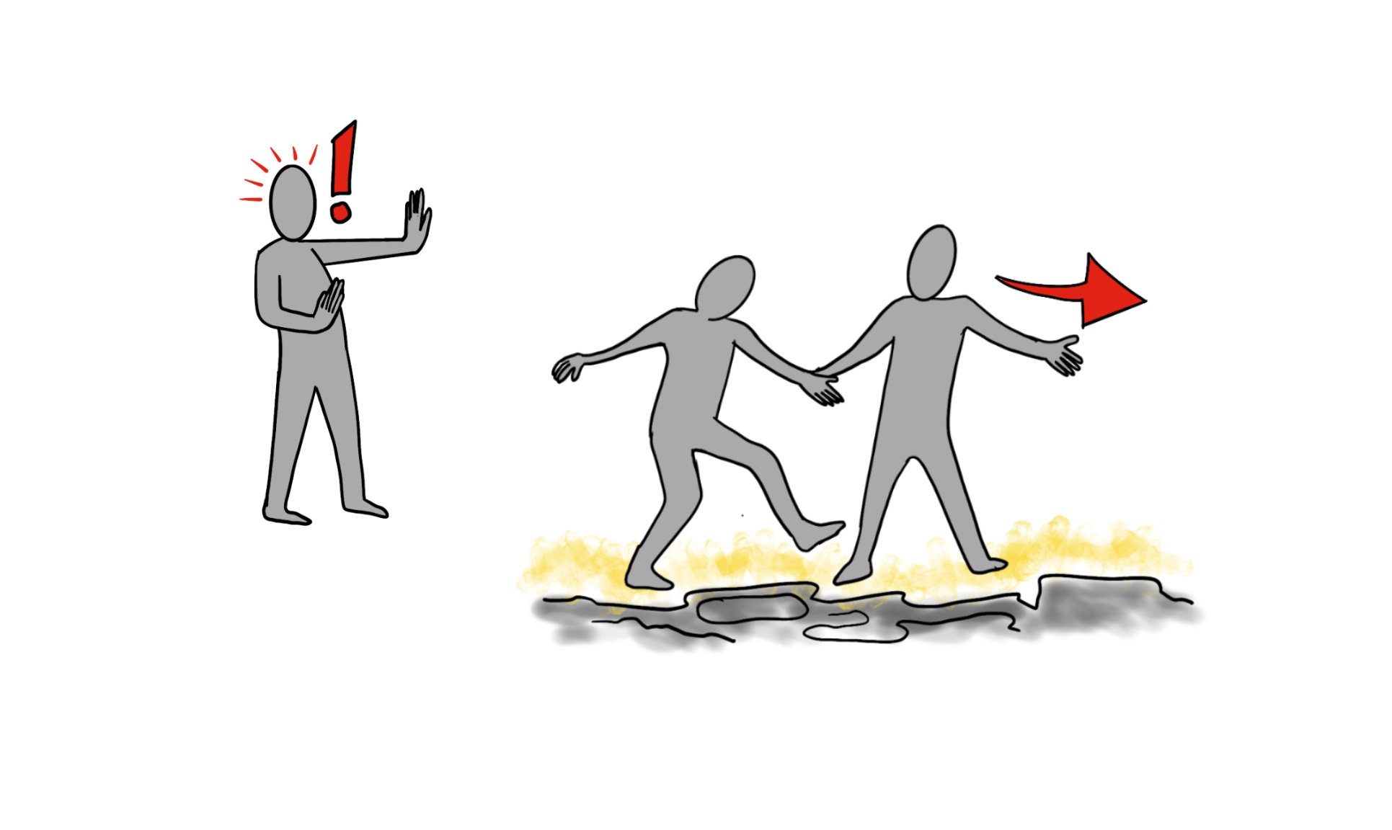
How can people become ‘unstuck’?
Give me the chance to try life outside

Slide 13
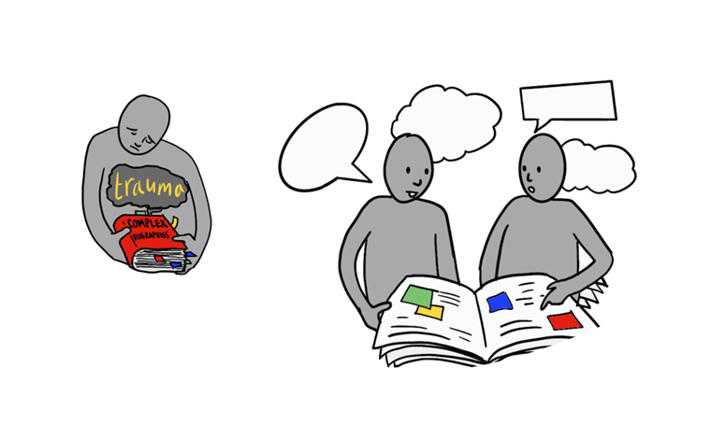
How can people become ‘unstuck’?
Please help me with the trauma I’ve experienced

Slide 14
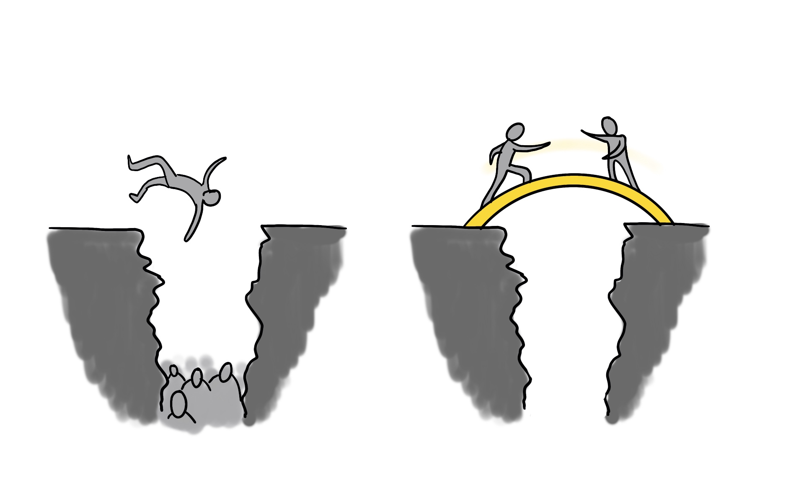
How can people become ‘unstuck’?
Don’t let us fall through the cracks

Slide 15
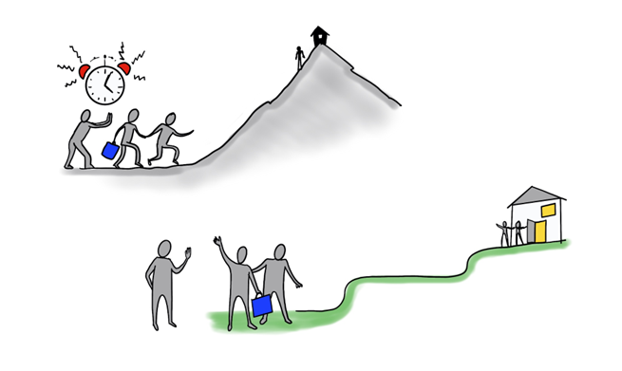
How can people become ‘unstuck’?

Slide 16
Advocacy
Part of the social care extension
Fairly low response rate
Mix of statutory and independent

Slide 17
What people said
“Advocates are brilliant... They come every Friday to speak to us and that. They come to every meeting. They have their own views and stuff like that on you know how you progress and – yeah, they are really amazing people. They’re independent, they’re not tied to [the] NHS.”

Slide 18
What advocates said
“Something needs to happen in terms of providers because that can really badly delay things as well - so once people have, you know, got a certain history attached to them, then it becomes harder and harder to find providers. I think that is a major issue.”

Slide 19
Mixed experiences
“We have to fight to get people advocates and then it’s pot luck as to whether you get an advocate who can do the job or not, put bluntly.”
“When it comes to being in the community it’s really hard to get an advocate.”
“I think we’ve had very mixed experiences. So I think where people have needed help from advocates, it’s hit and miss depending on the skills of the advocate really.”

Slide 20
Sharing our findings
Policy guide
Training film
More accessible versions
Exhibition
Long report

Slide 21
The Ikon – 7th – 19th March 2023

Slide 22
Acknowledgements
This project is funded by the National Institute for Health and Care Research (NIHR) Health and Social Care Delivery Research (HSDR) programme (project reference NIHR130298).
The views expressed are those of the author(s) and not necessarily those of the NIHR or the Department of Health and Social Care.
Thank you to everyone who took part and who helped in so many different ways

Slide 23
What do you think?
Can you bring the oomph?

Slide 24
What we think
Changing Our Lives approach to advocacy
https://youtu.be/HlAXepkh5cc

Slide 25
Find out more
https://www.birmingham.ac.uk/schools/social-policy/departments/social-work-social-care/research/why-are-we-stuck-in-hospital.aspx

